Slide 1
THG Simulations
Project update
Week 3
09/08/2023
David Amorim

Slide 2
Overview
Since last week, over 30 different pressure scans were simulated
The following parameters were varied in the process:
Pressure
Input beam power
CEO phase
Ionisation (on/off)
Gas (Argon/Neon)
The raw data is available on Sync&Share

Slide 3
Overview
The resulting data has been analysed with respect to three main effects:
Saturation
Spectral profile
Beam profile
Self-steepening
Mostly focussed on the pulse properties at and around the saturation point
This analysis is still incomplete, with many factors left to consider (e.g. position of beam focus in the cell…)

Slide 4
I. SATURATION

Slide 5
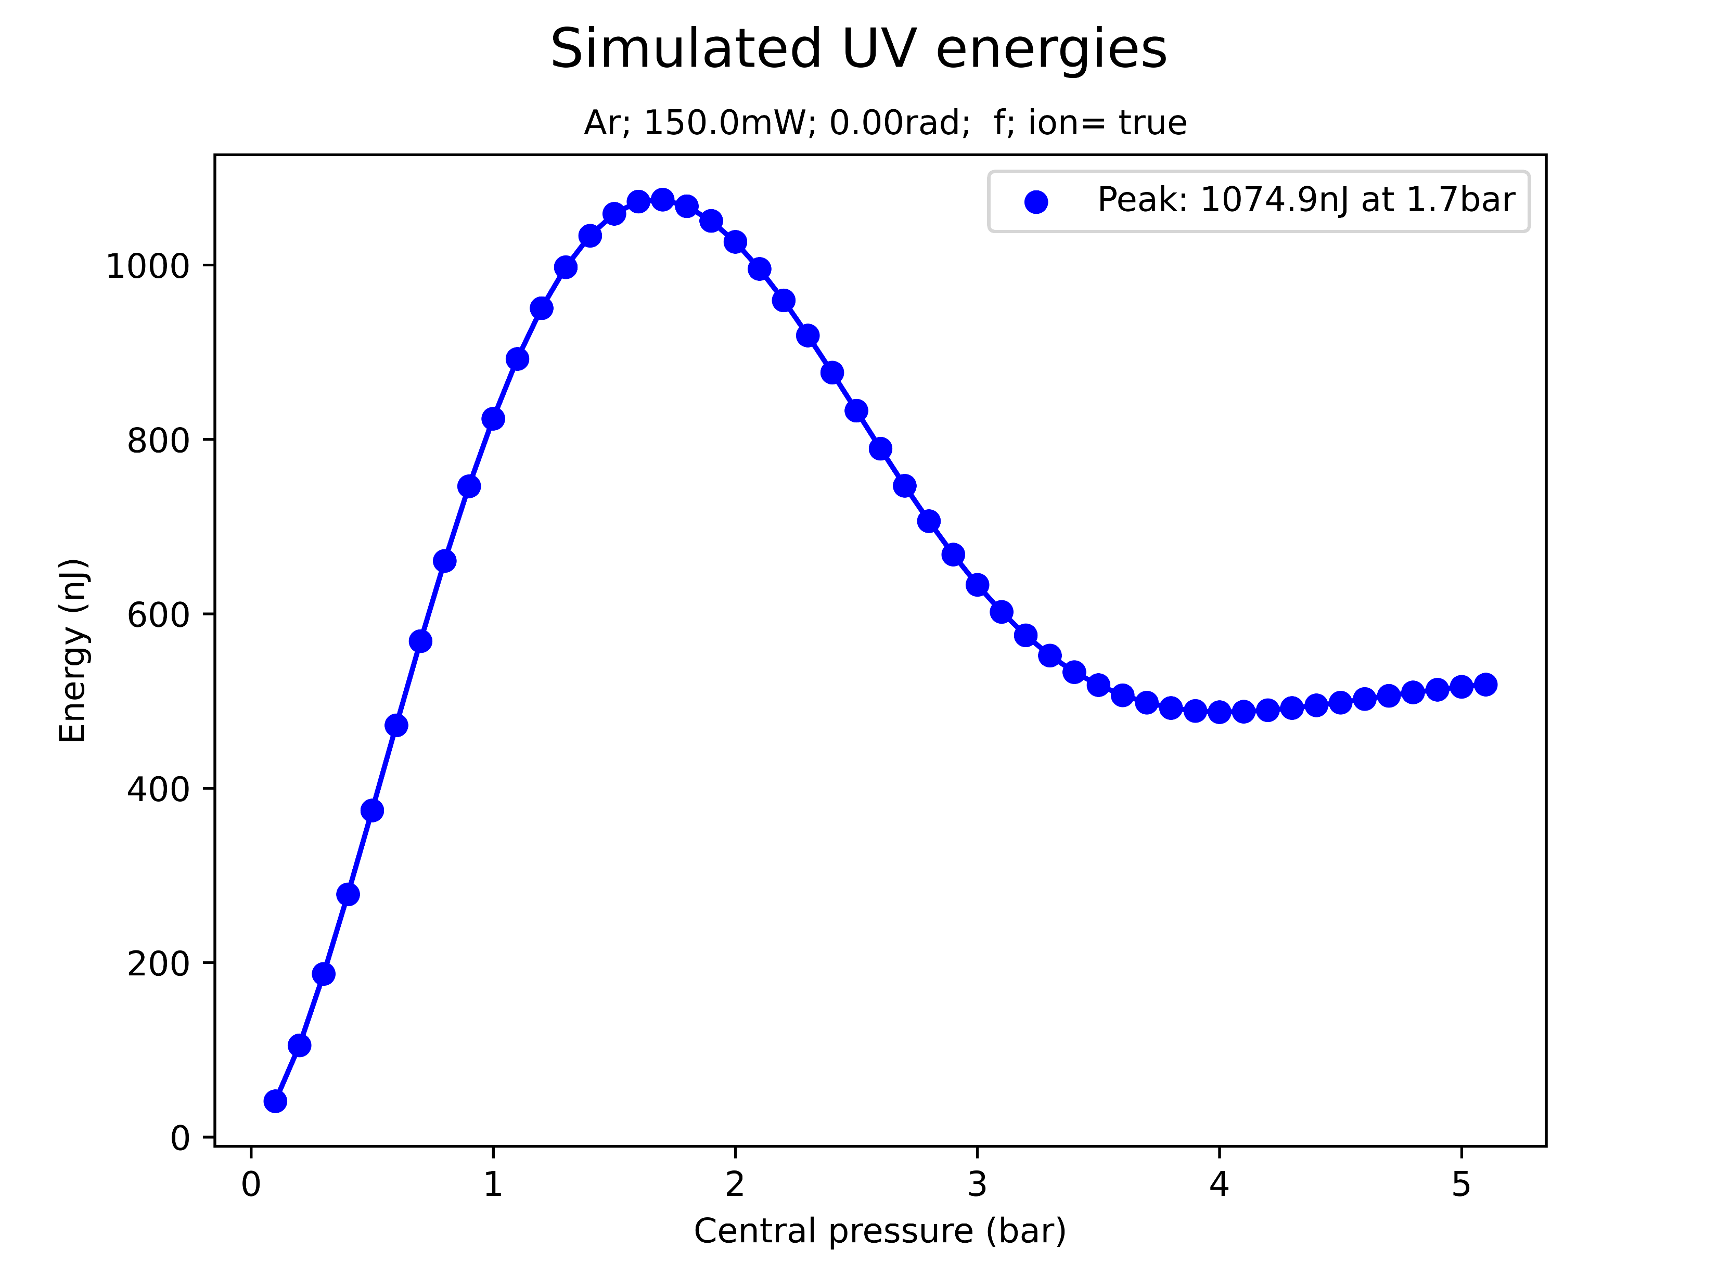
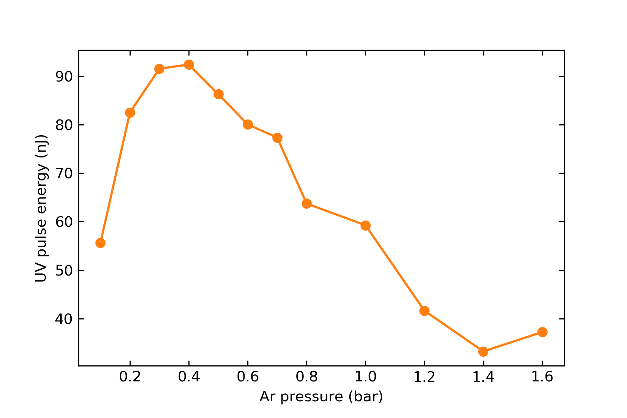
Saturation
simulated
At sufficiently high pressures, the simulation predicts a saturation in the UV energy
Qualitatively, this agrees with experiments
However, simulated saturation energies and pressures are much higher!
measured (same params)

Slide 6
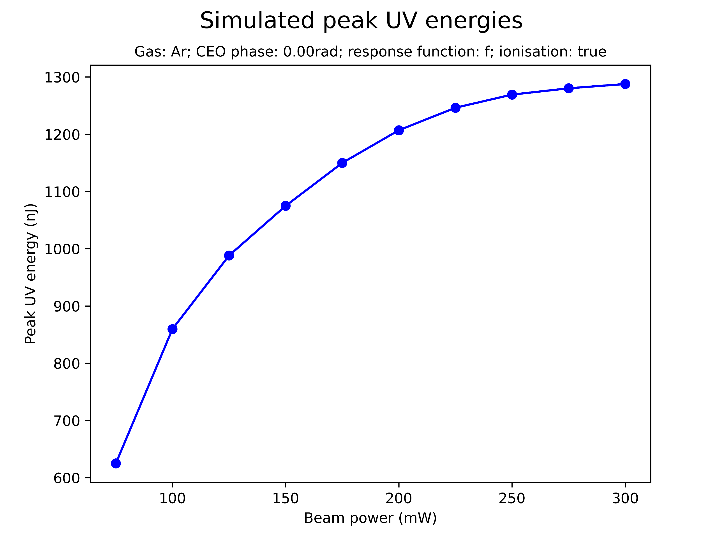
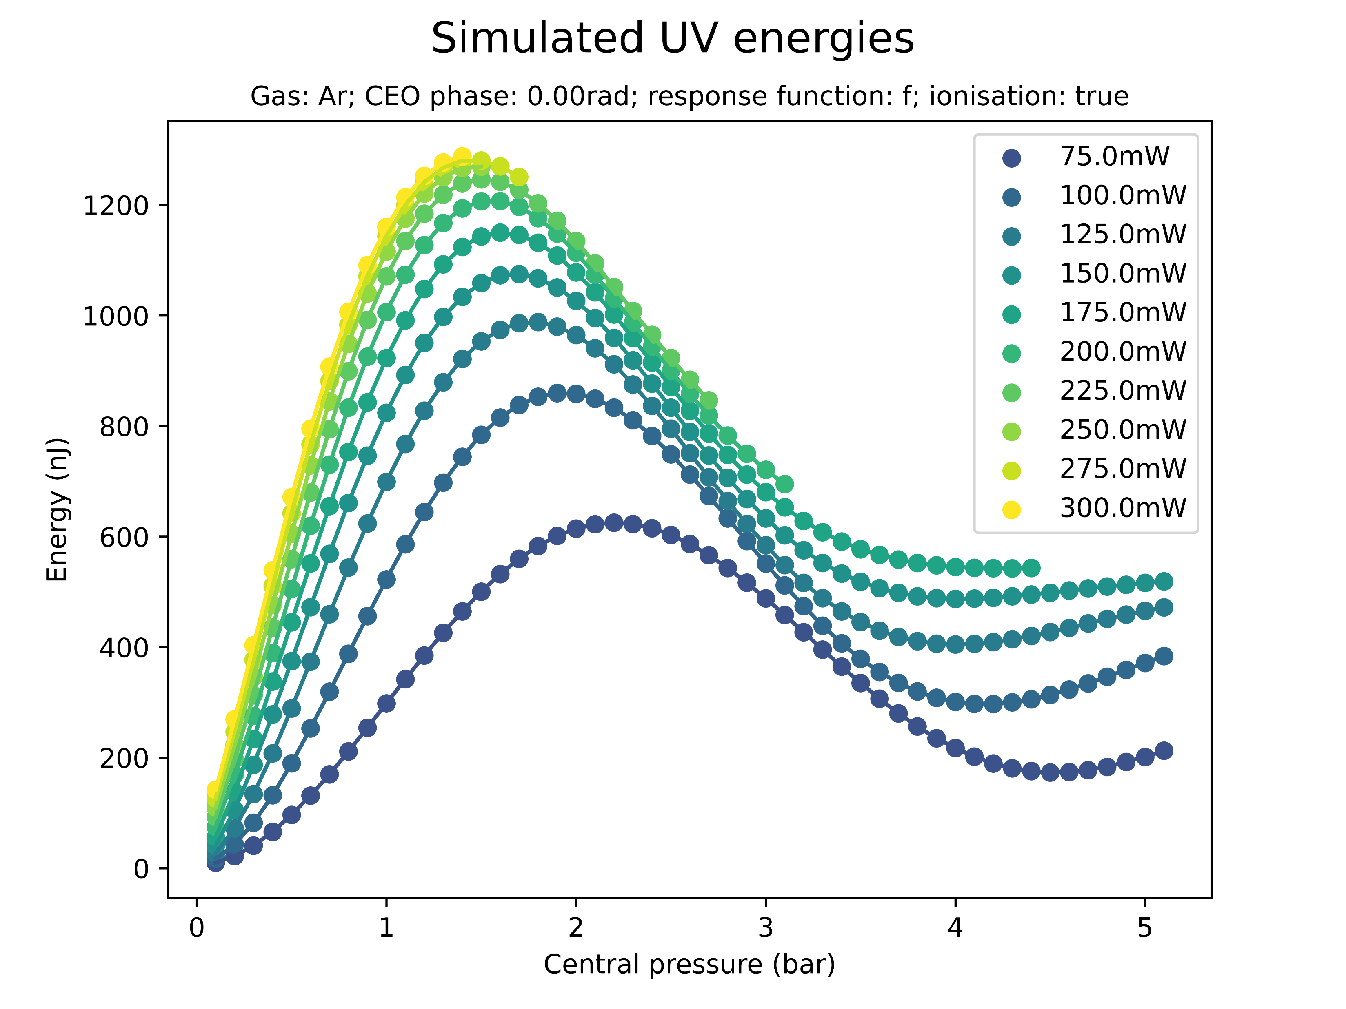
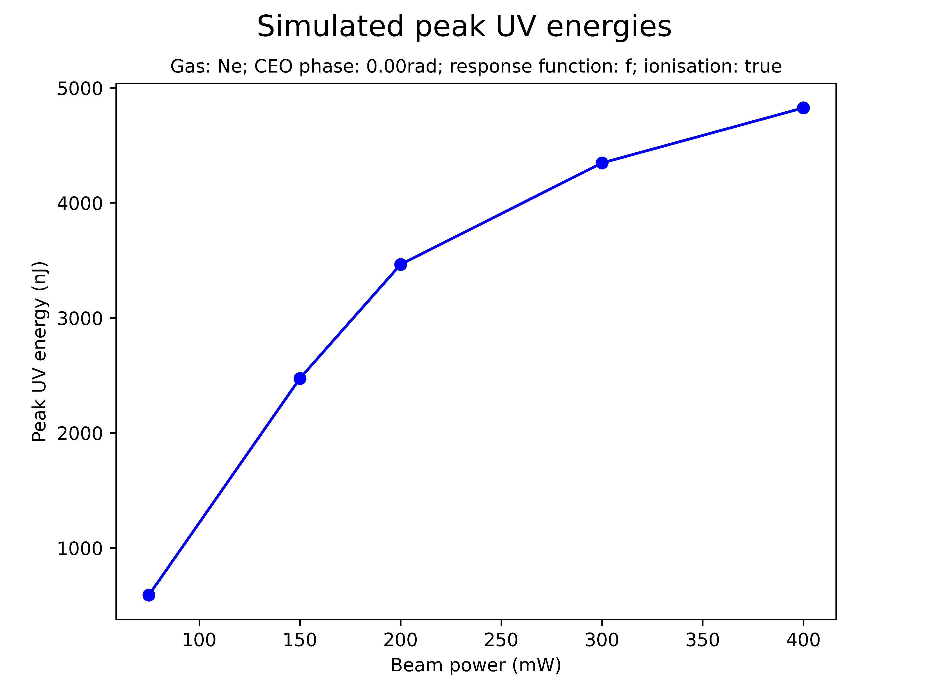
Effect of beam power on saturation
Increasing the beam power increases the peak UV energy
There seems to be a threshold at roughly 1300nJ

Slide 7
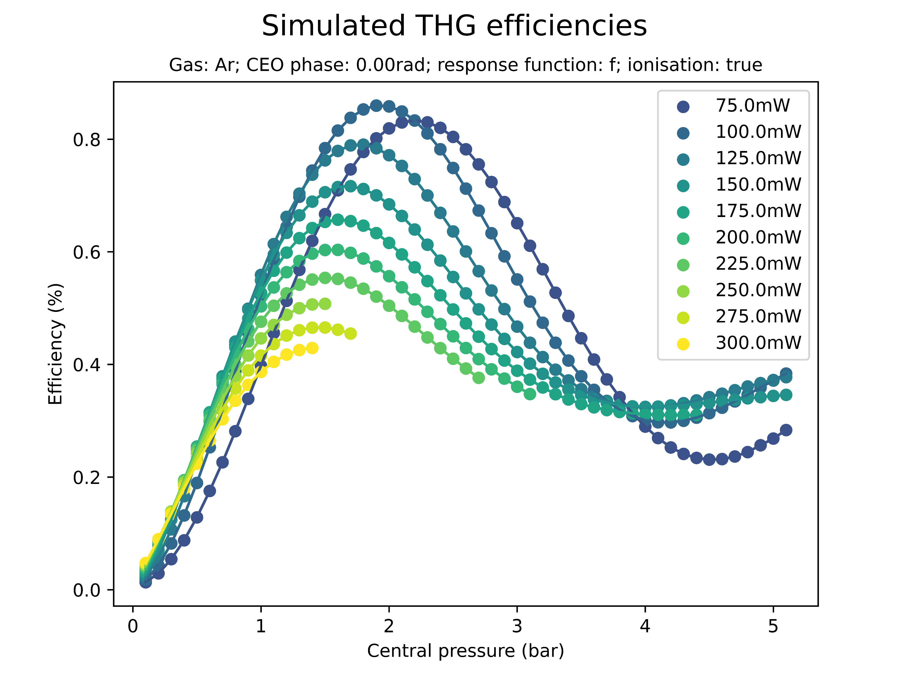
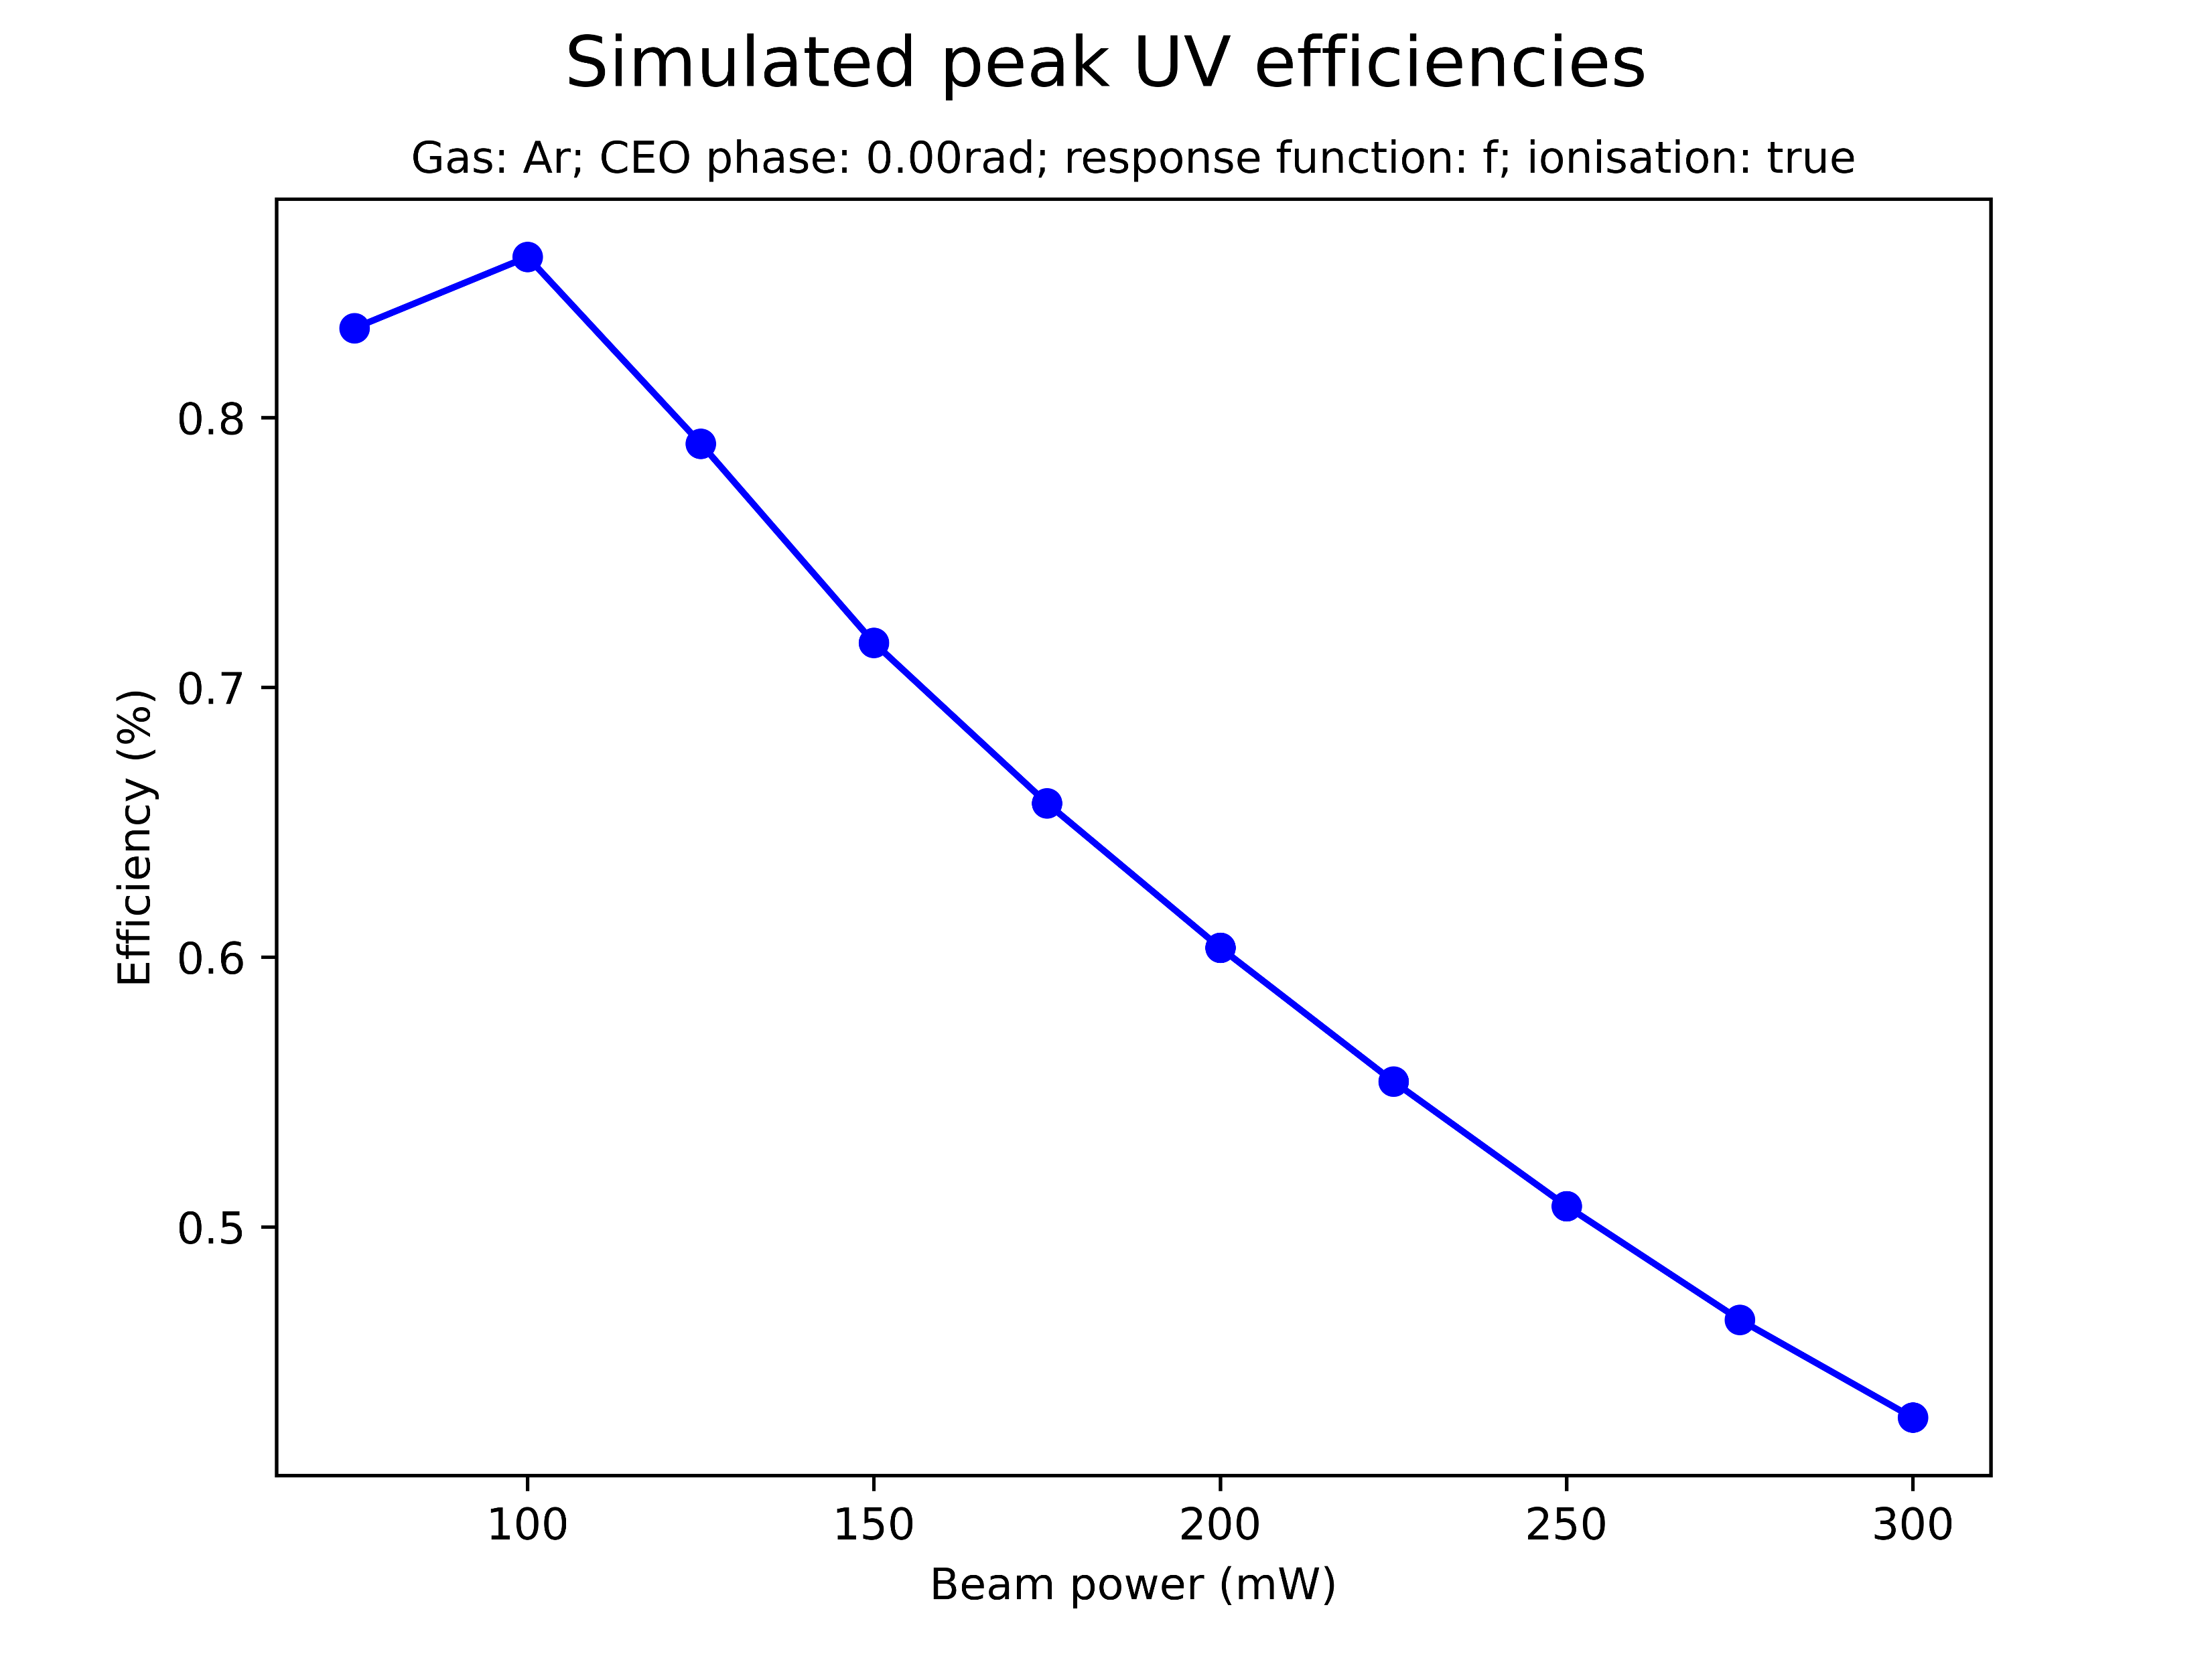
Effect of beam power on saturation
Increasing the beam power decreases the peak THG efficiency
This ensures the peak UV energy threshold

Slide 8
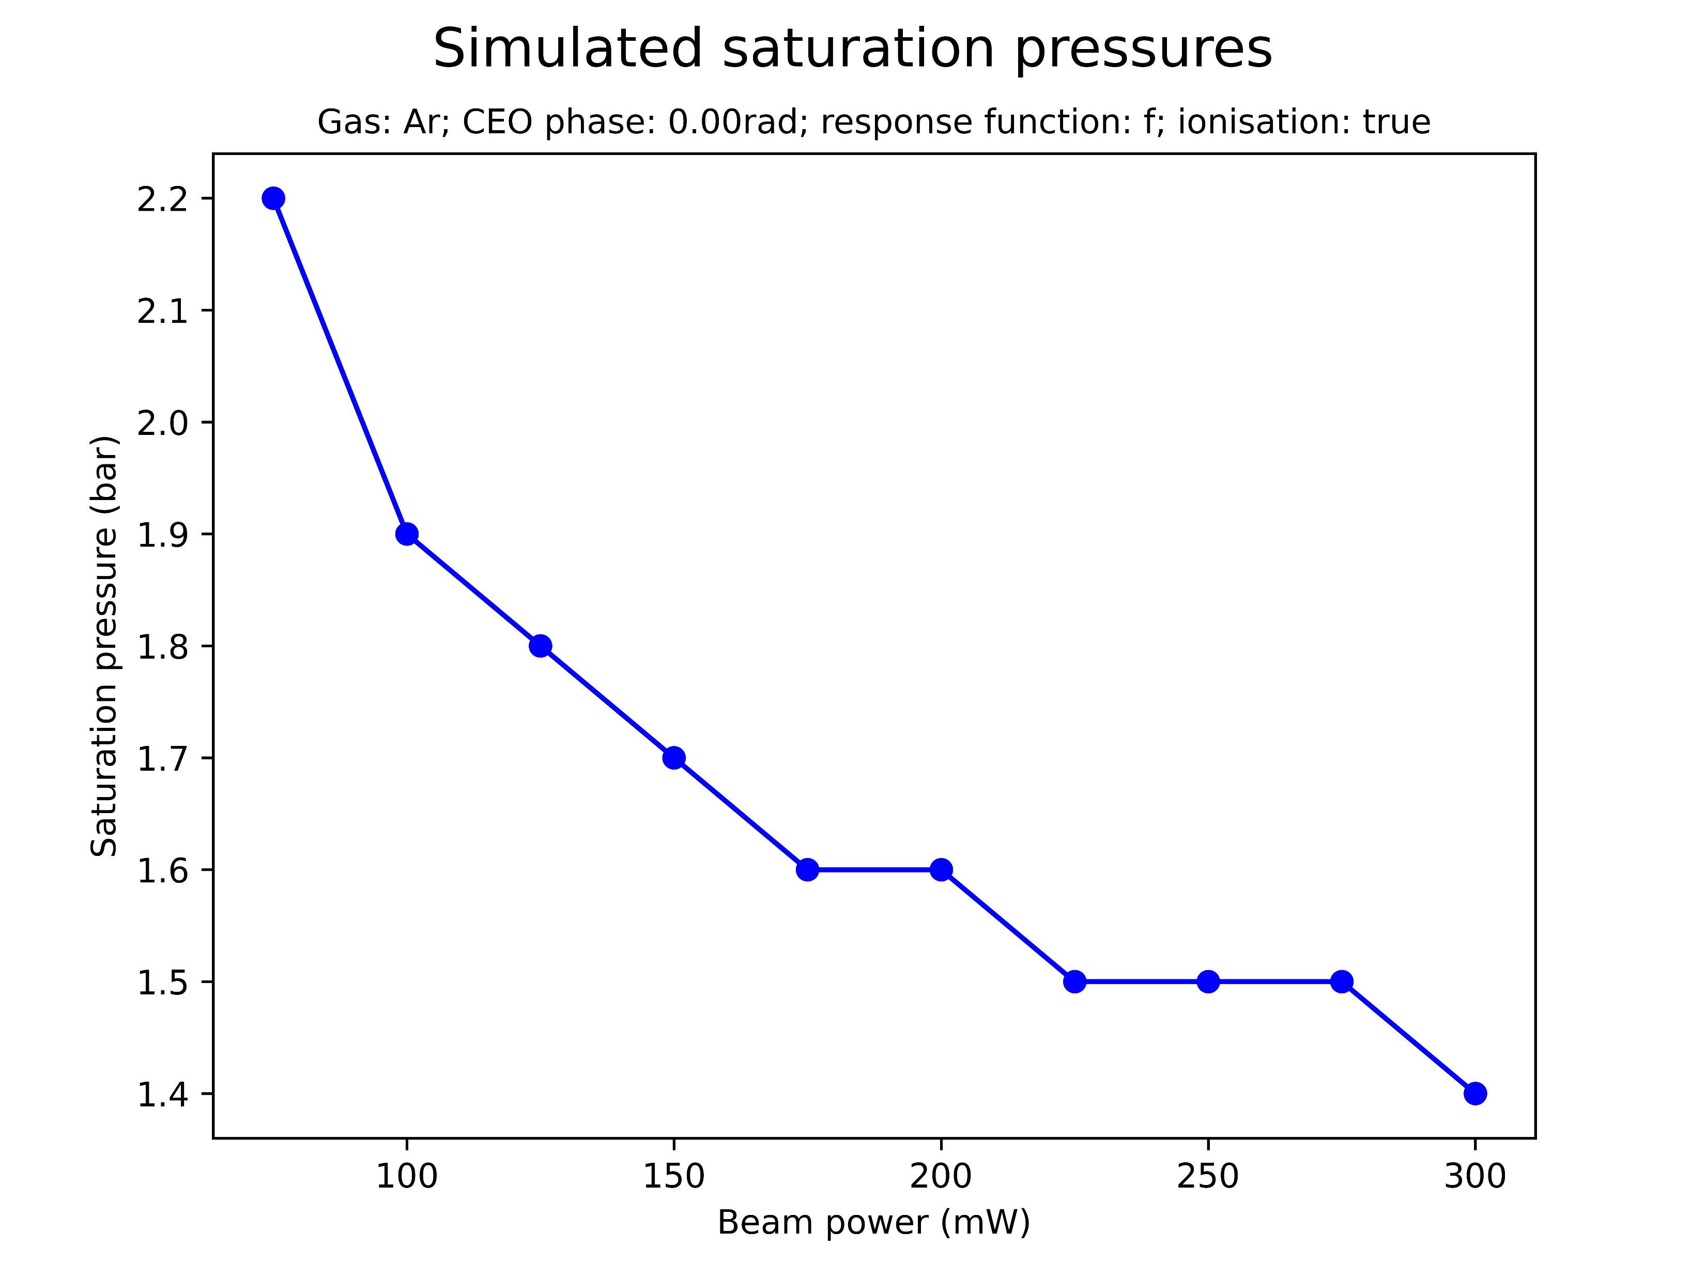
Effect of beam power on saturation
Increasing the beam power decreases the saturation pressure
For high beam powers the simulations broke down at pressures beyond the saturation point

Slide 9
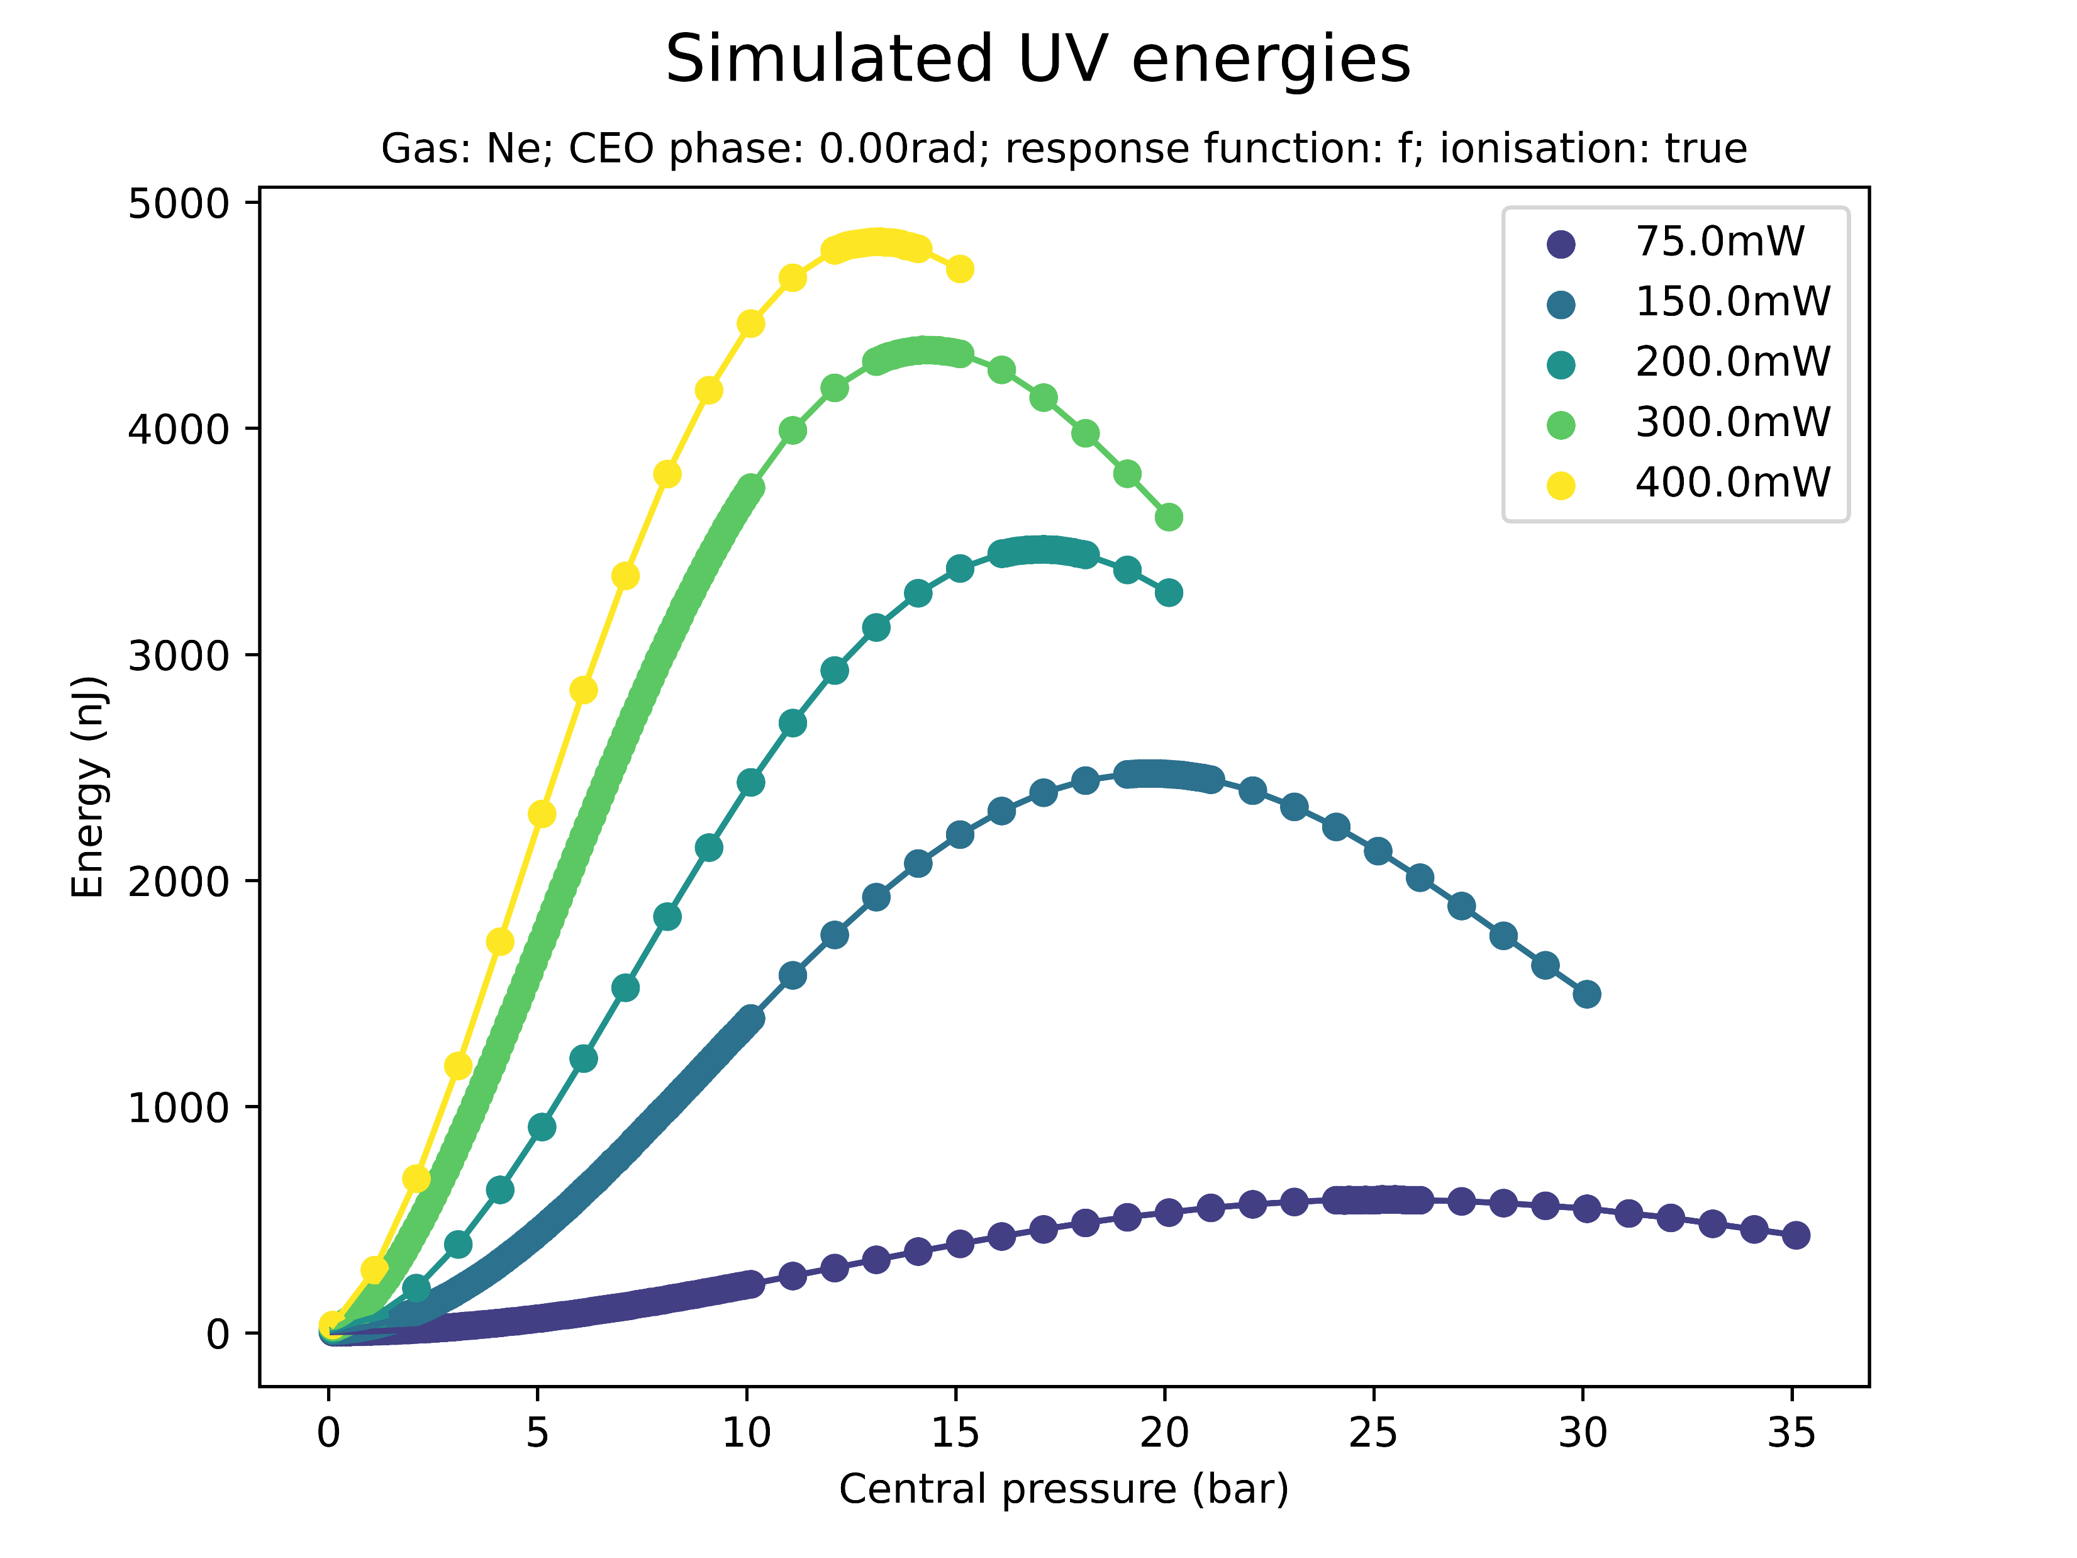
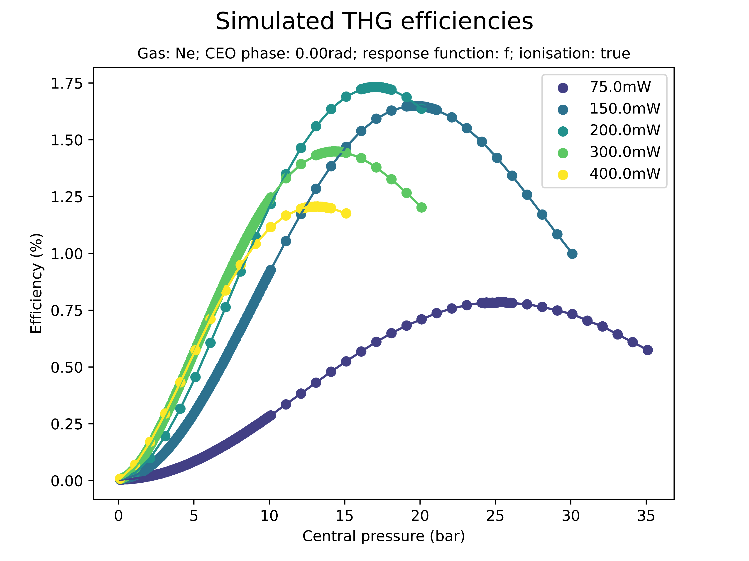
Effect of beam power on saturation (Ne)
Equivalent effects were observed for Neon
Energies, pressures, and beam powers involved are much higher than for Argon

Slide 10
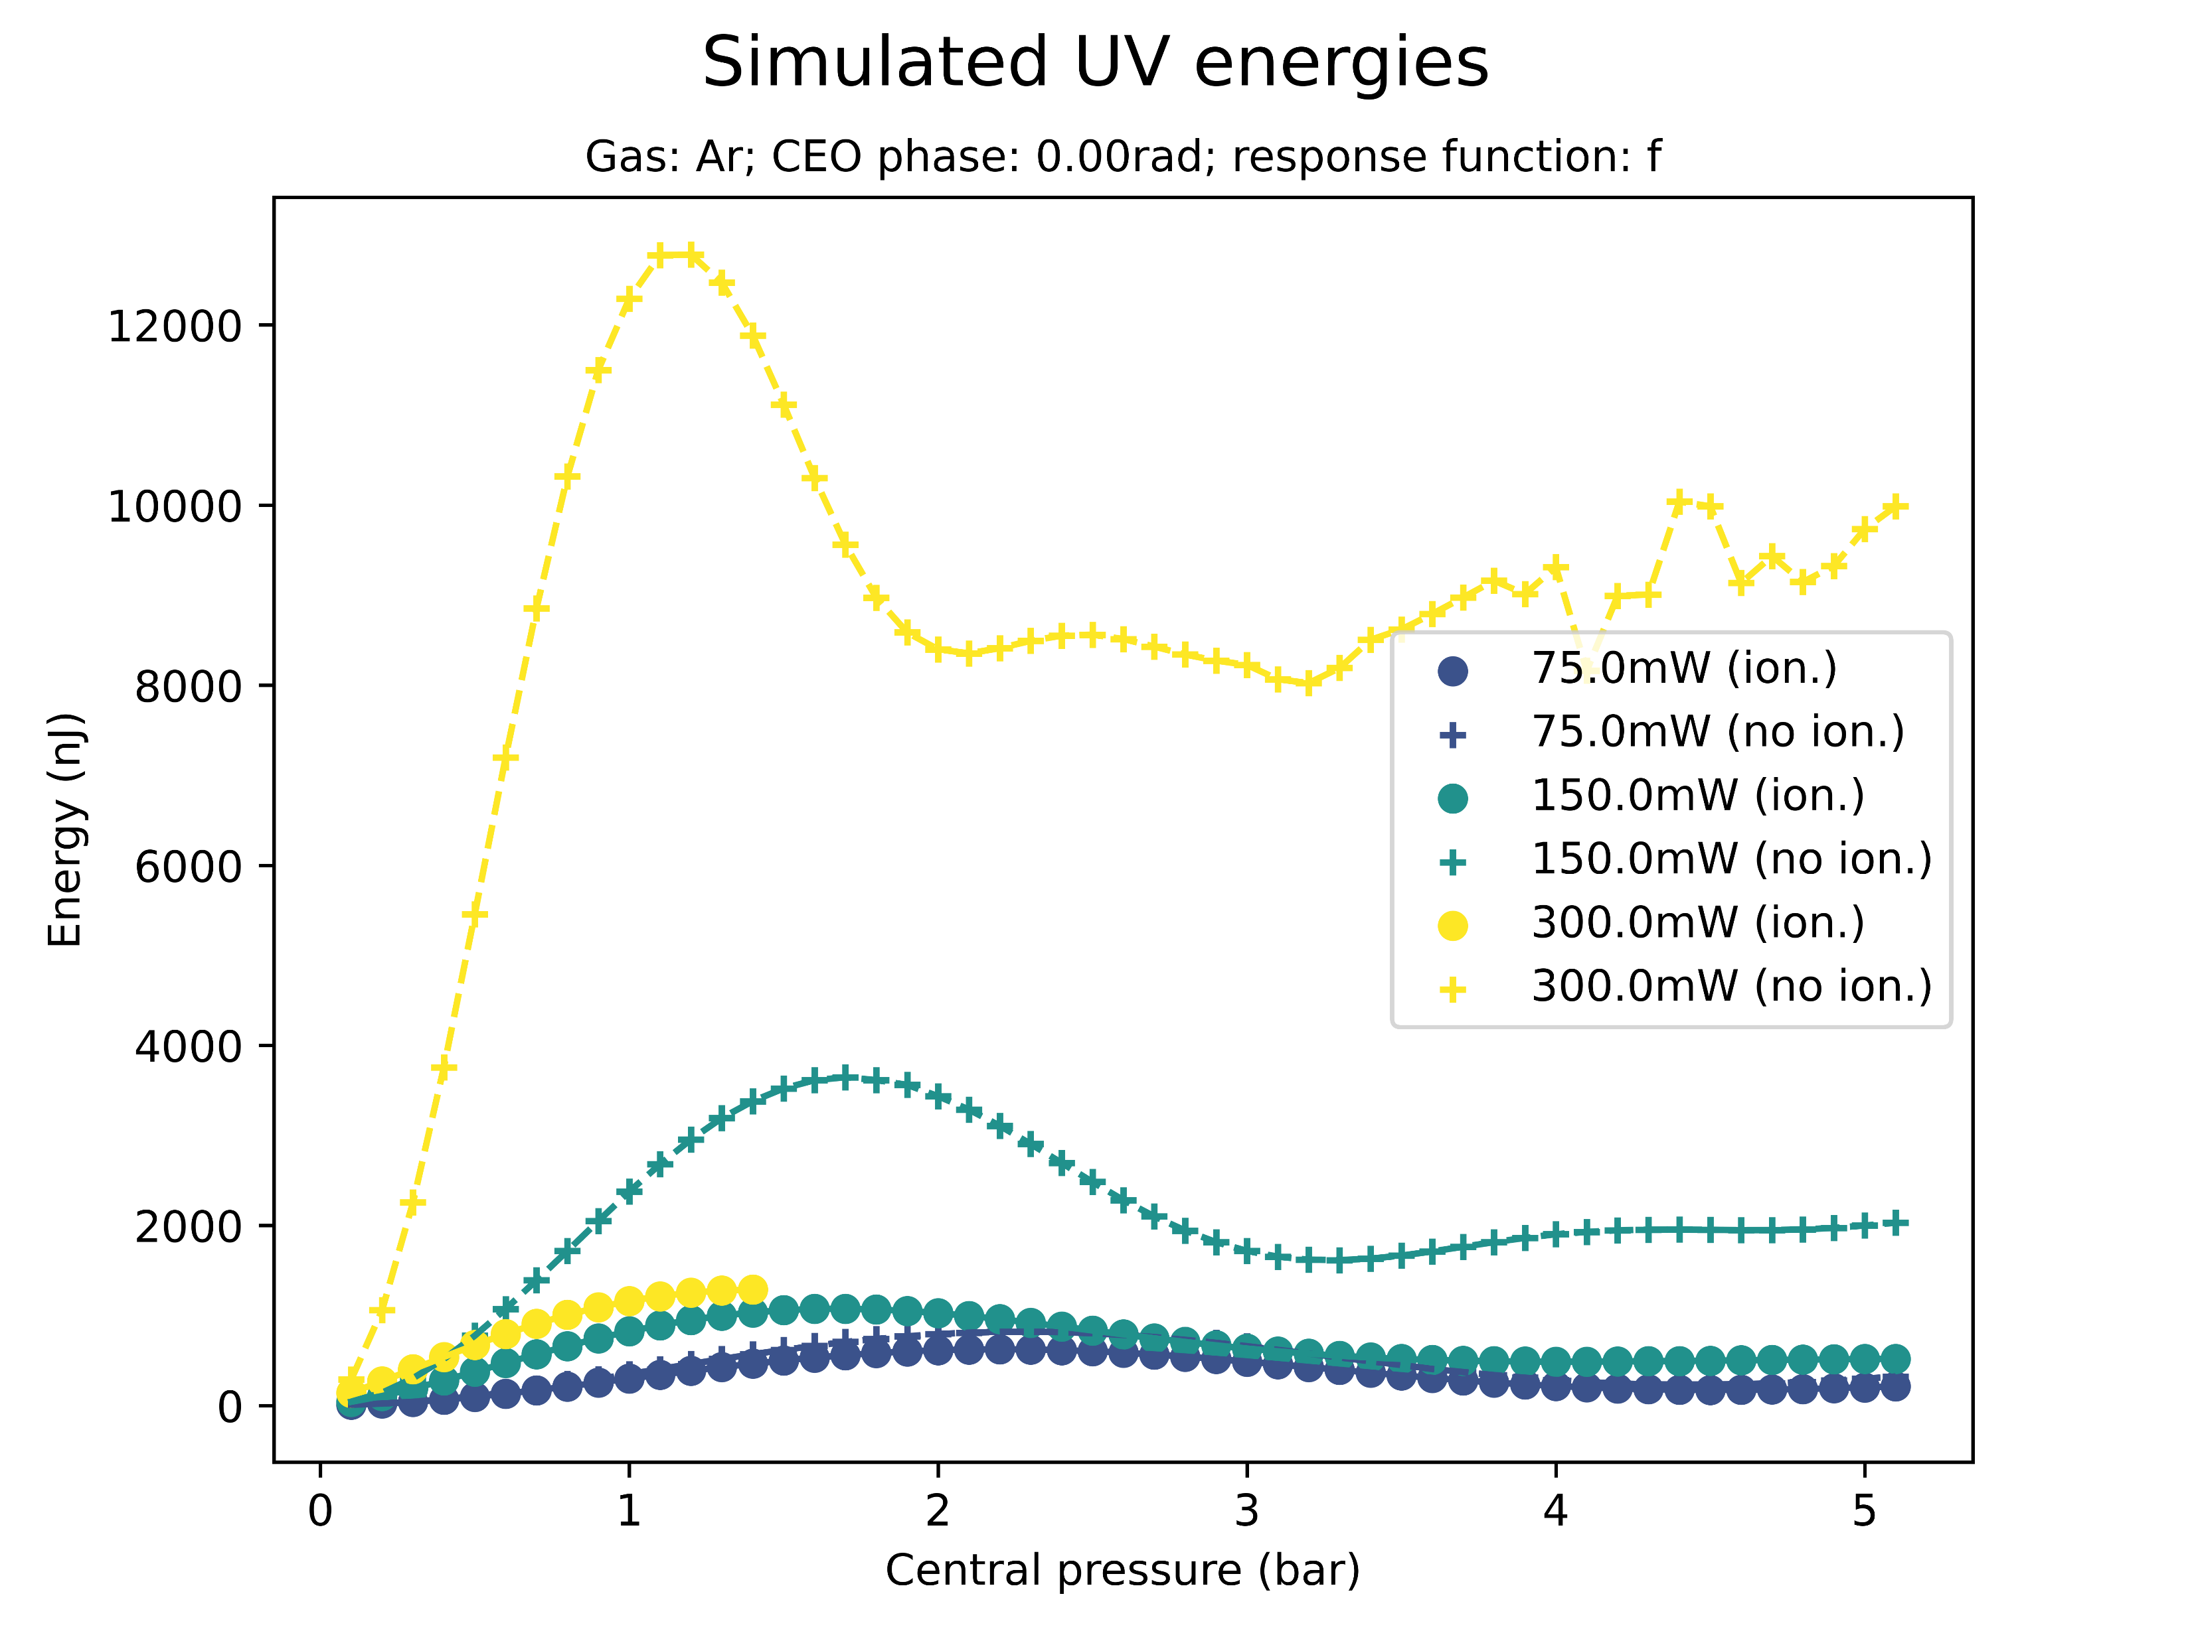
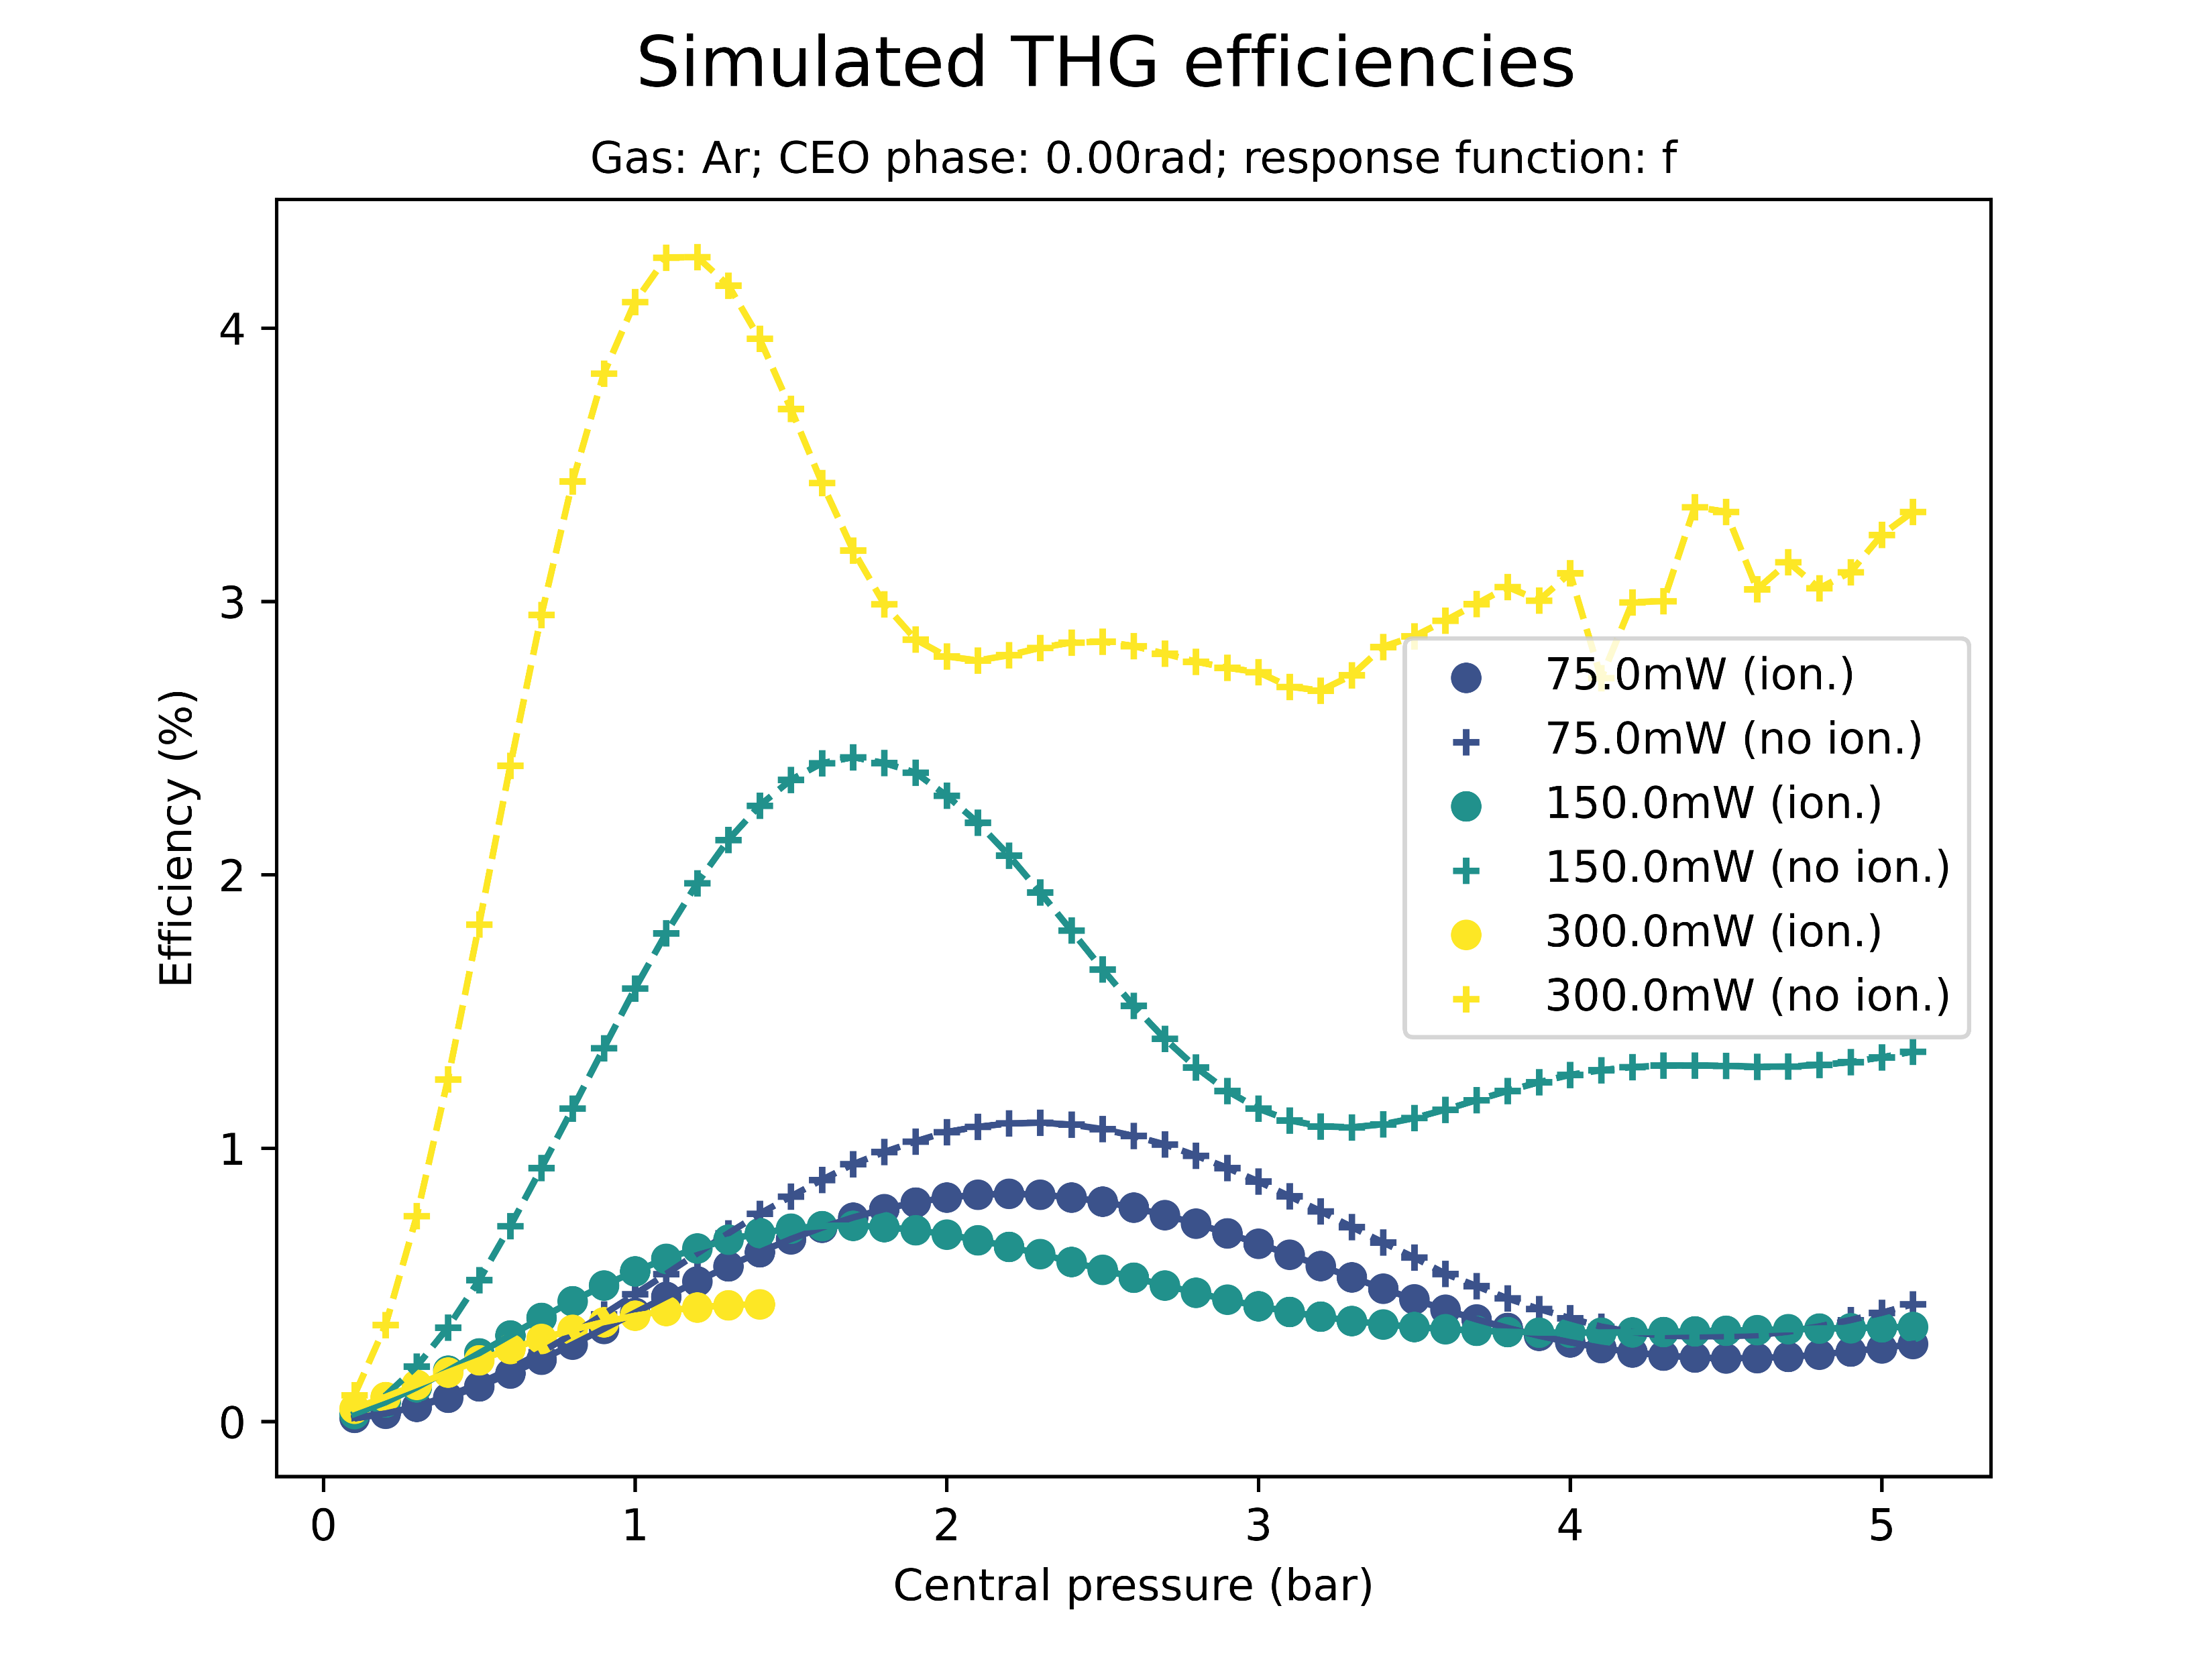
Effect of ionisation on saturation
Saturation sets in even when the ionisation response is turned off
Without ionisation, peak energies and efficiencies are significantly higher; saturation pressure is largely unaffected

Slide 11
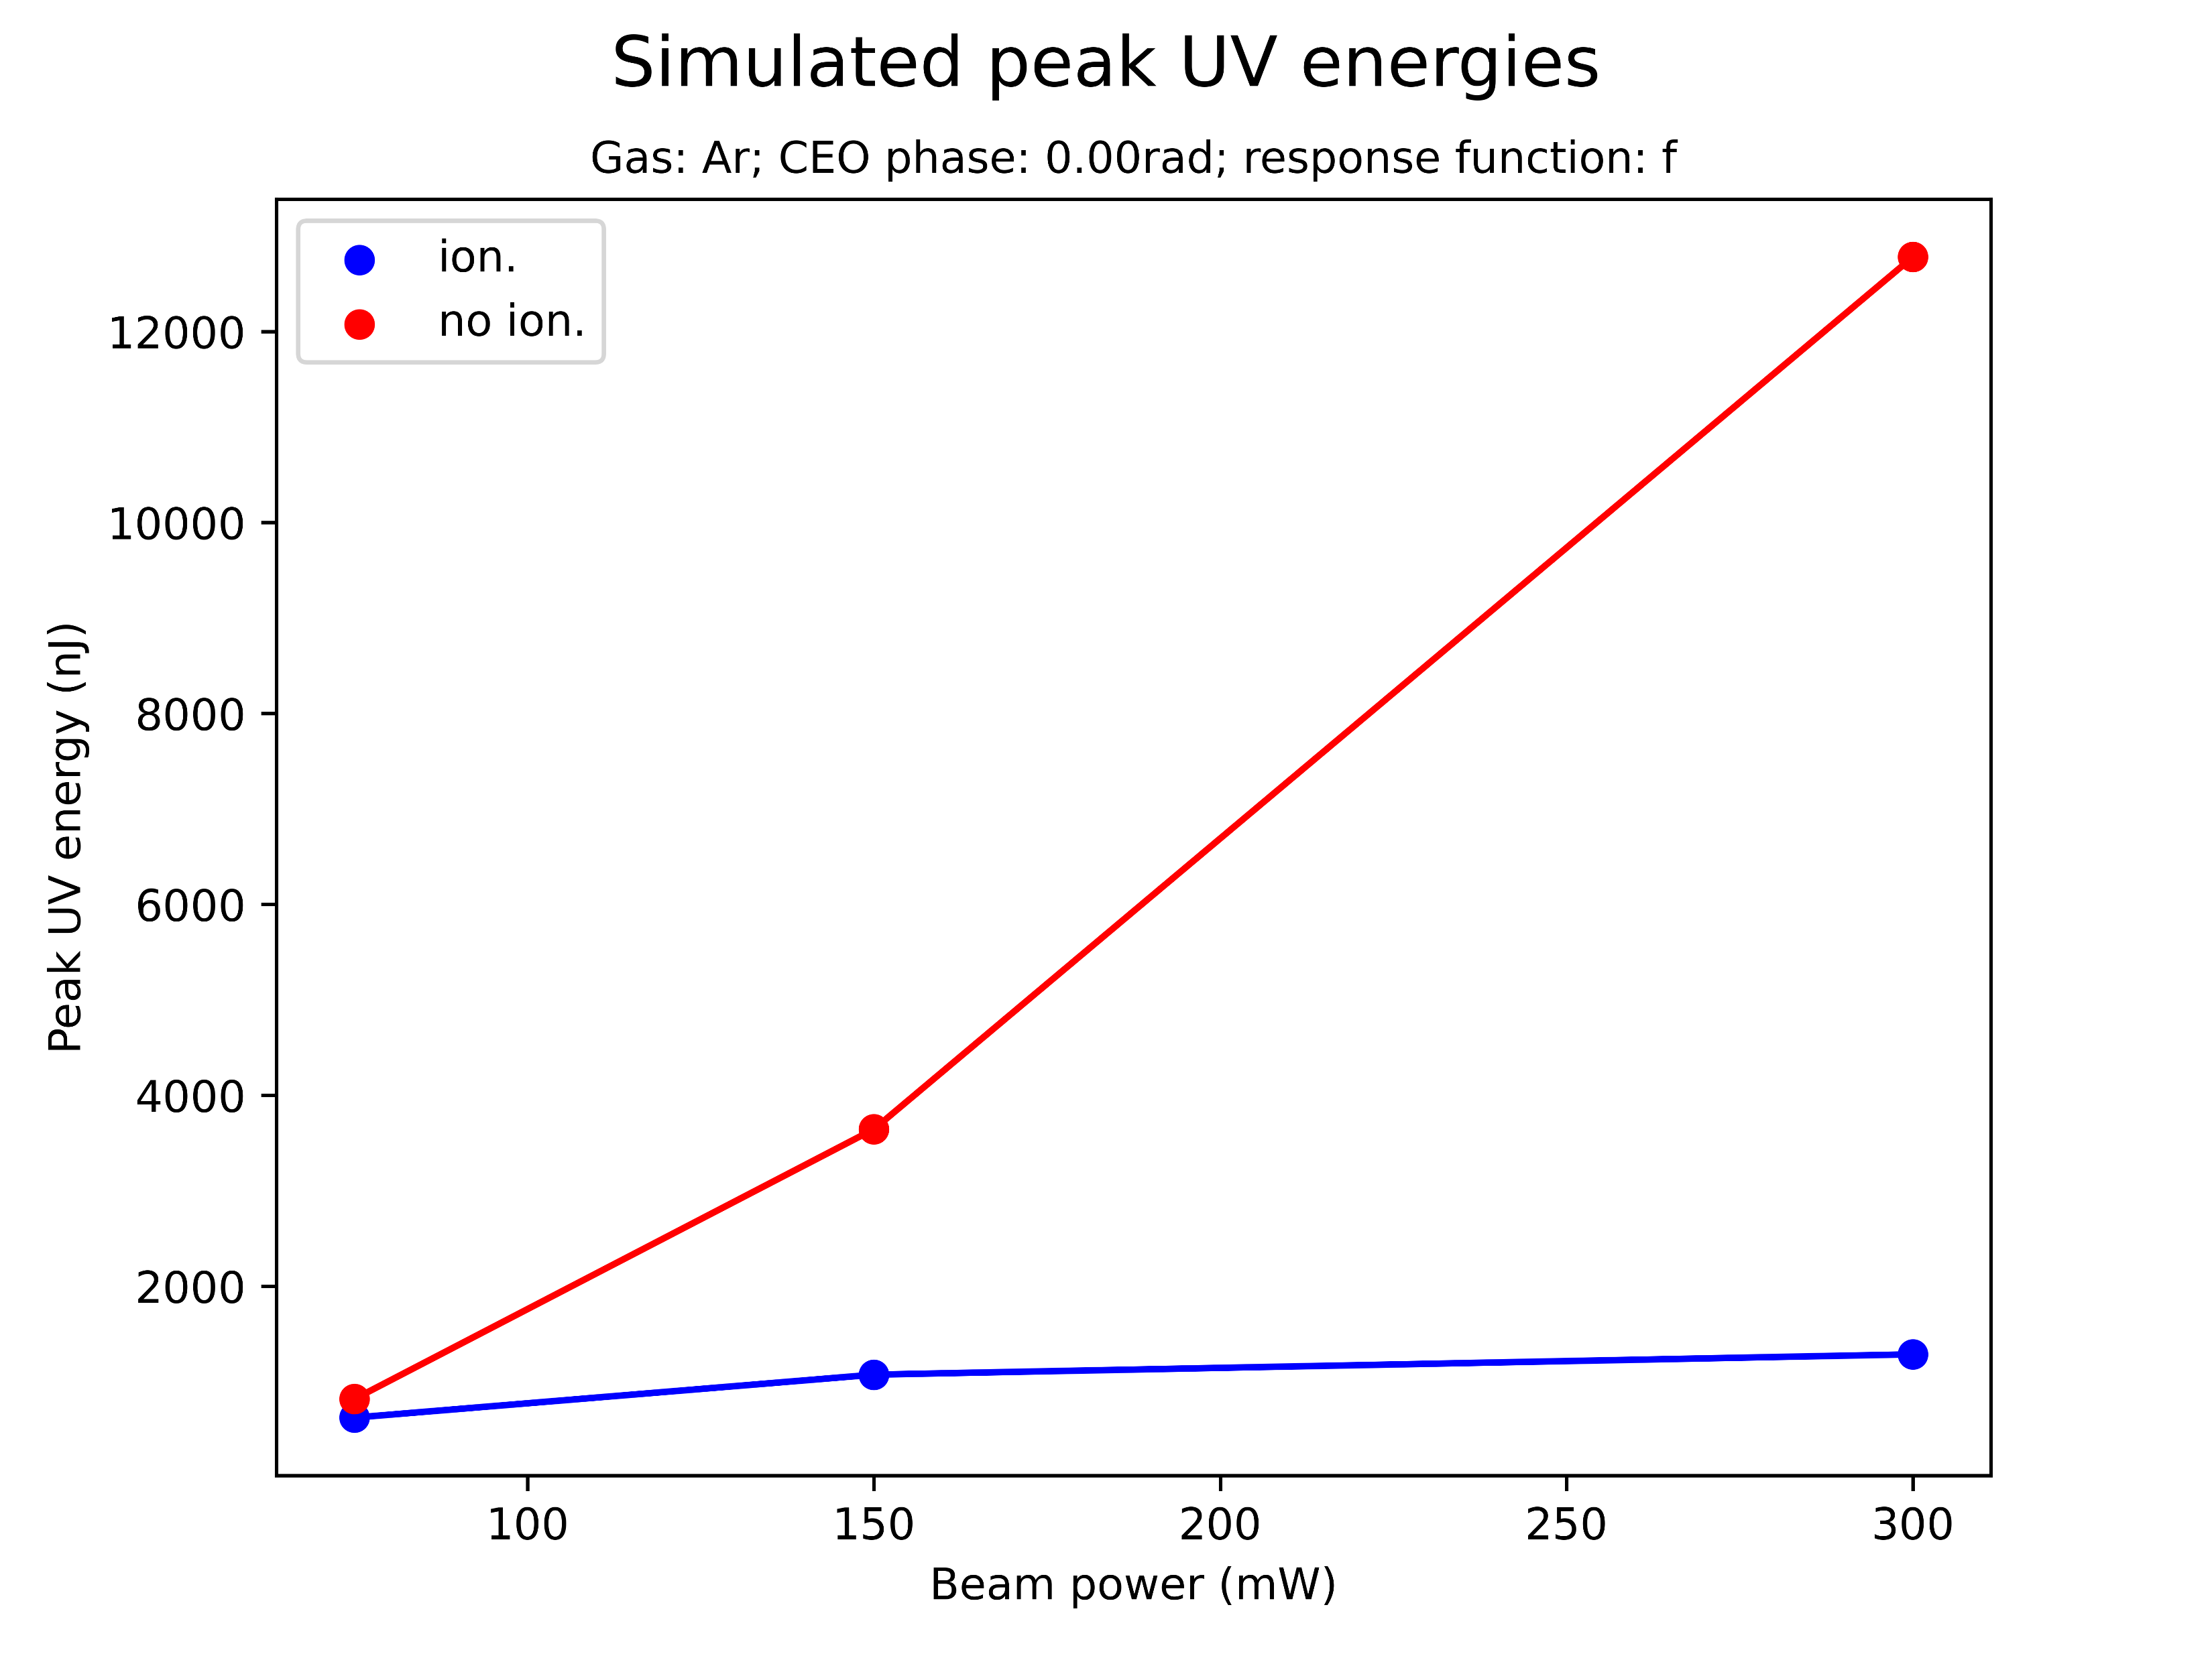
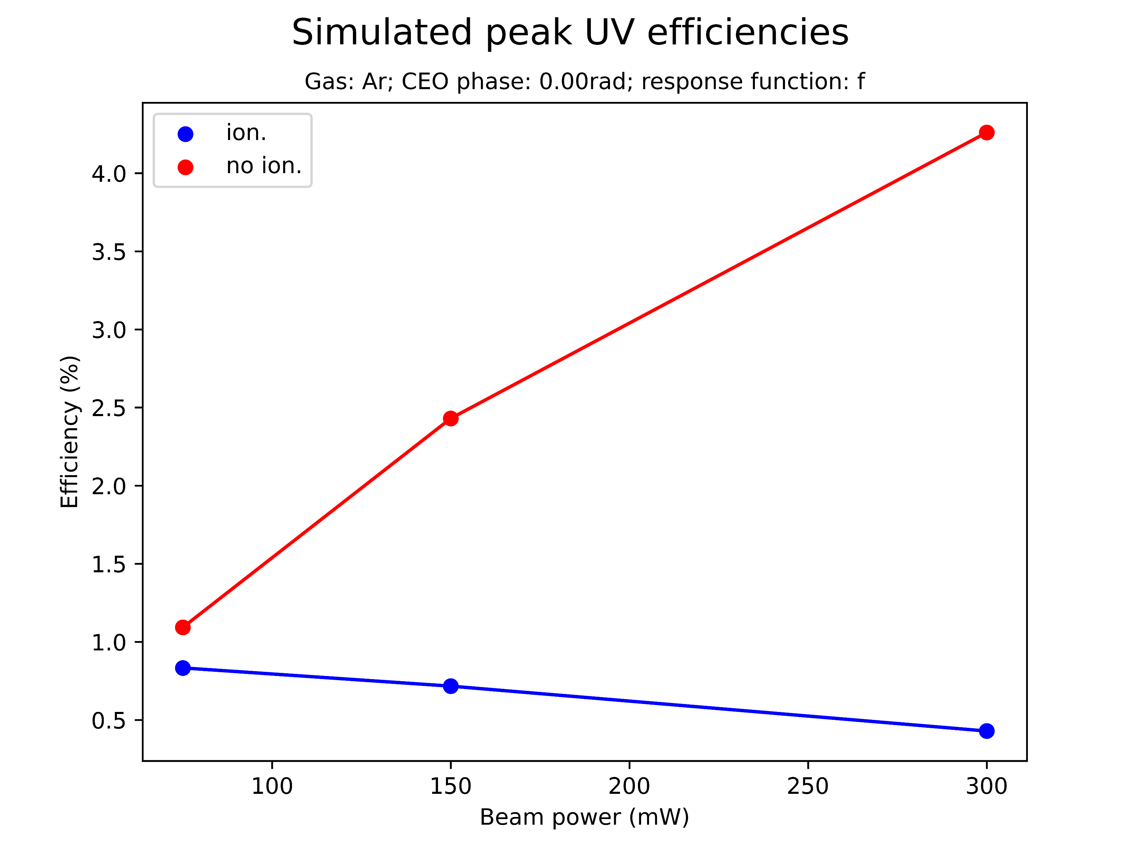
Effect of ionisation on saturation
Is there also a threshold UV energy value without ionisation? Does efficiency eventually decrease with beam power?

Slide 12
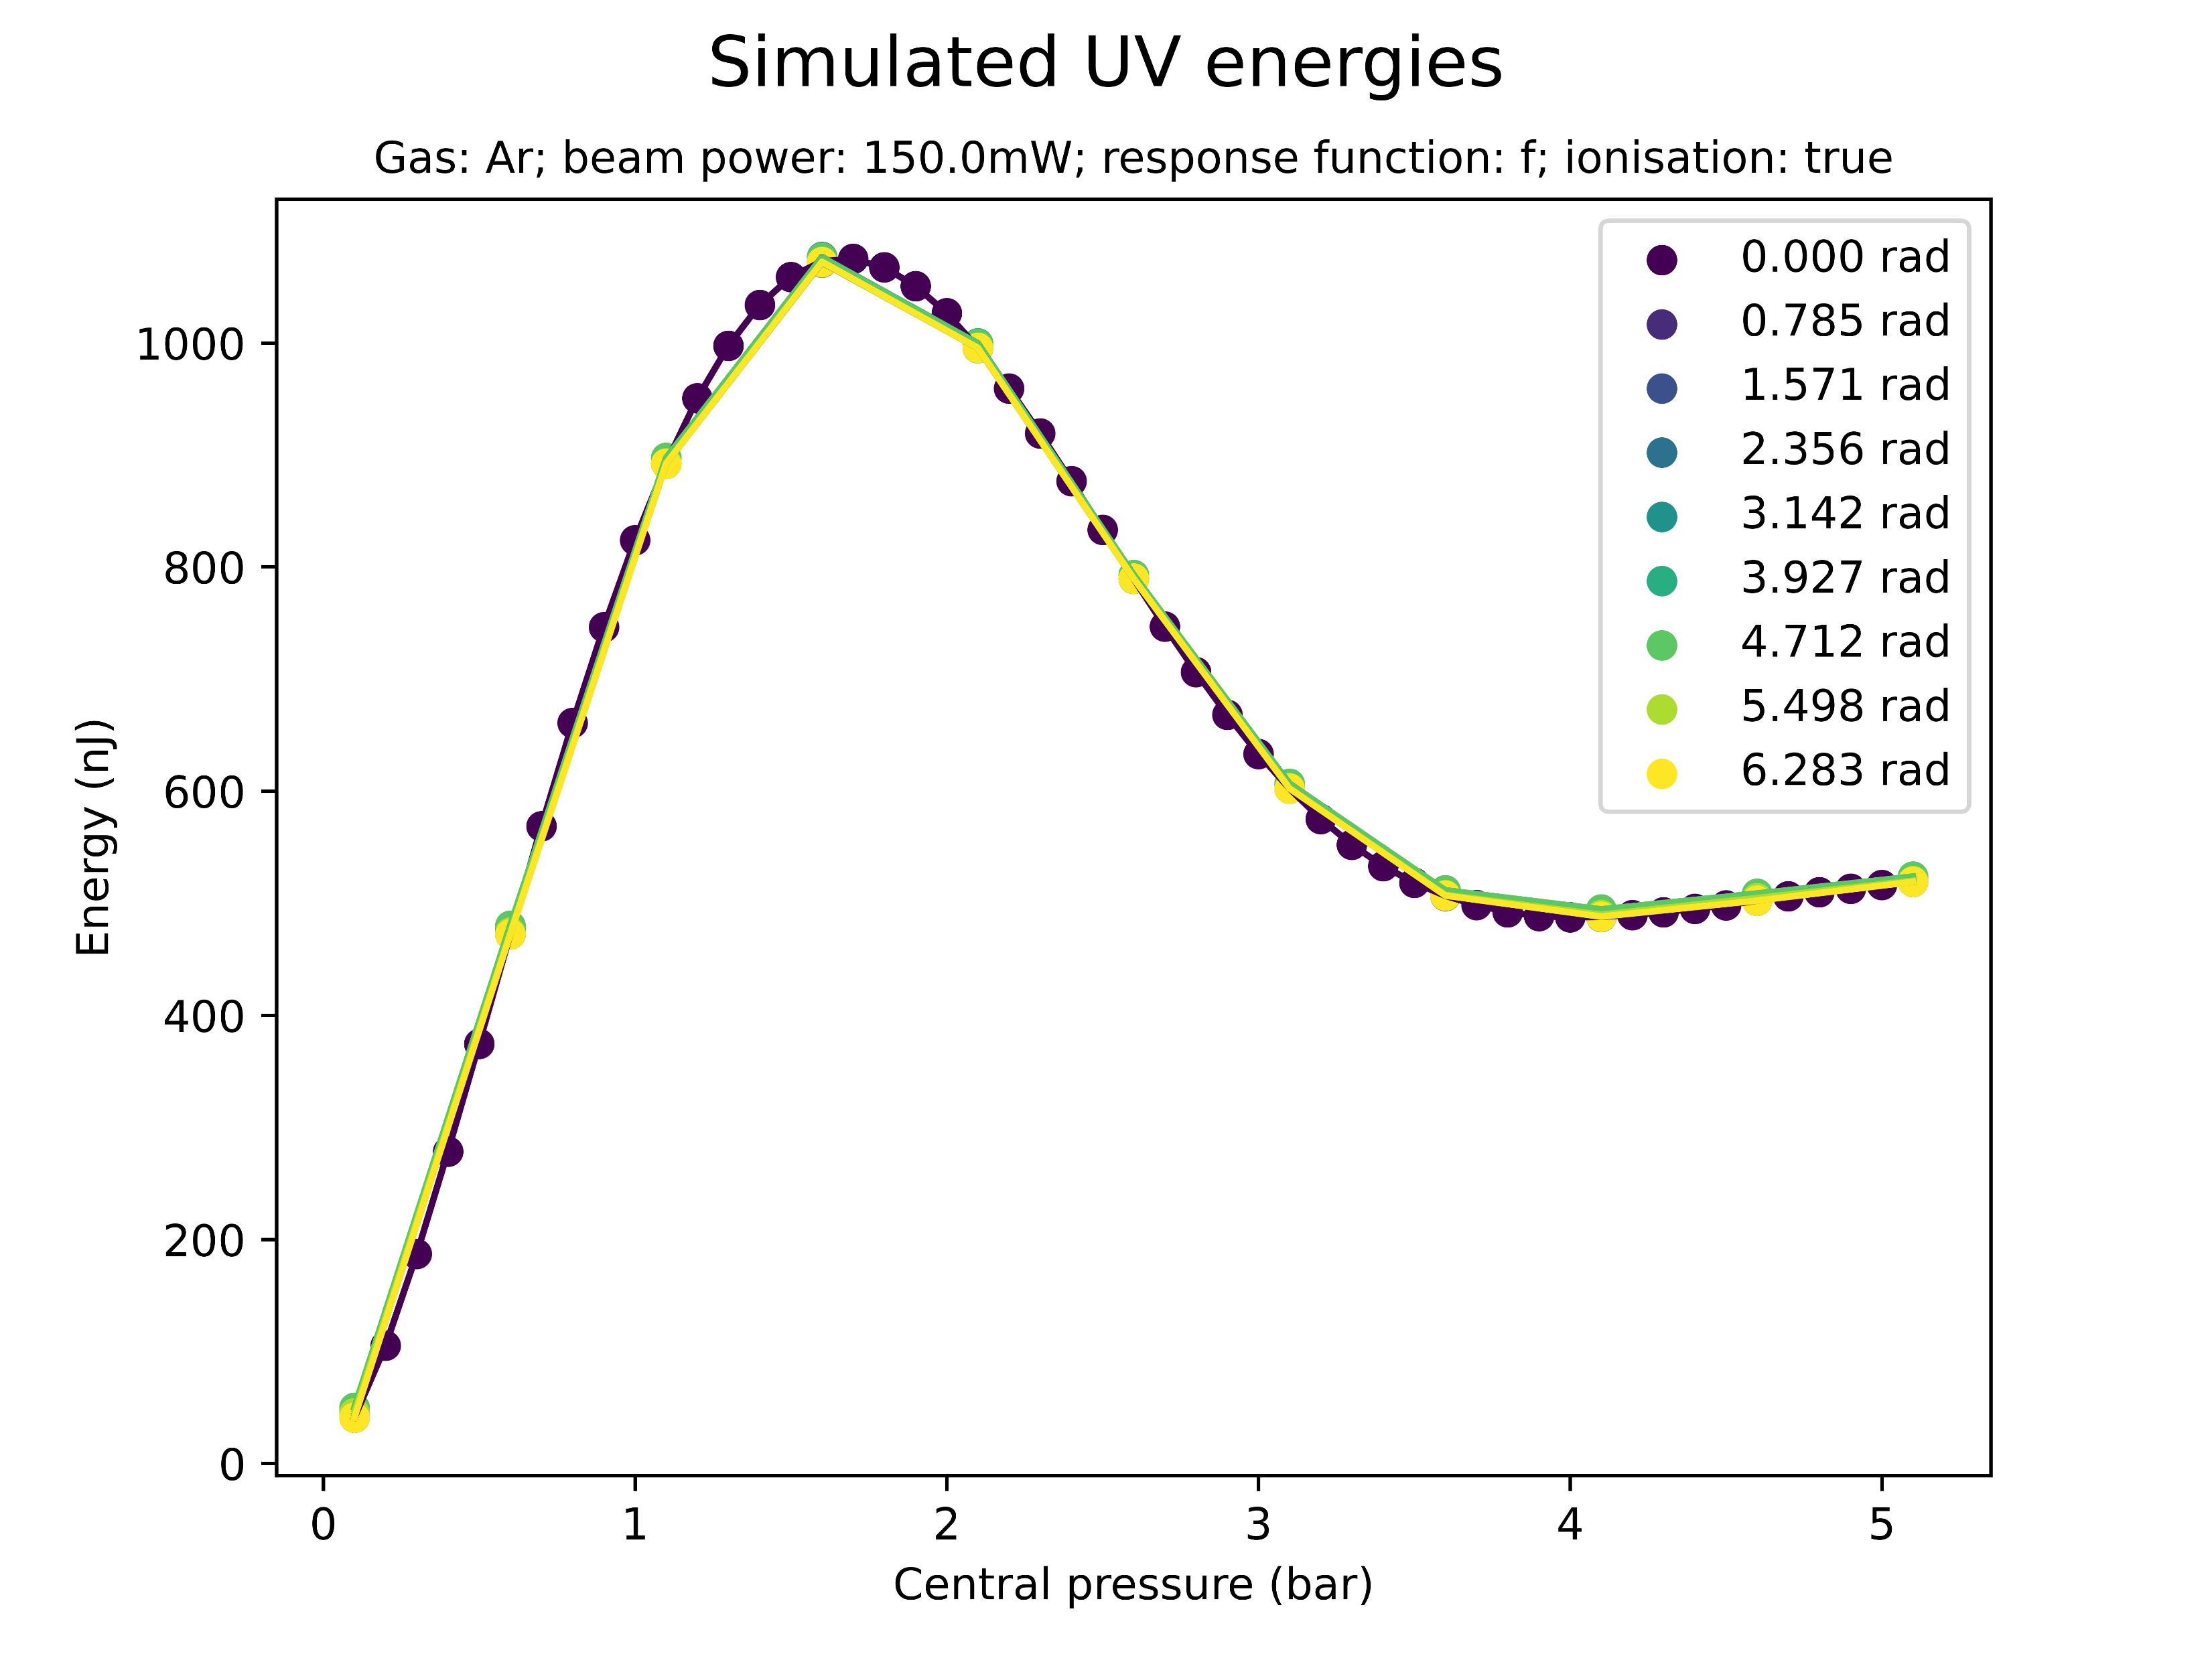
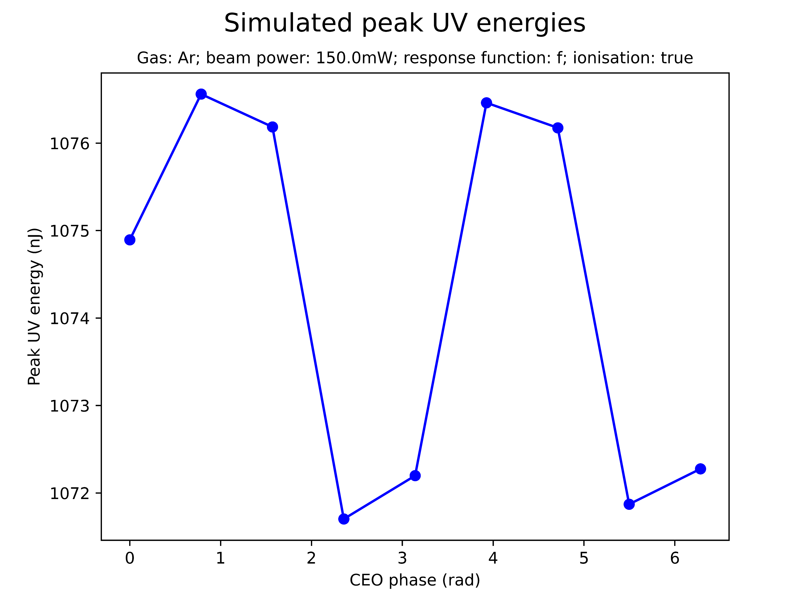
Effect of CEO phase on saturation
Negligible sinusoidal variation of peak UV energy/peak THG efficiency with CEO phase
Note: only tested for 150mW Argon

Slide 13
Summary: saturation
Saturation occurs at significantly higher energies and pressures than in the experimental data
Can the pressure discrepancy be explained by the pressure measurement having been taken outside the cell?
Saturation is correlated to input beam power: at higher beam powers it sets in at lower pressures, though at larger peak UV energies
What is the physical reason for the apparent threshold on peak UV energies and the decrease in efficiency?
Ionisation is not necessary for saturation but does enhance it
Is there a threshold peak UV energy and decrease in efficiency without ionisation?
CEO phase has a mostly negligible effect on saturation

Slide 14
II. SPECTRAL PROFILE

Slide 15
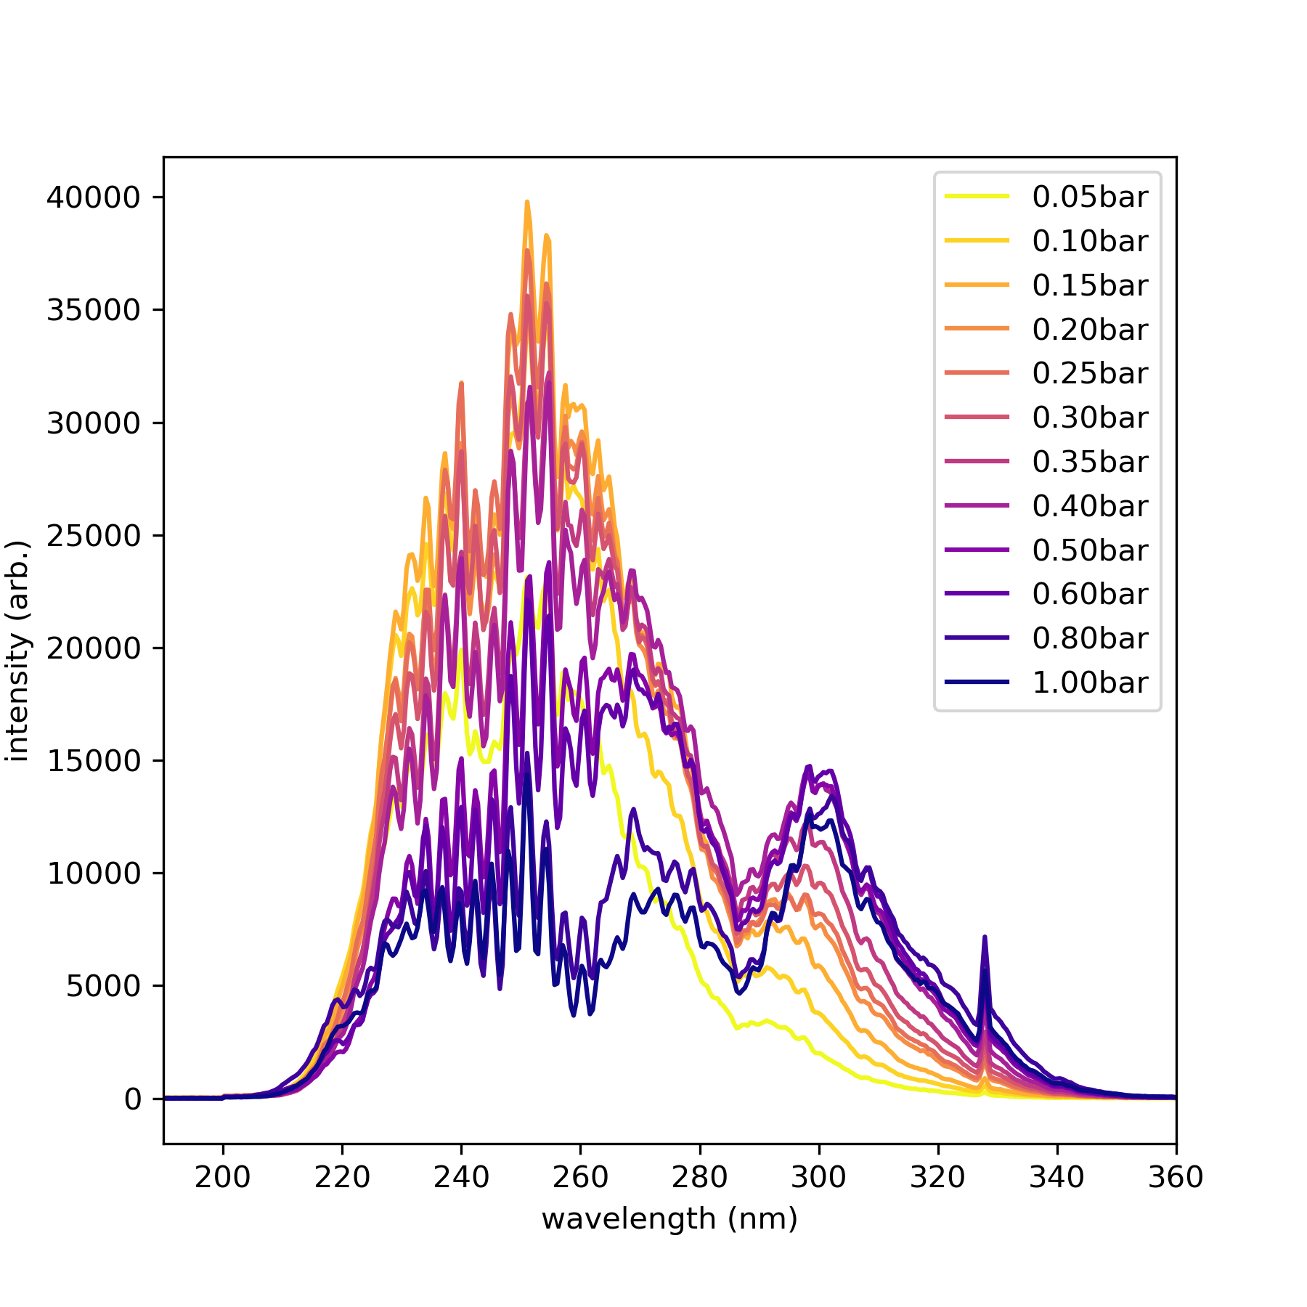
“Spectral breakdown”
Measured Argon spectrum at 300mW
At pressures beyond the saturation pressure, “spectral breakdown” can be observed experimentally
This involves a decrease in the 266nm TH peak and the appearance of new spectral peaks
These effects were reproduced by the simulations but, again, at much higher pressures

Slide 16
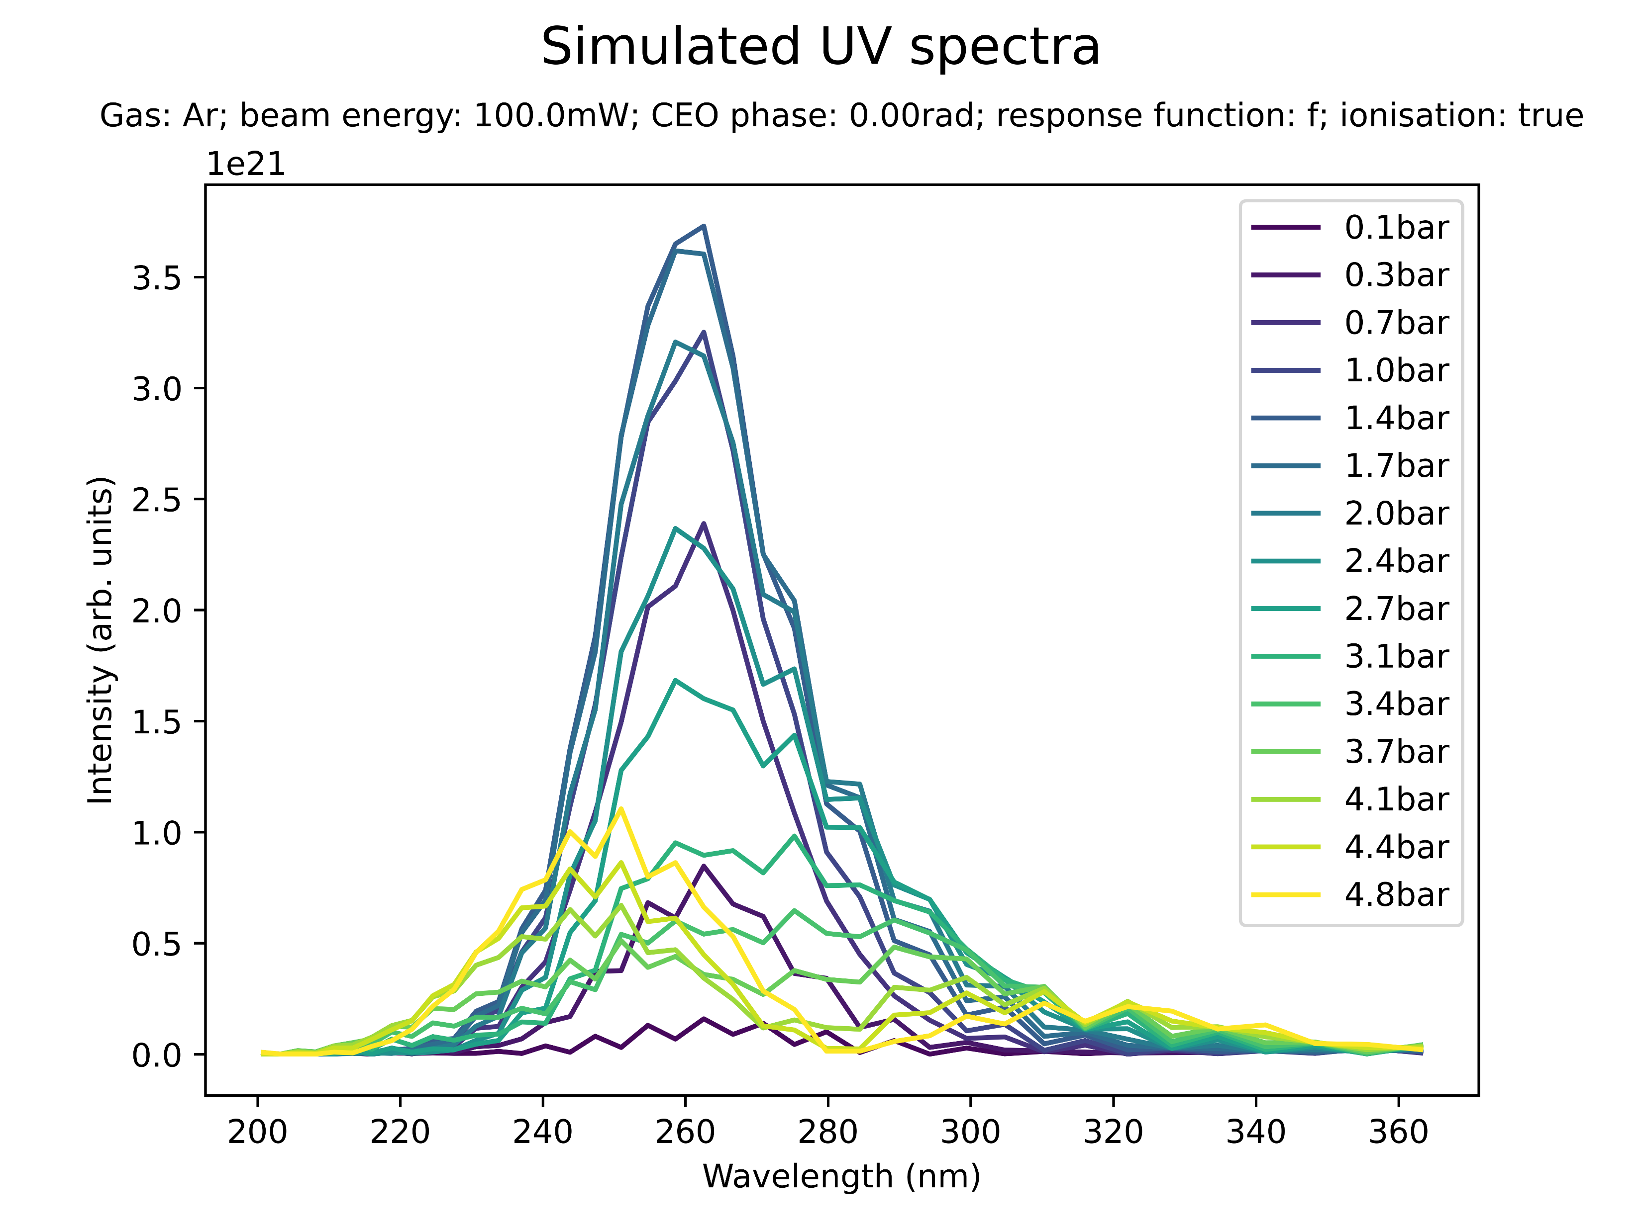
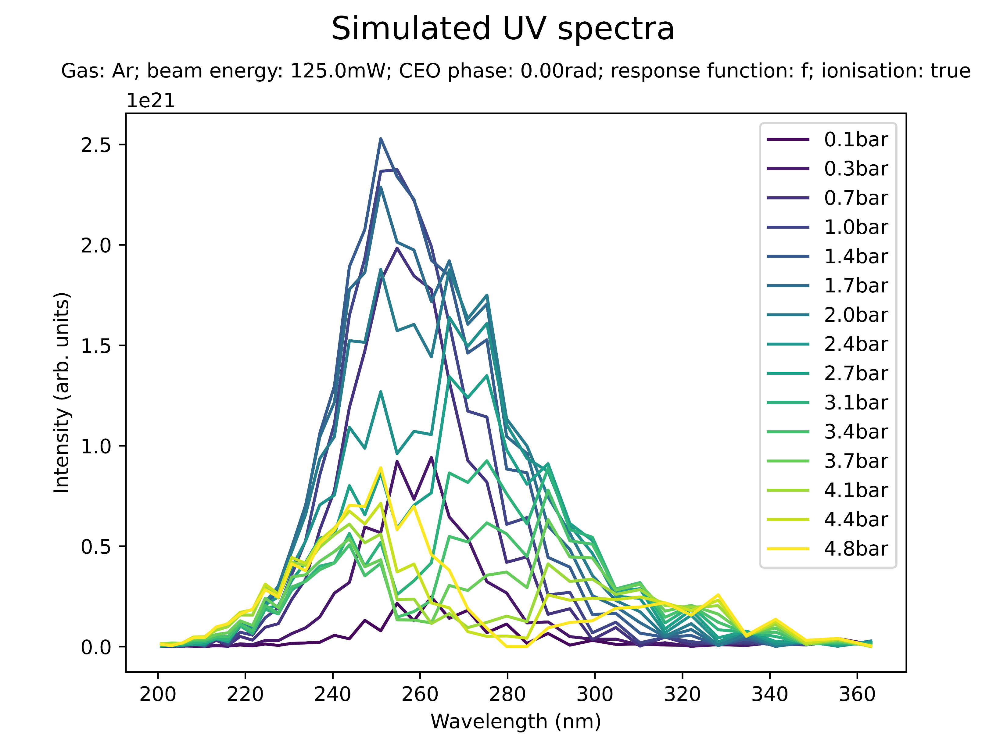
Effect of beam power on spectral profile (Ar)
Low power (Ar): blueshift with peak at 250nm

Slide 17
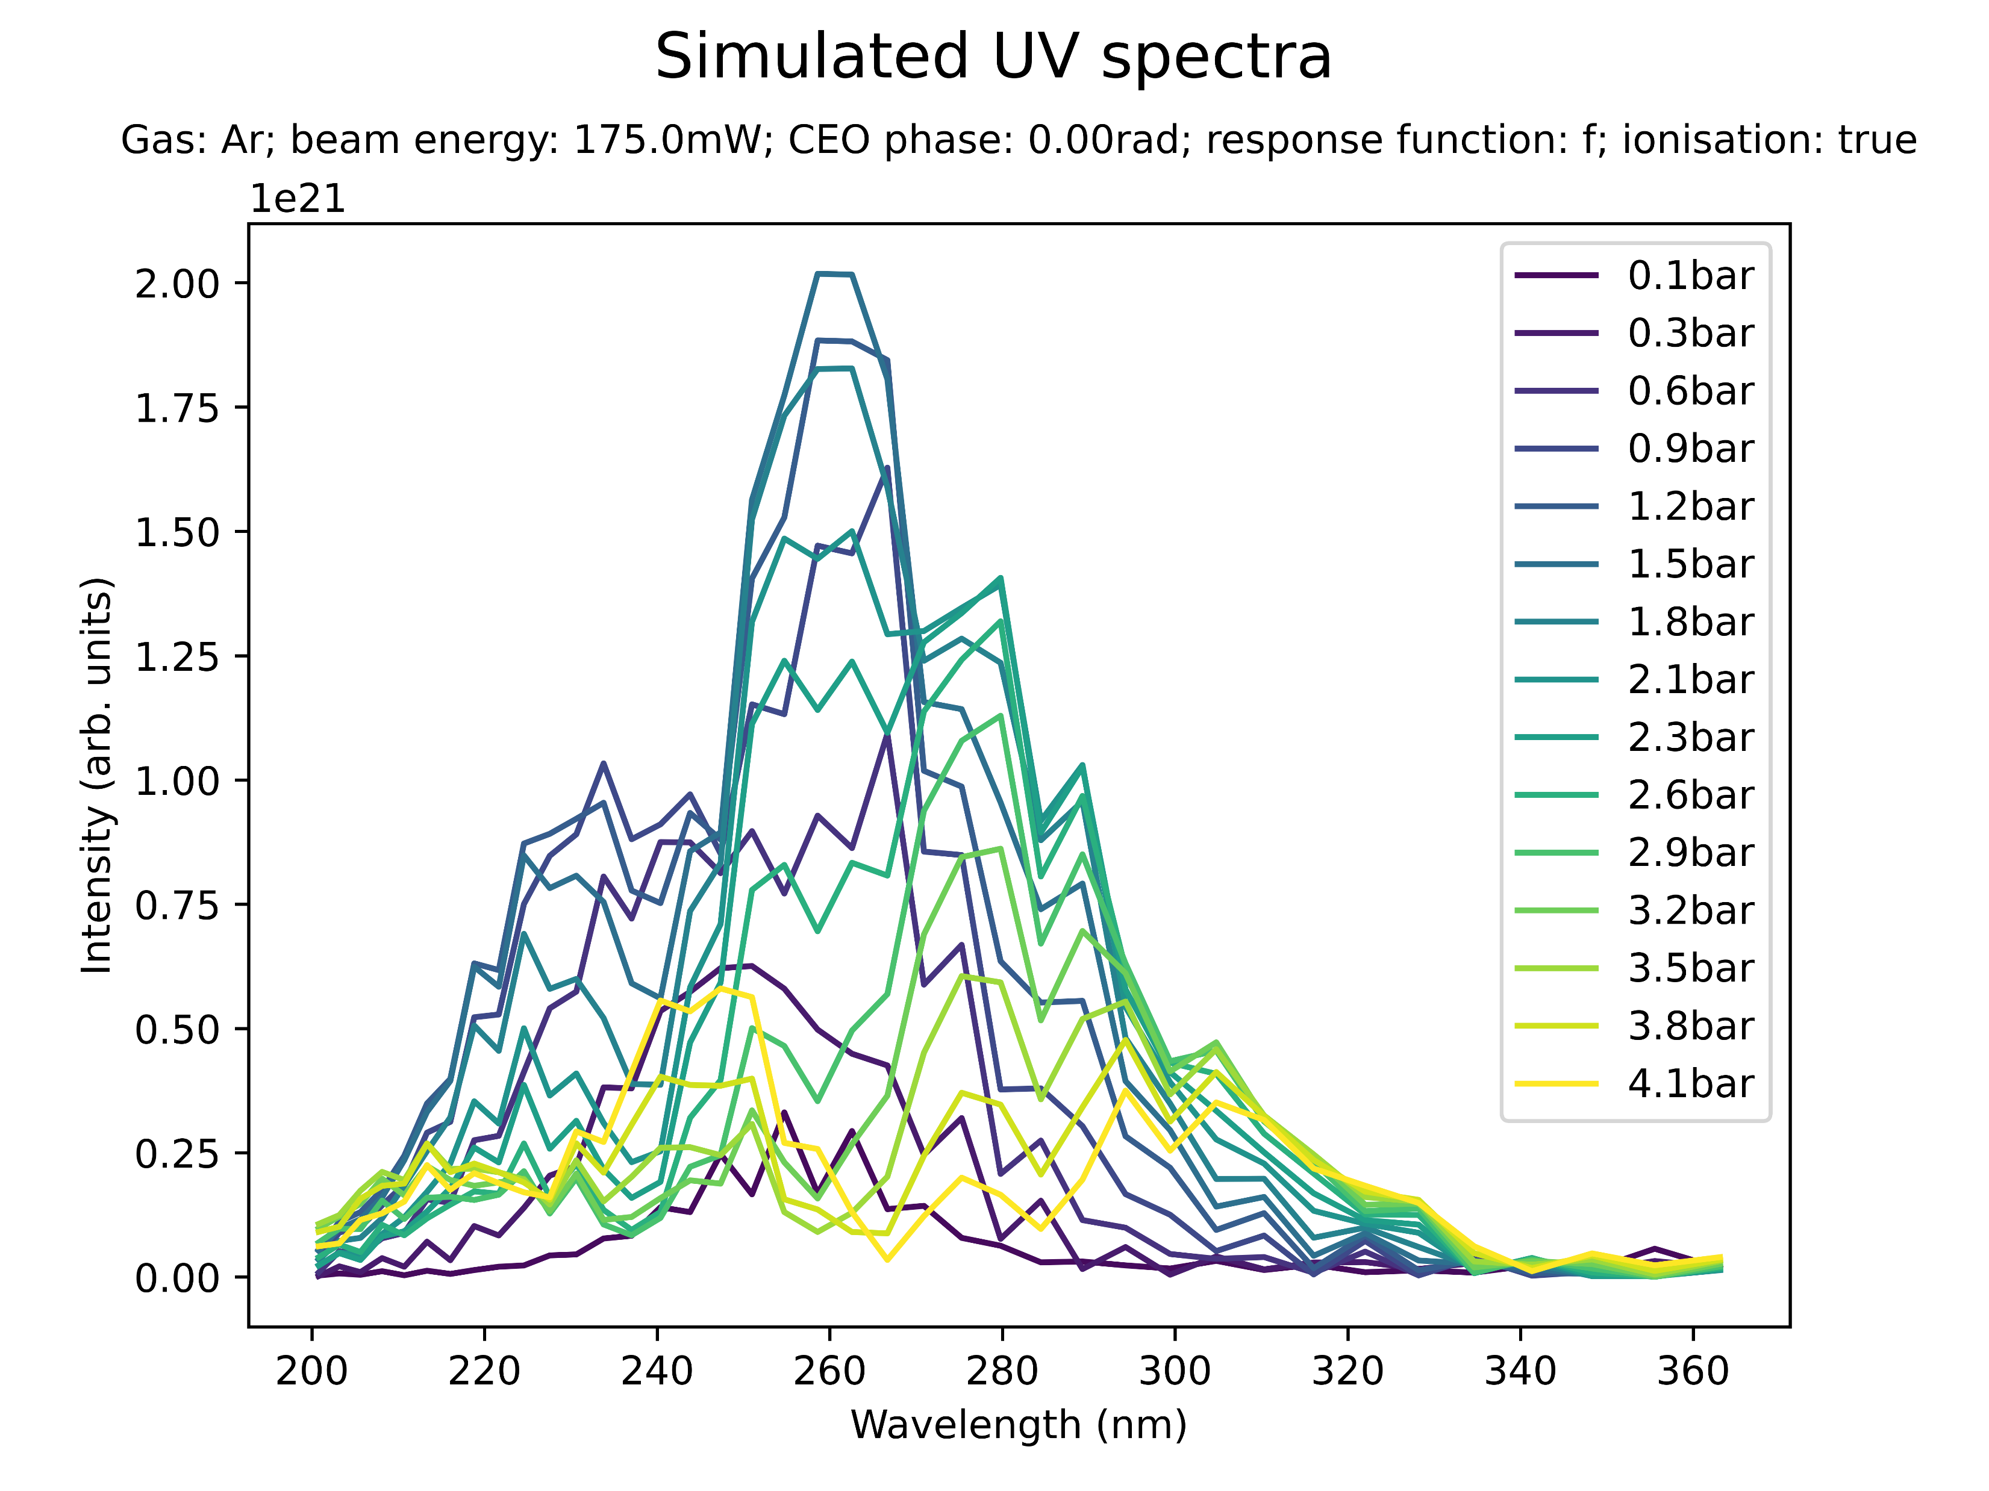
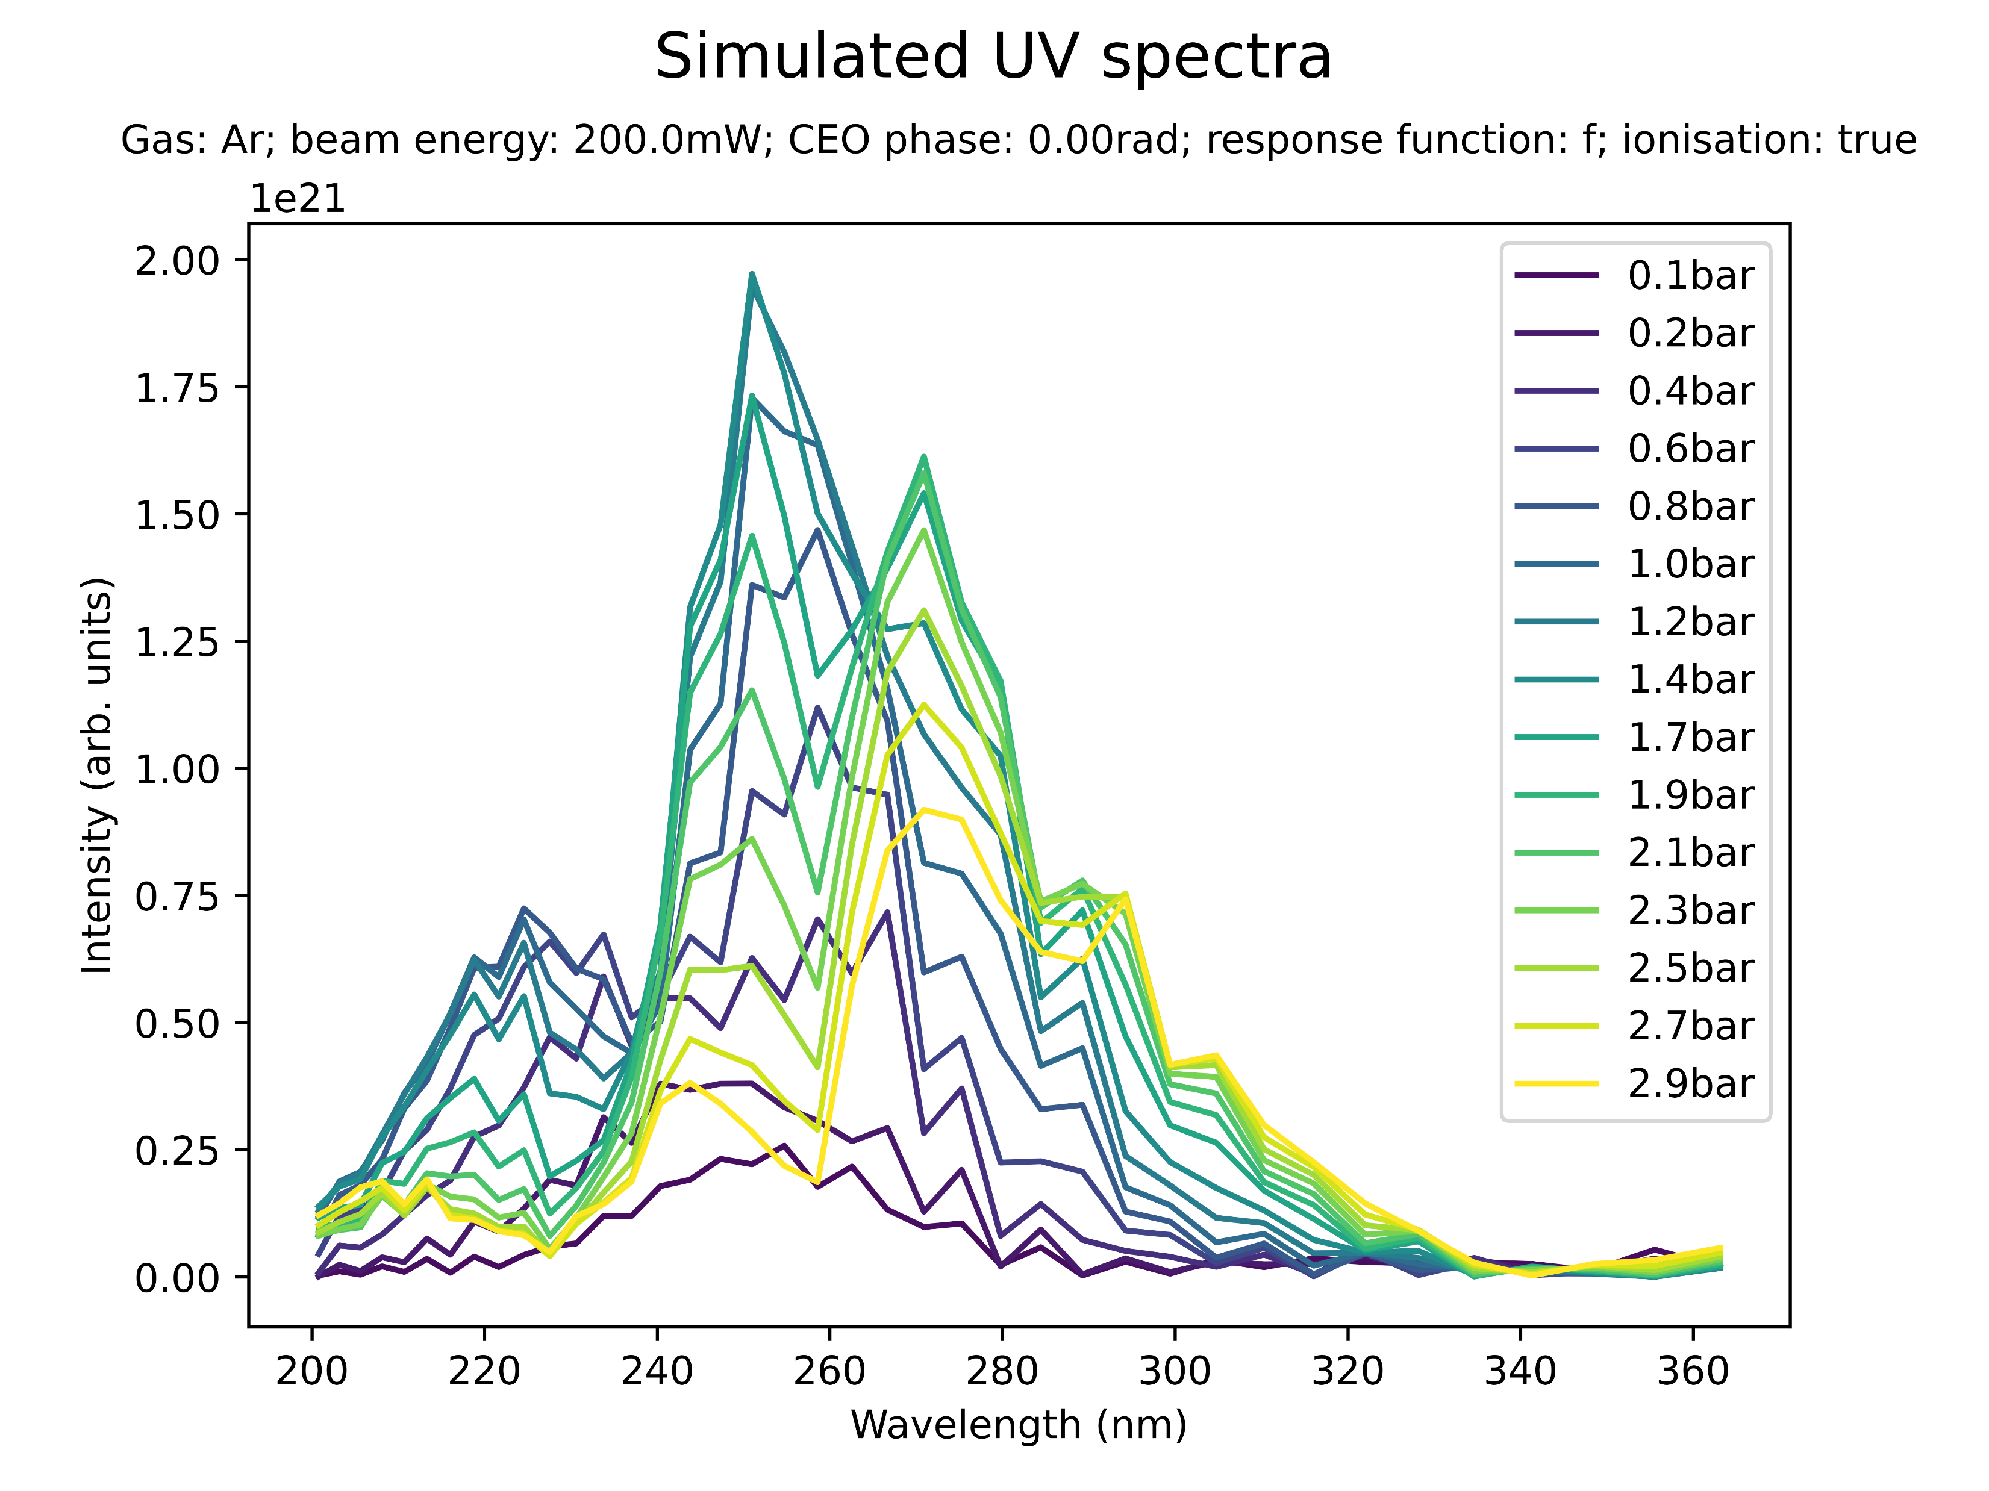
Effect of beam power on spectral profile (Ar)
Medium power (Ar): additional peaks at 230nm and 290nm

Slide 18
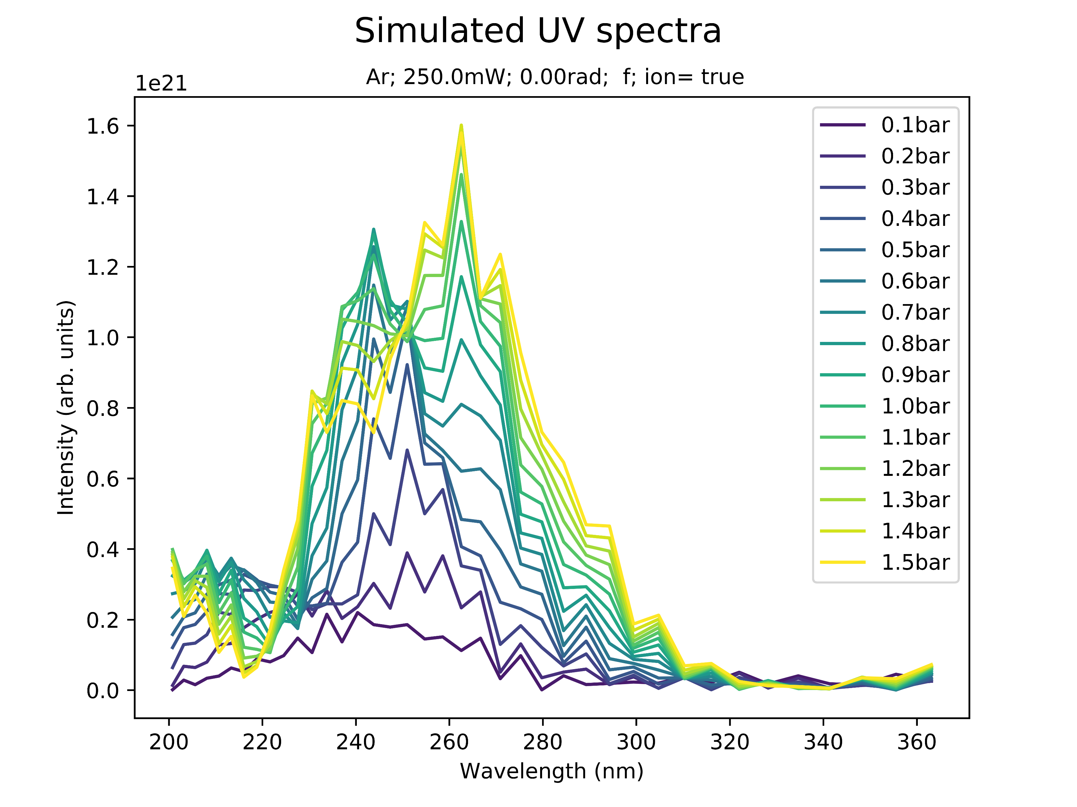
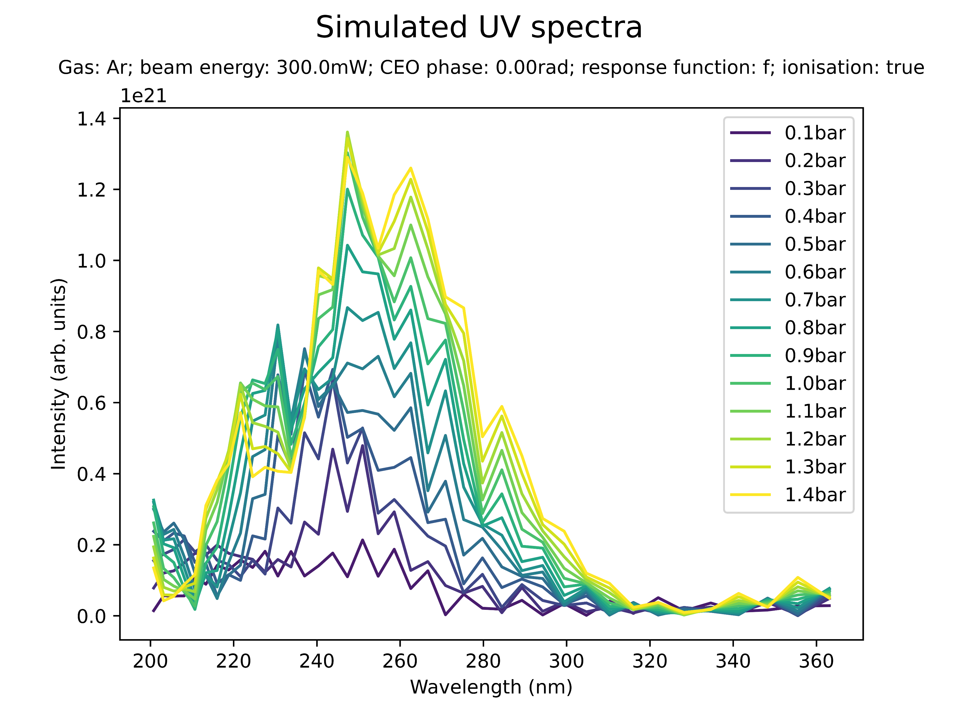
Effect of beam power on spectral profile (Ar)
High power (Ar): prominent peaks at 240nm; indication of sub-200nm peak

Slide 19
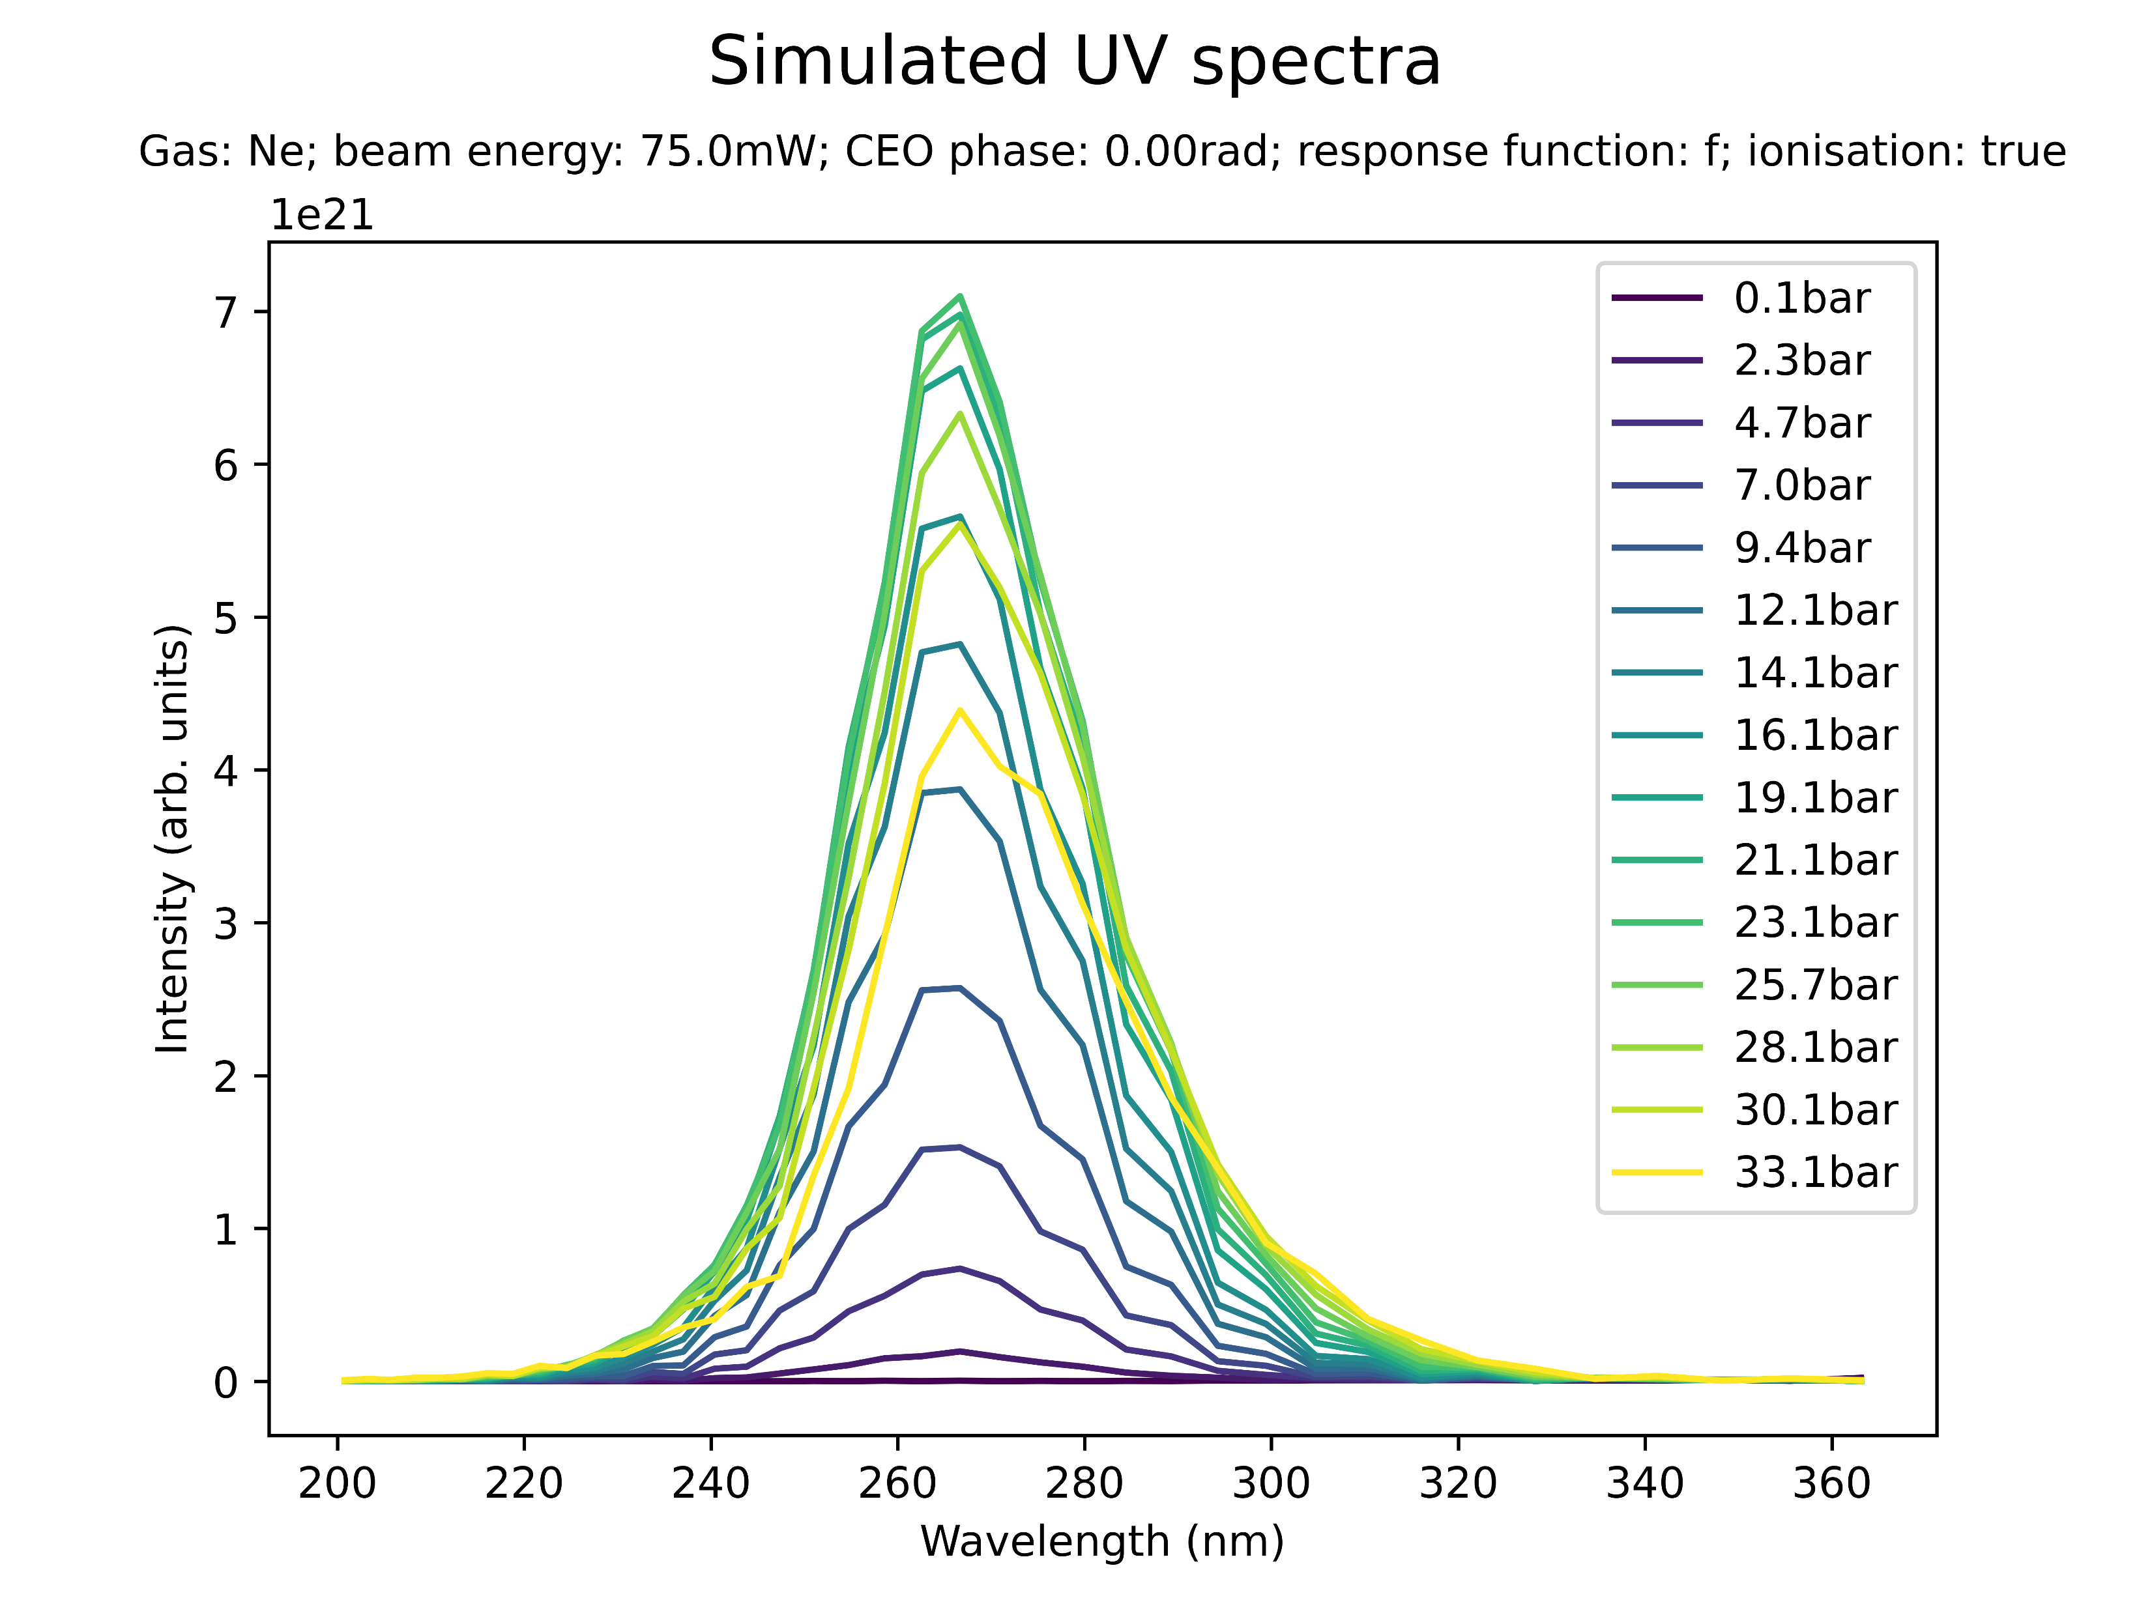
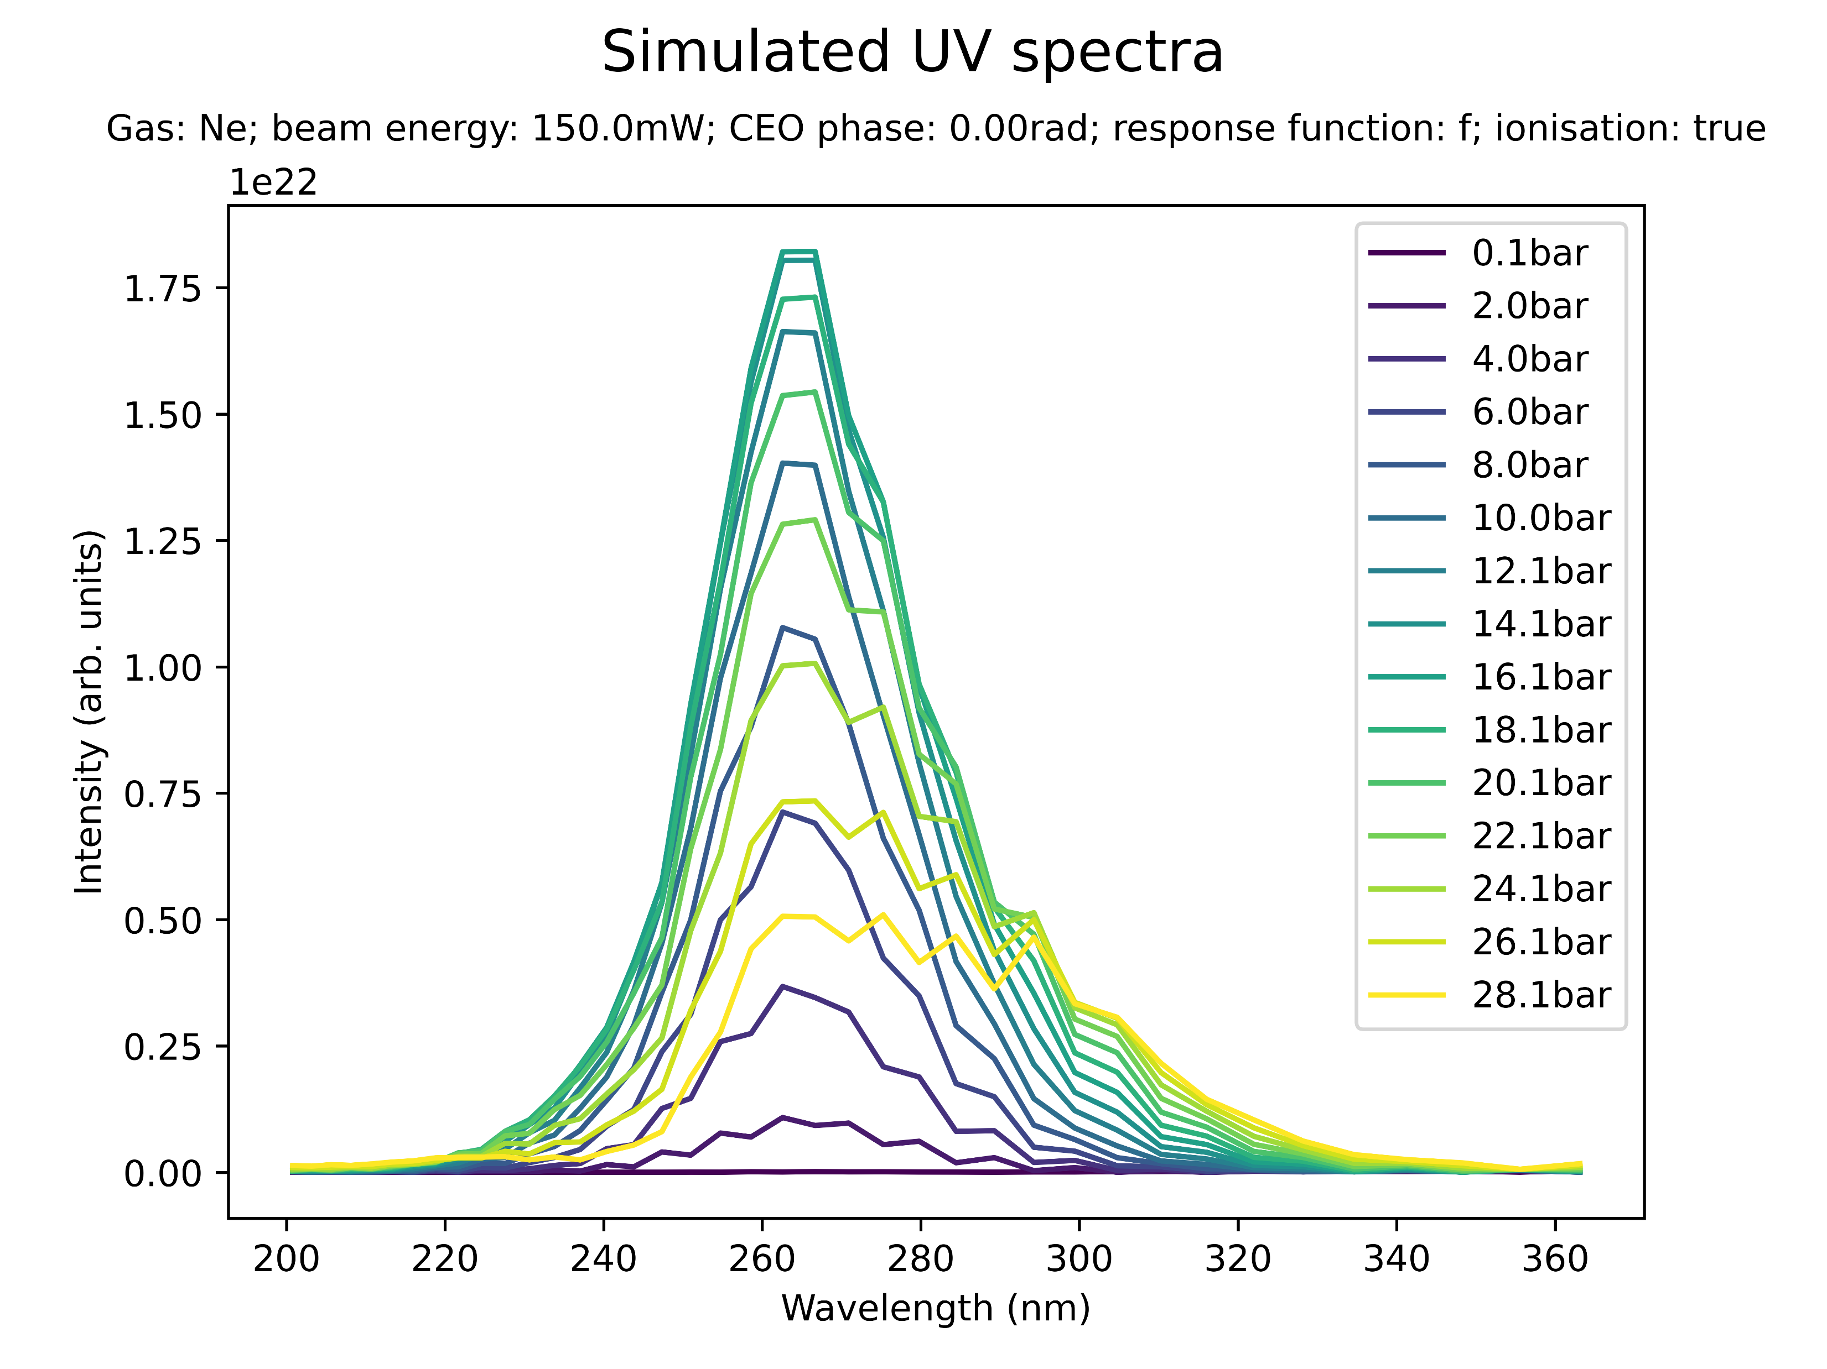
Effect of beam power on spectral profile (Ne)
Low power (Ne): redshift with peak at 290nm

Slide 20
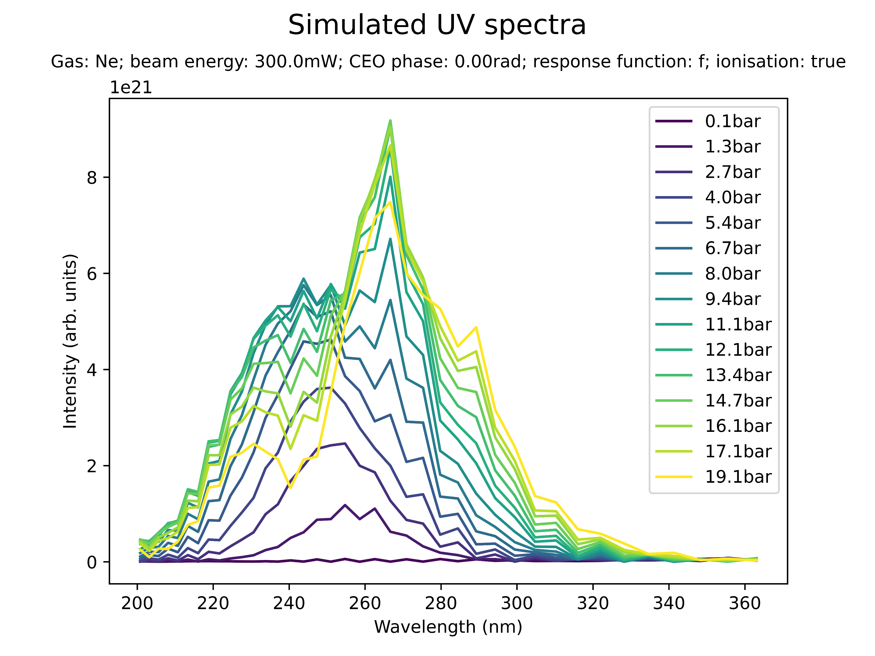
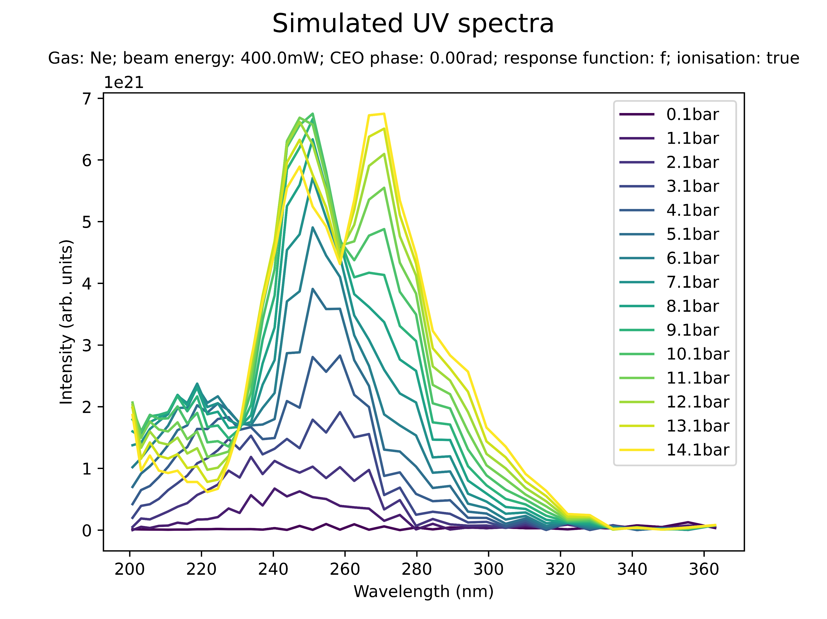
Effect of beam power on spectral profile (Ne)
High power (Ne): prominent peak at 250nm; indication of sub-200nm peak

Slide 21
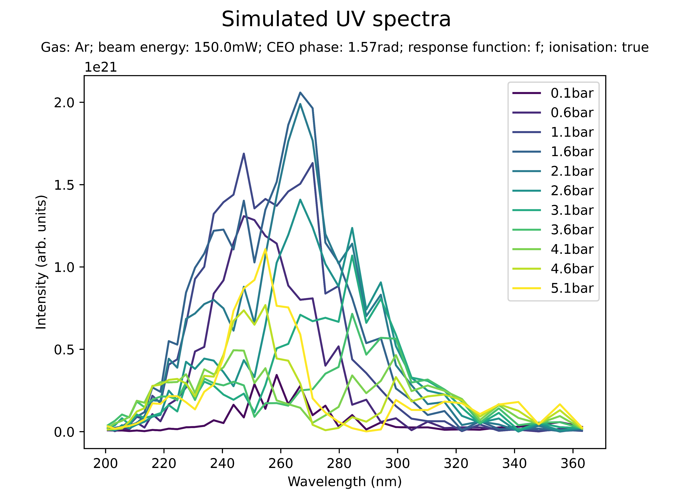
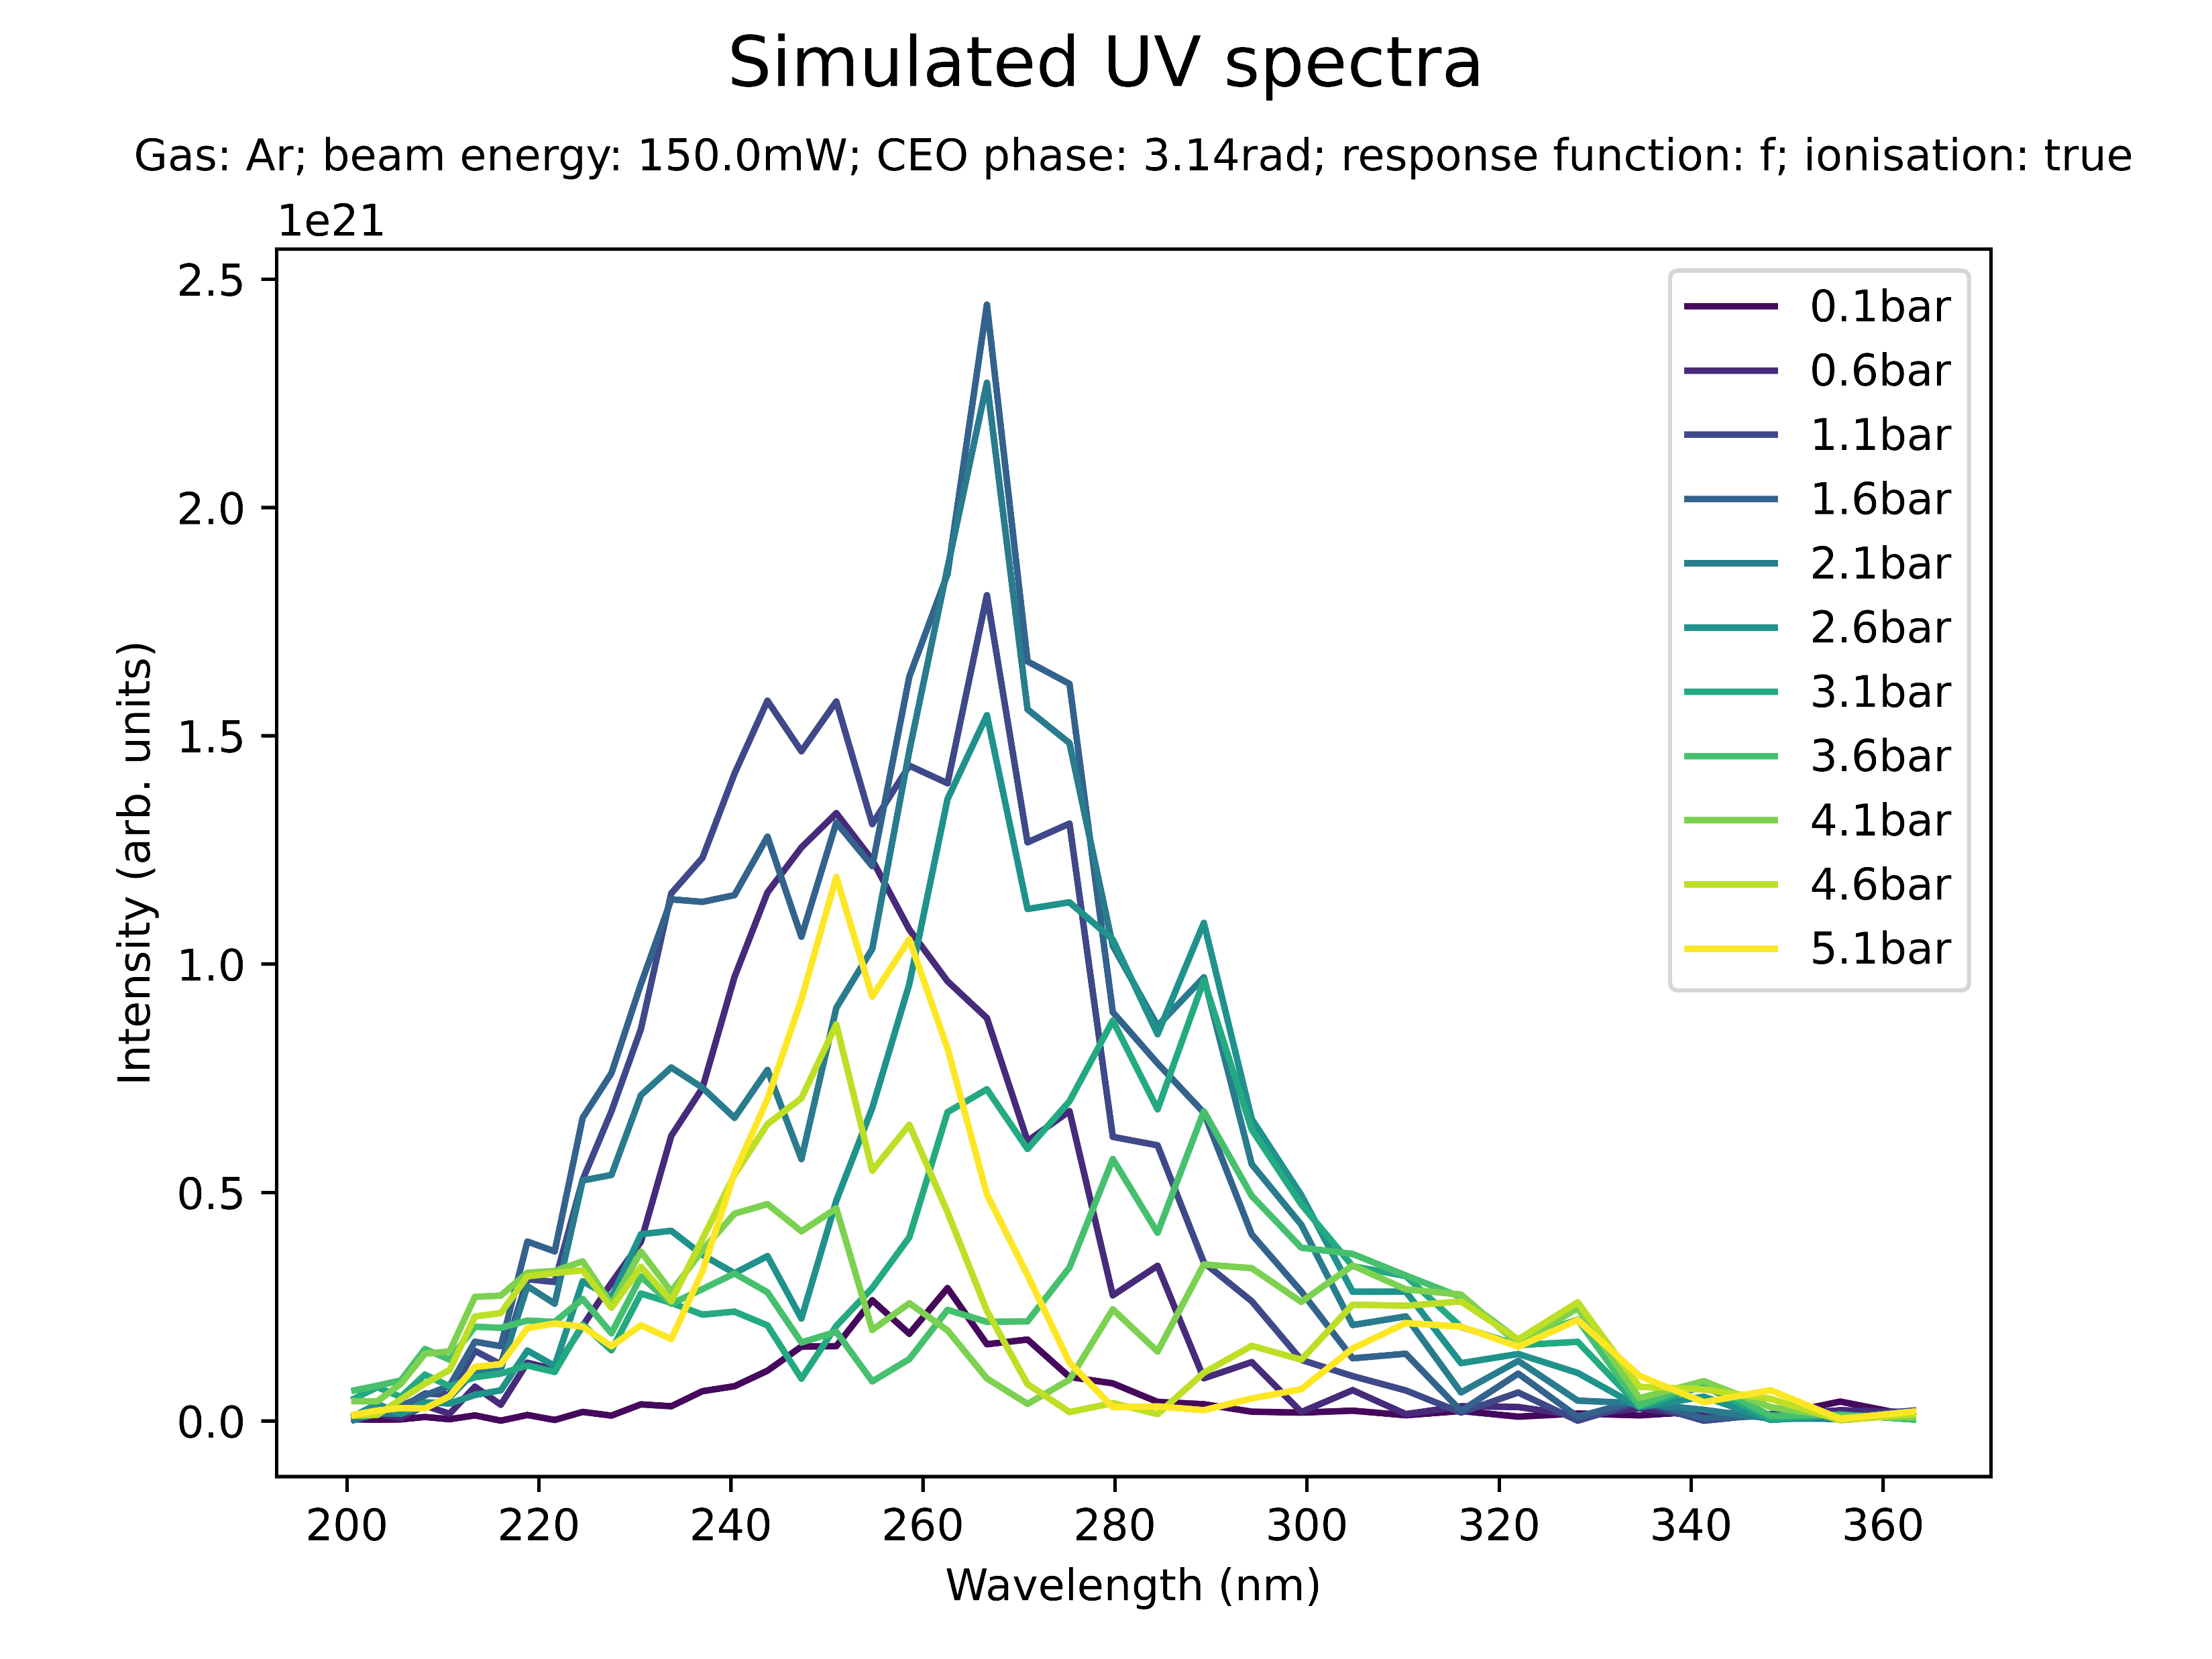
Effect of CEO phase on spectral peaks
The CEO phase seems to have an impact on the spectral profile: no effect on overall shape but individual peaks are different

Slide 22
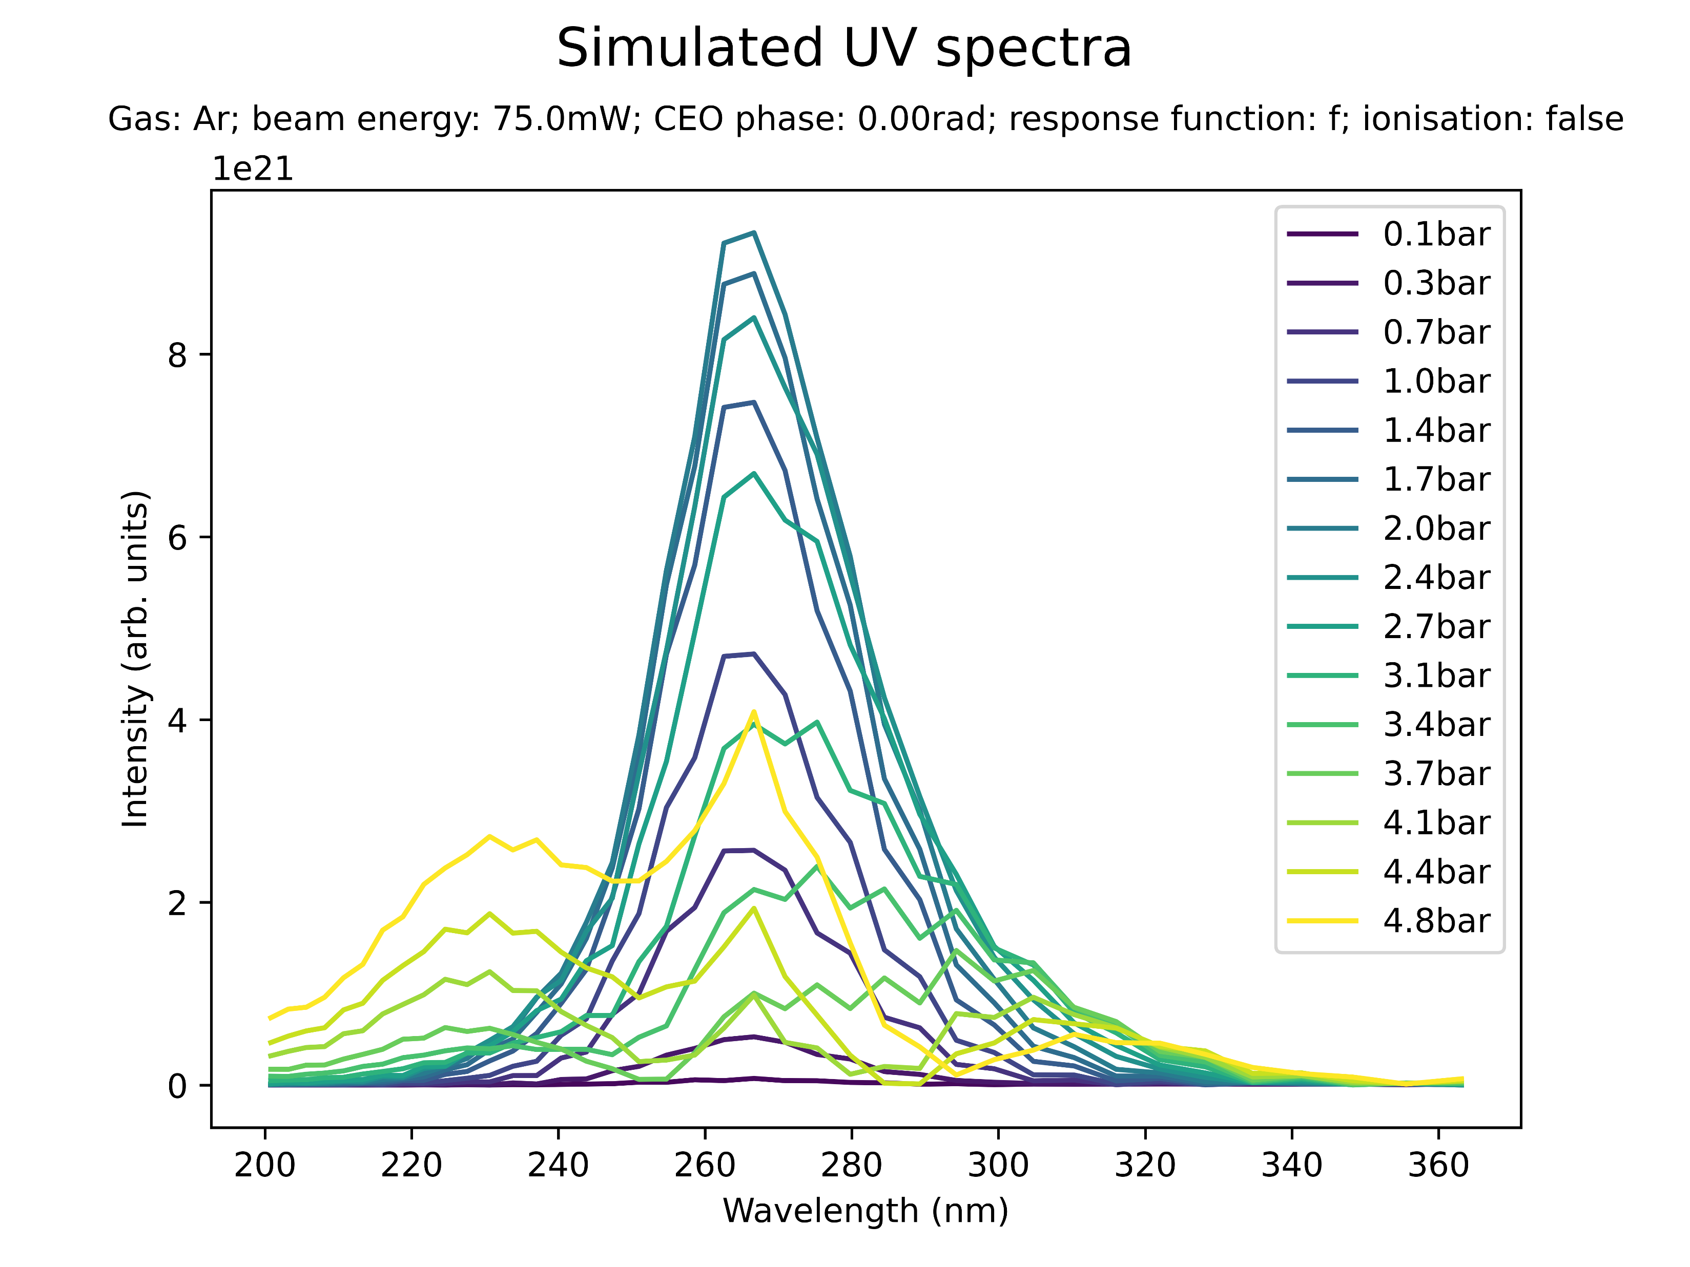
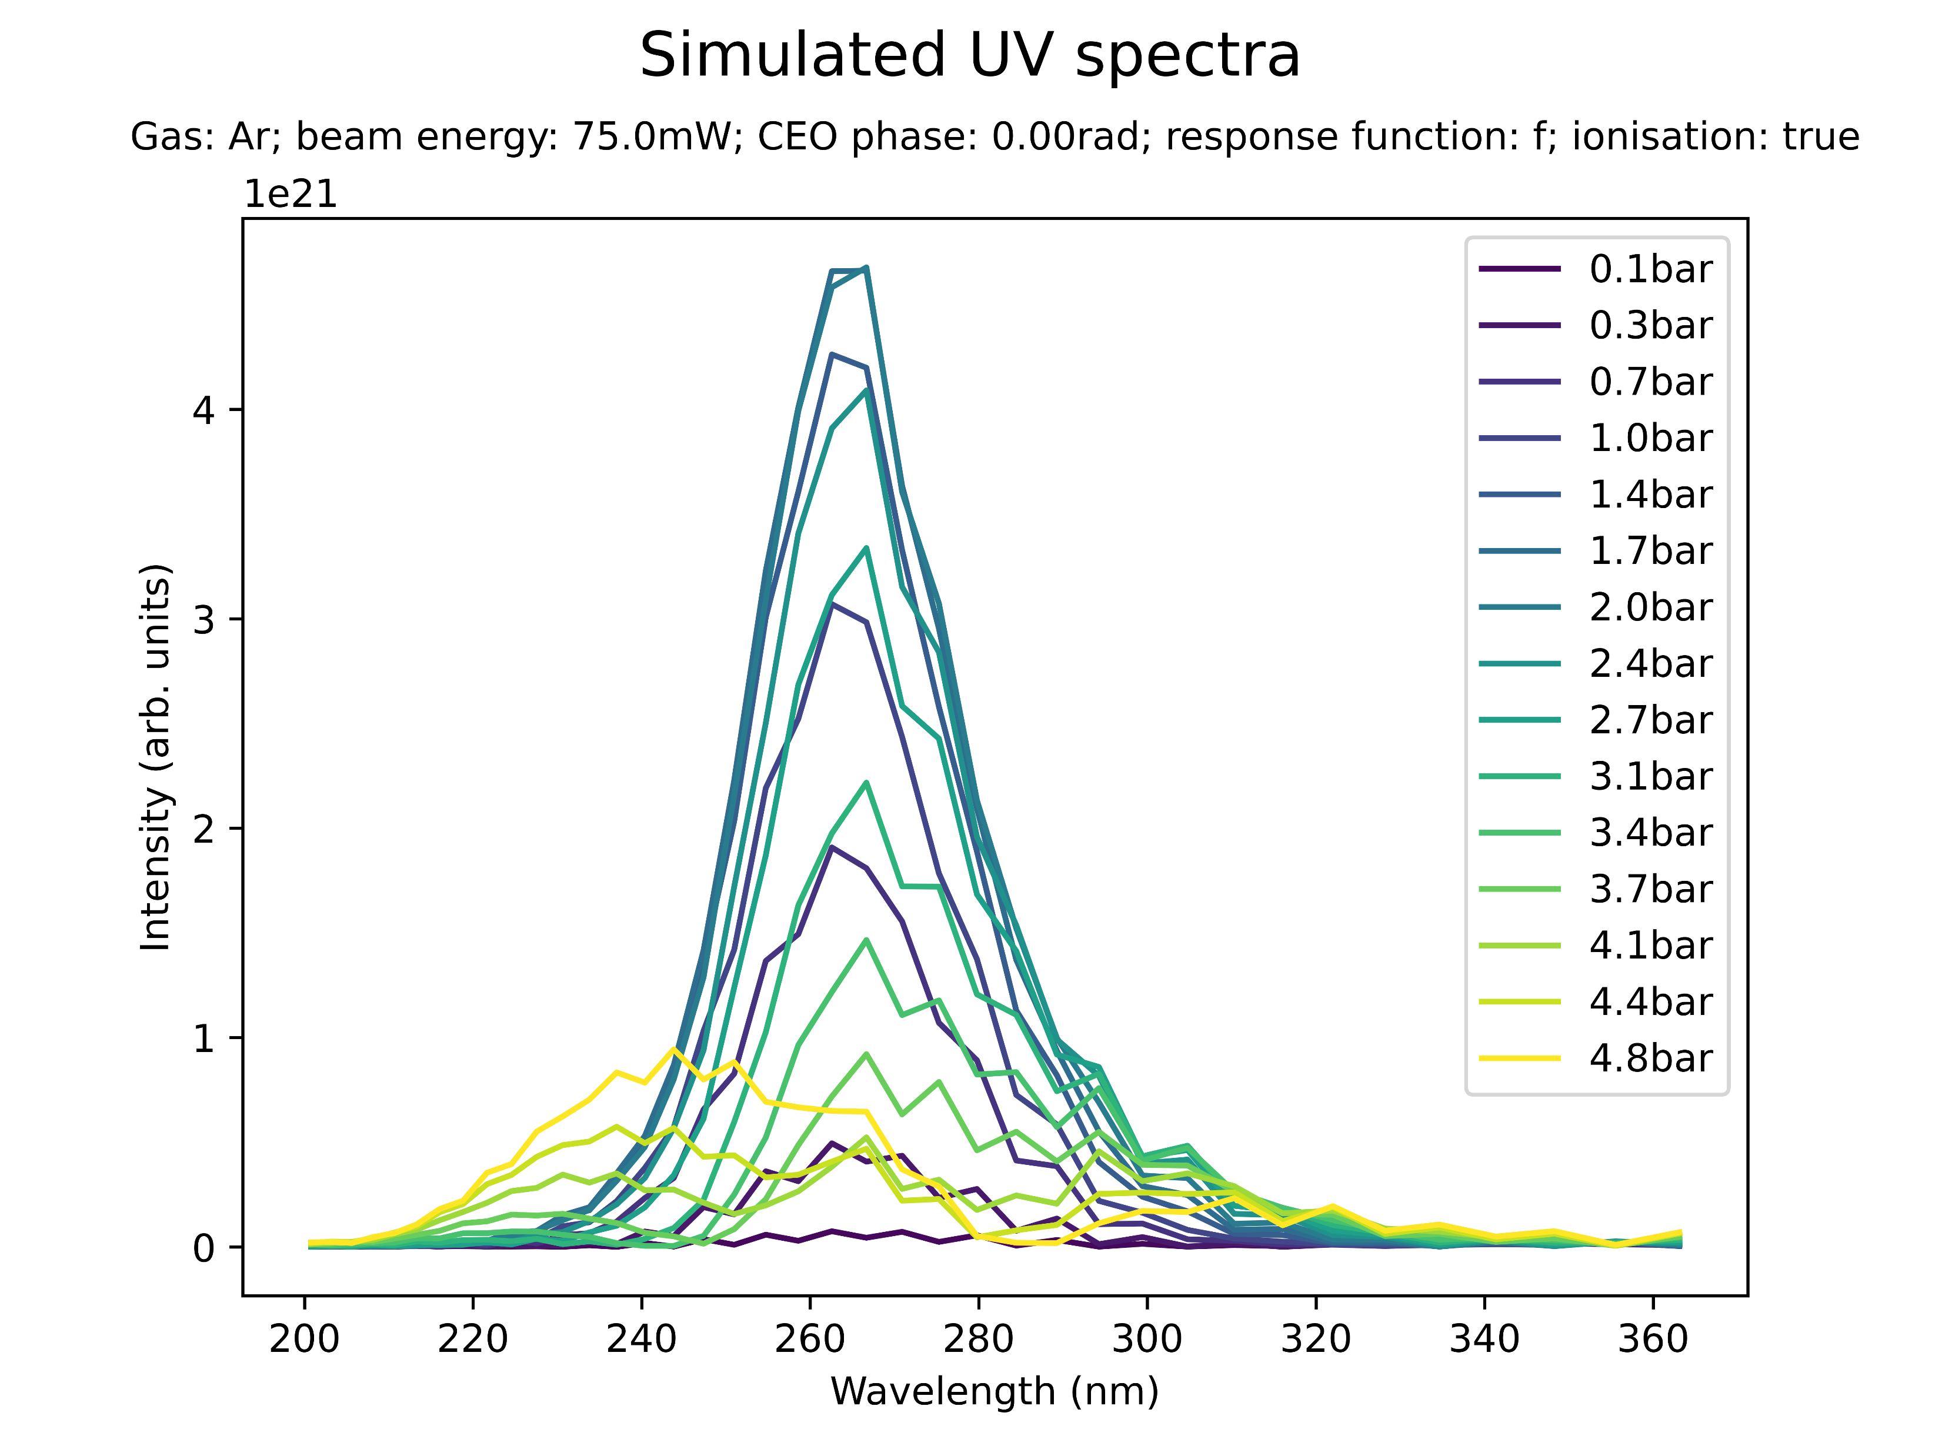
Effect of ionisation on spectral profile
no ion.
ion.
Low power (Ar): ionisation suppresses THG and the 230nm peak at high pressures

Slide 23
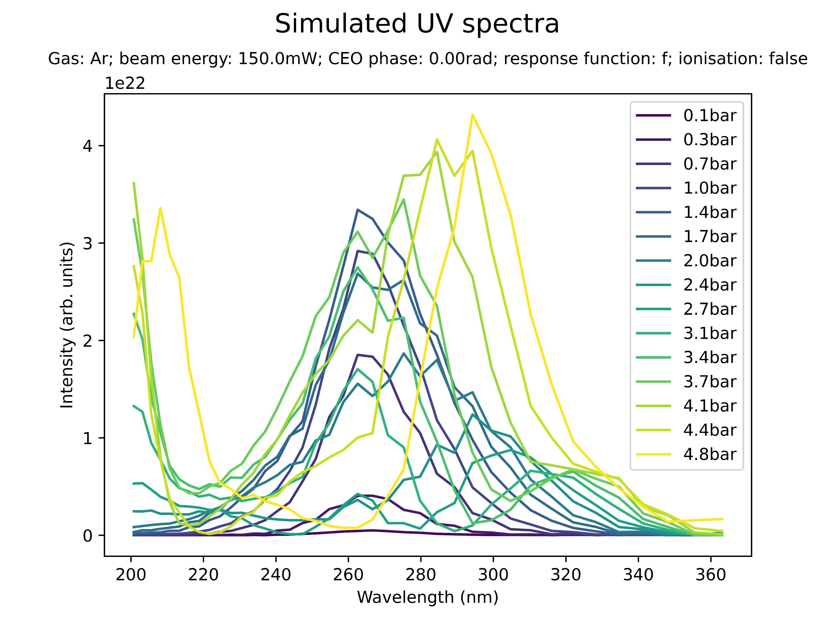
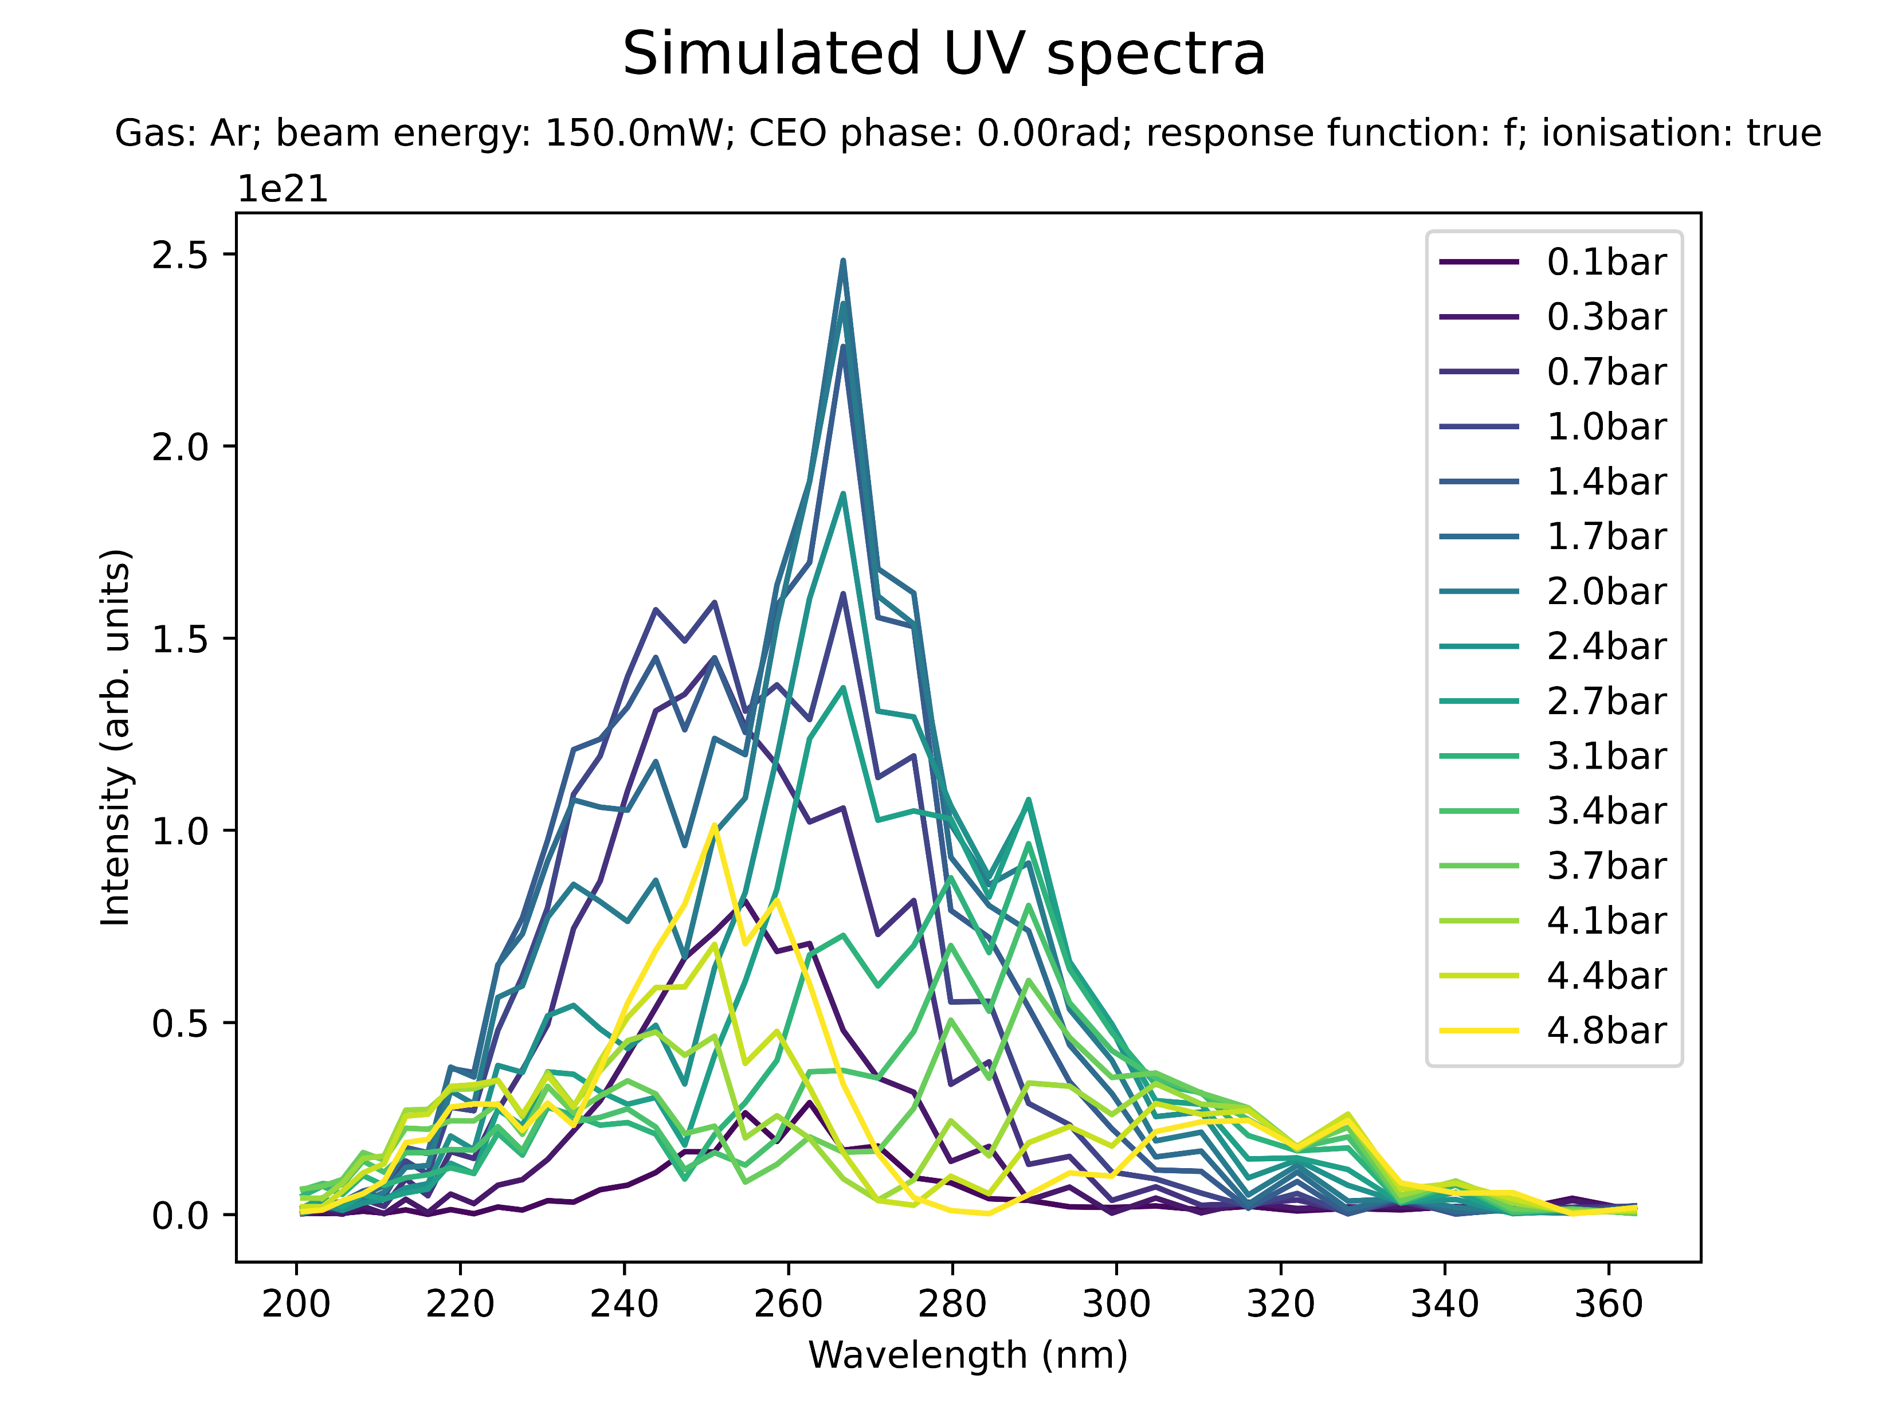
Effect of ionisation on spectral profile
no ion.
ion.
Medium power (Ar): ionisation significantly suppresses high-pressure peaks at 210nm and 300nm

Slide 24

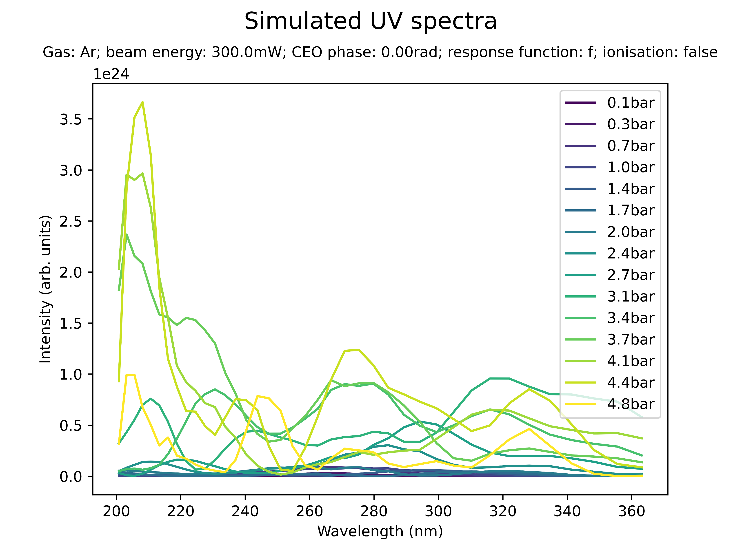
Effect of ionisation on spectral profile
no ion.
ion.
High power (Ar): very significant peaks at 210nm (additionally: 250nm, 330nm)
Note: the simulations with ionisation break down at 1.5 bar

Slide 25
Summary: spectral profile
UV spectra are affected by “spectral breakdown” for most combinations of parameters at pressures exceeding the saturation pressure
Can the additional/vanishing spectral peaks be related to any known spectral lines or energy levels?
Ionisation seems to have a significant effect in suppressing spectral breakdown
There is no clear relationship between beam power and spectral profile at high pressures
The CEO phase seems to affect the presence of certain spectral peaks
Is this in contradiction to it being largely inconsequential for saturation?
Note: most of the above has been considered in isolation, with no cross-checking of parameter influences

Slide 26
III. BEAM PROFILE

Slide 27
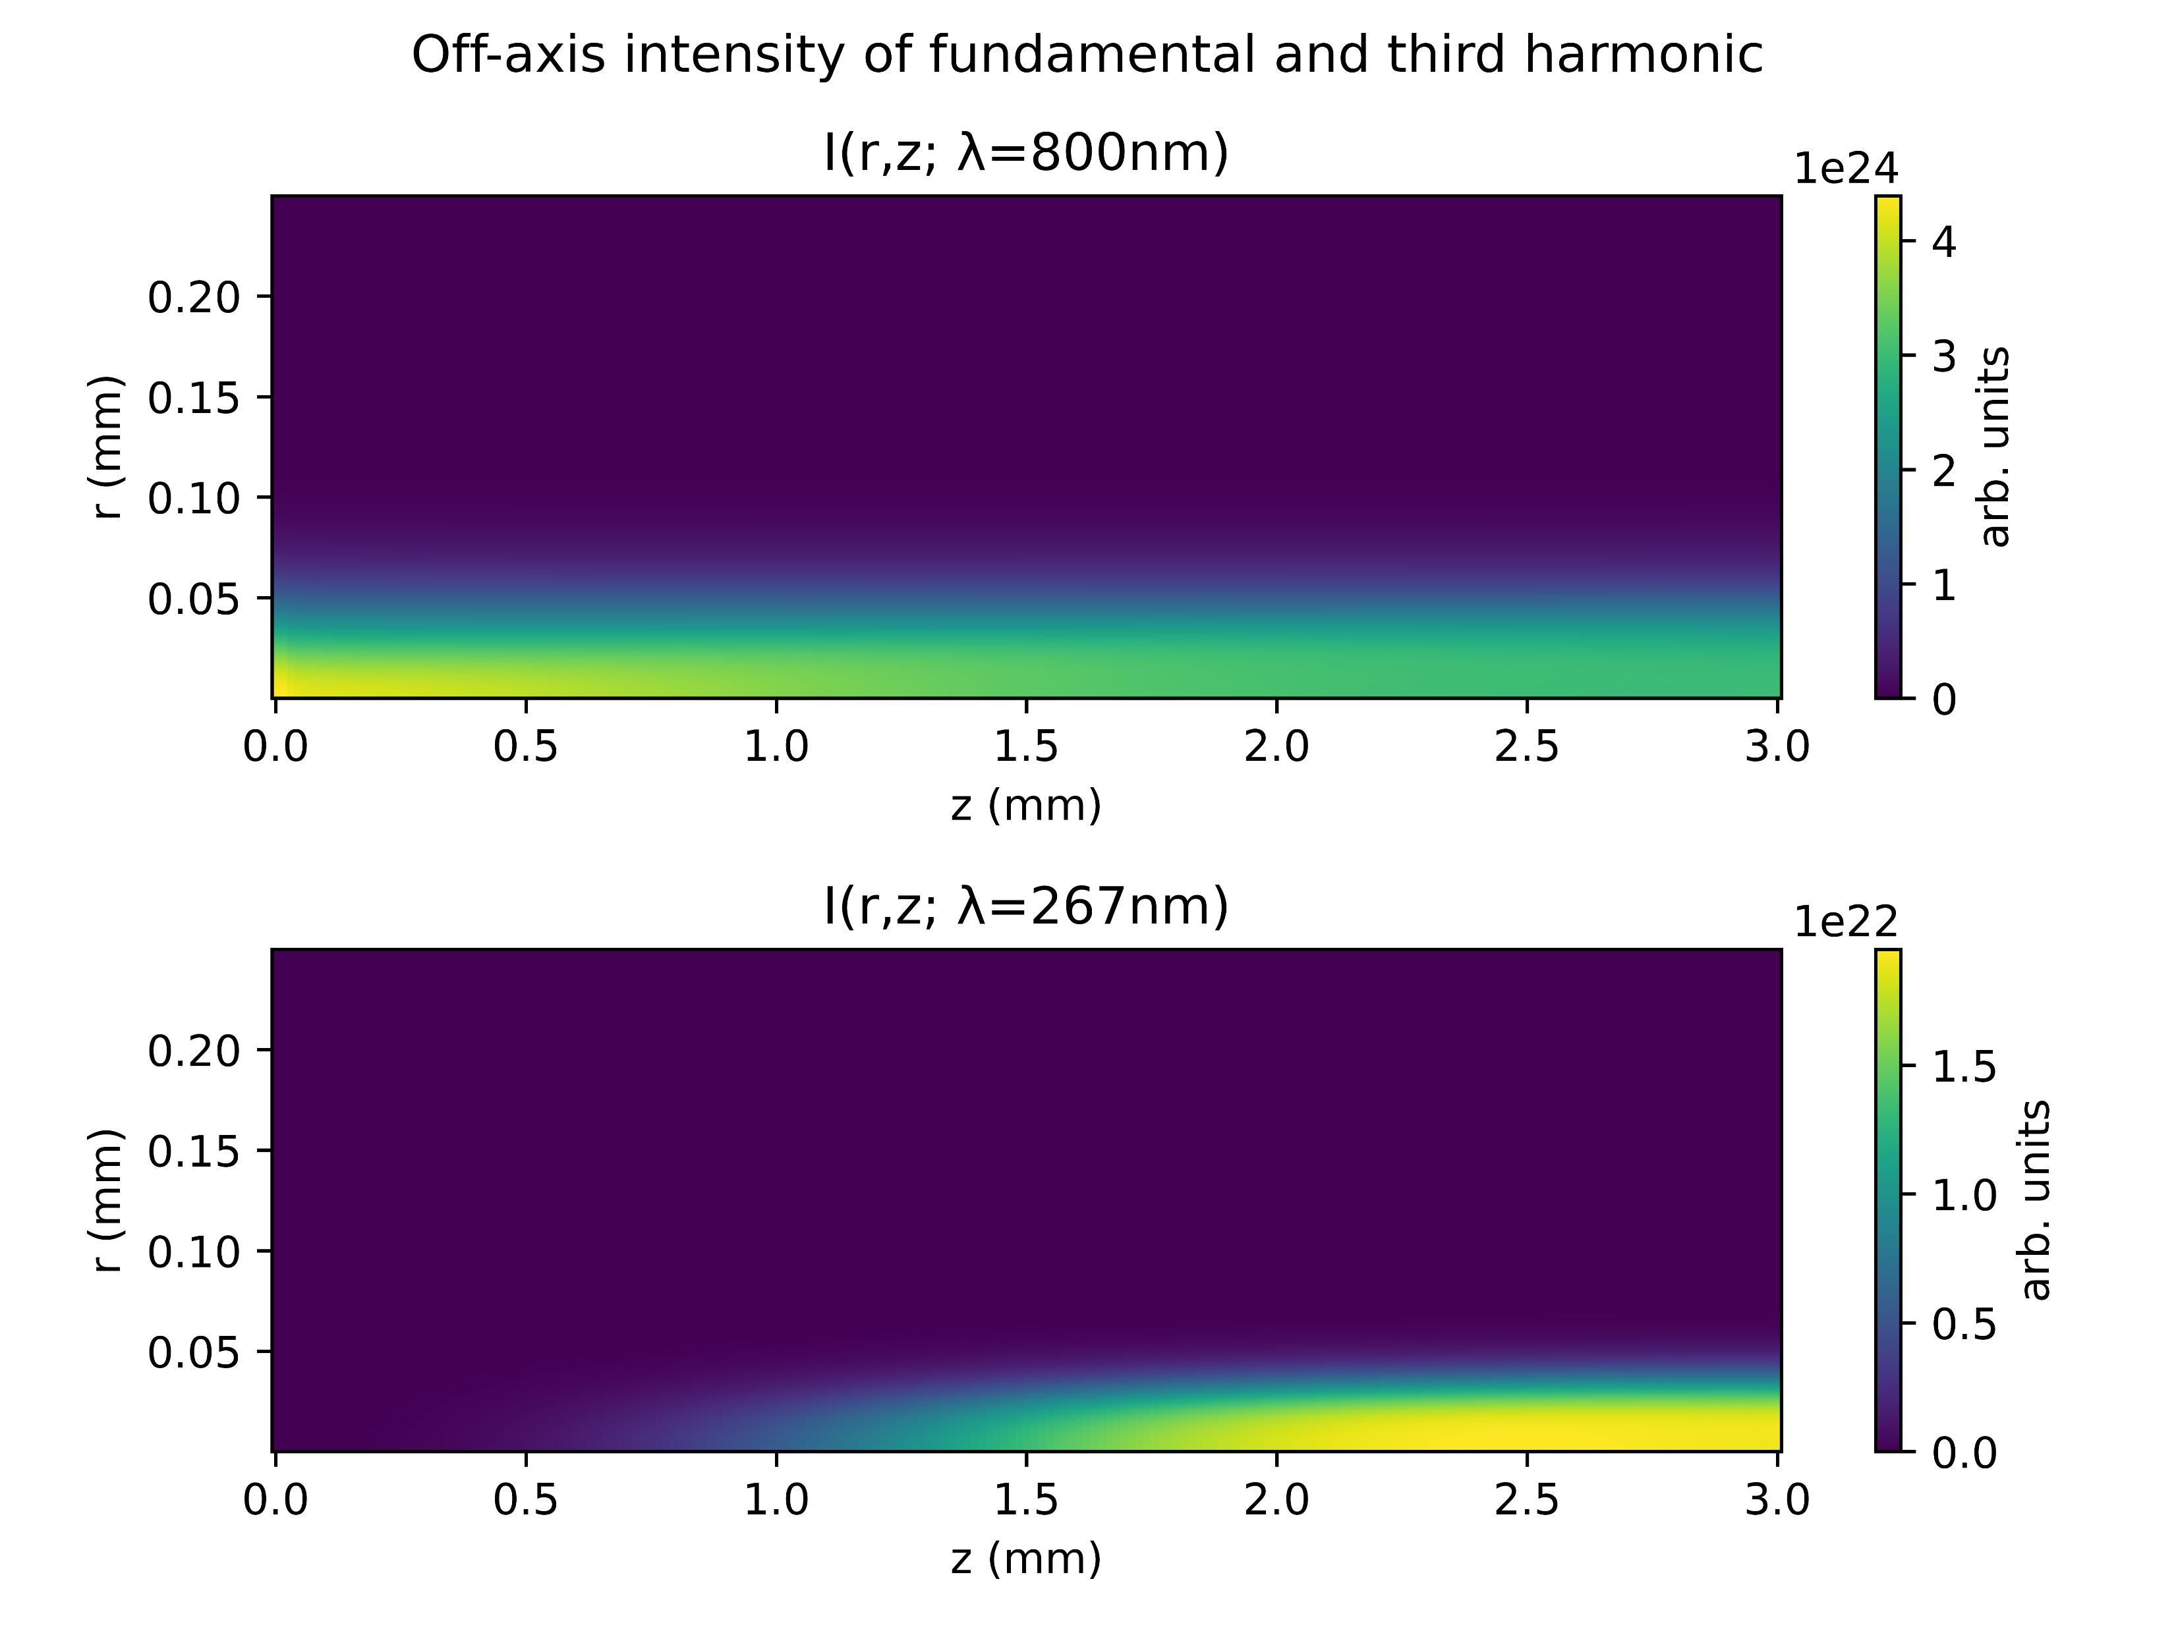
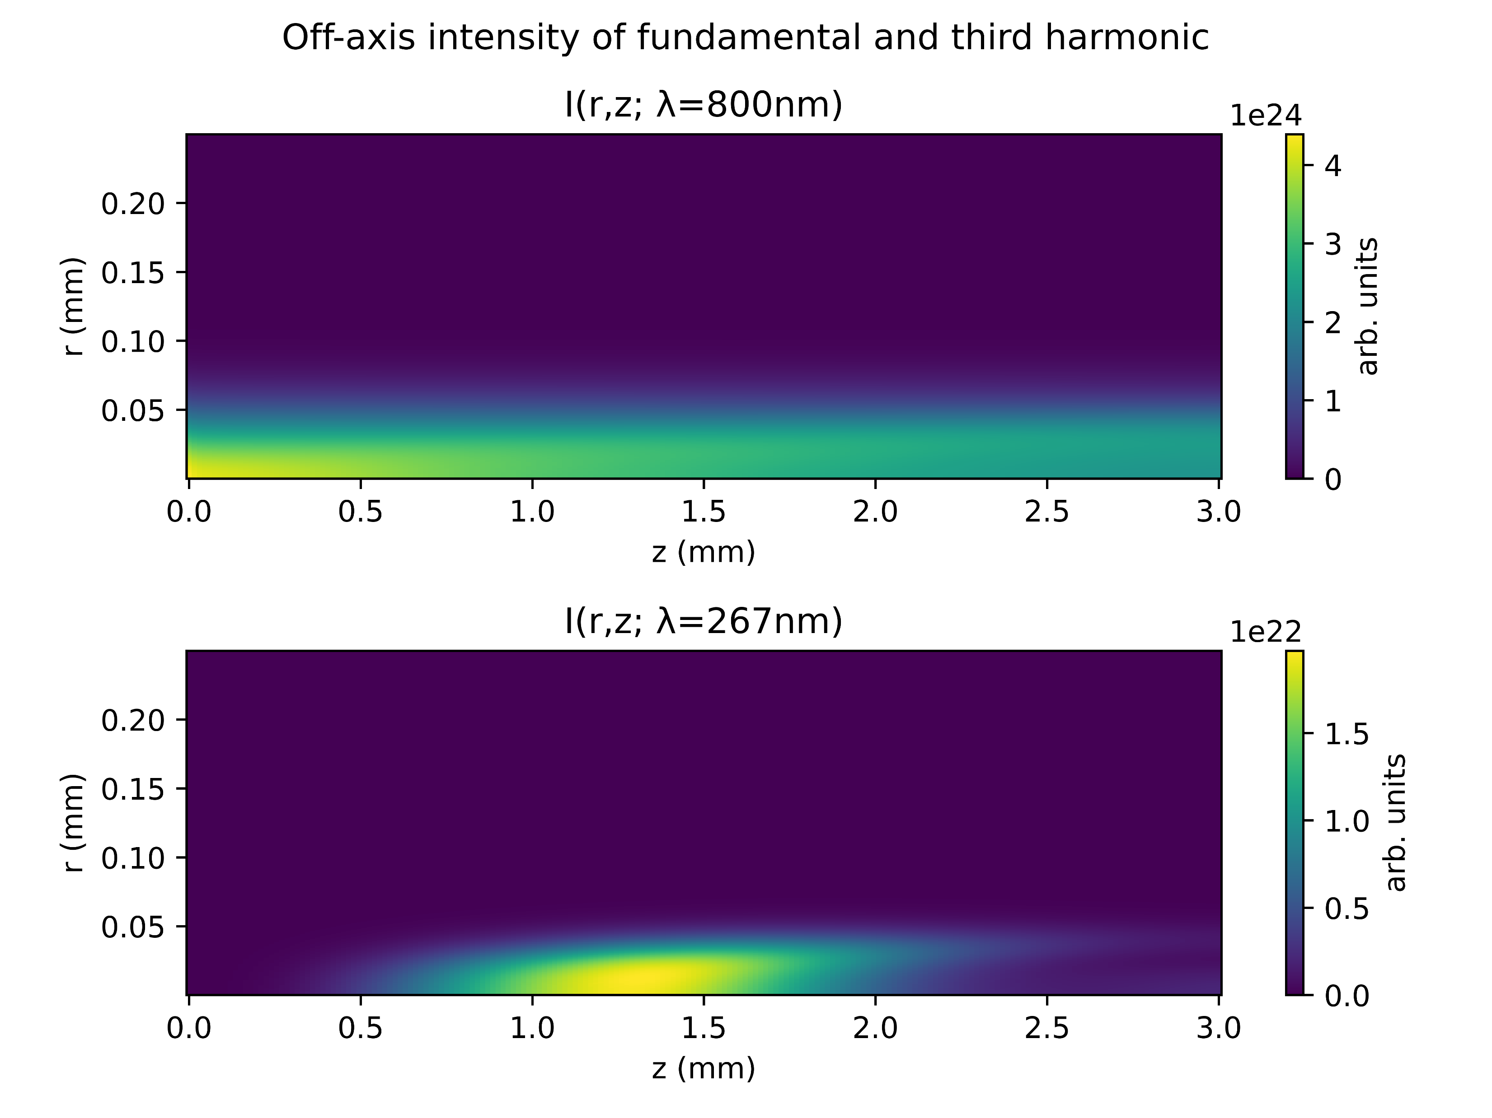
Beam profile at low power (75mW Argon)
At saturation pressure (2.2 bar)
Beyond saturation pressure (4.8 bar)

Slide 28
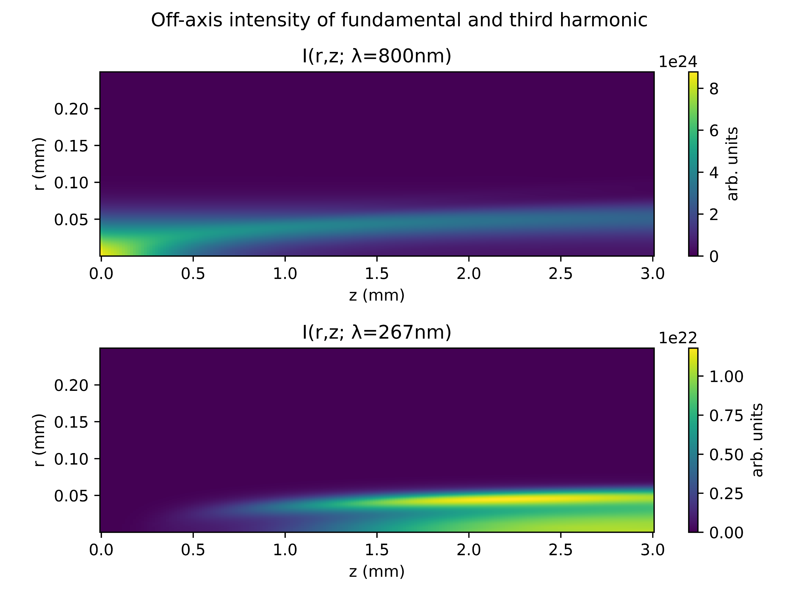
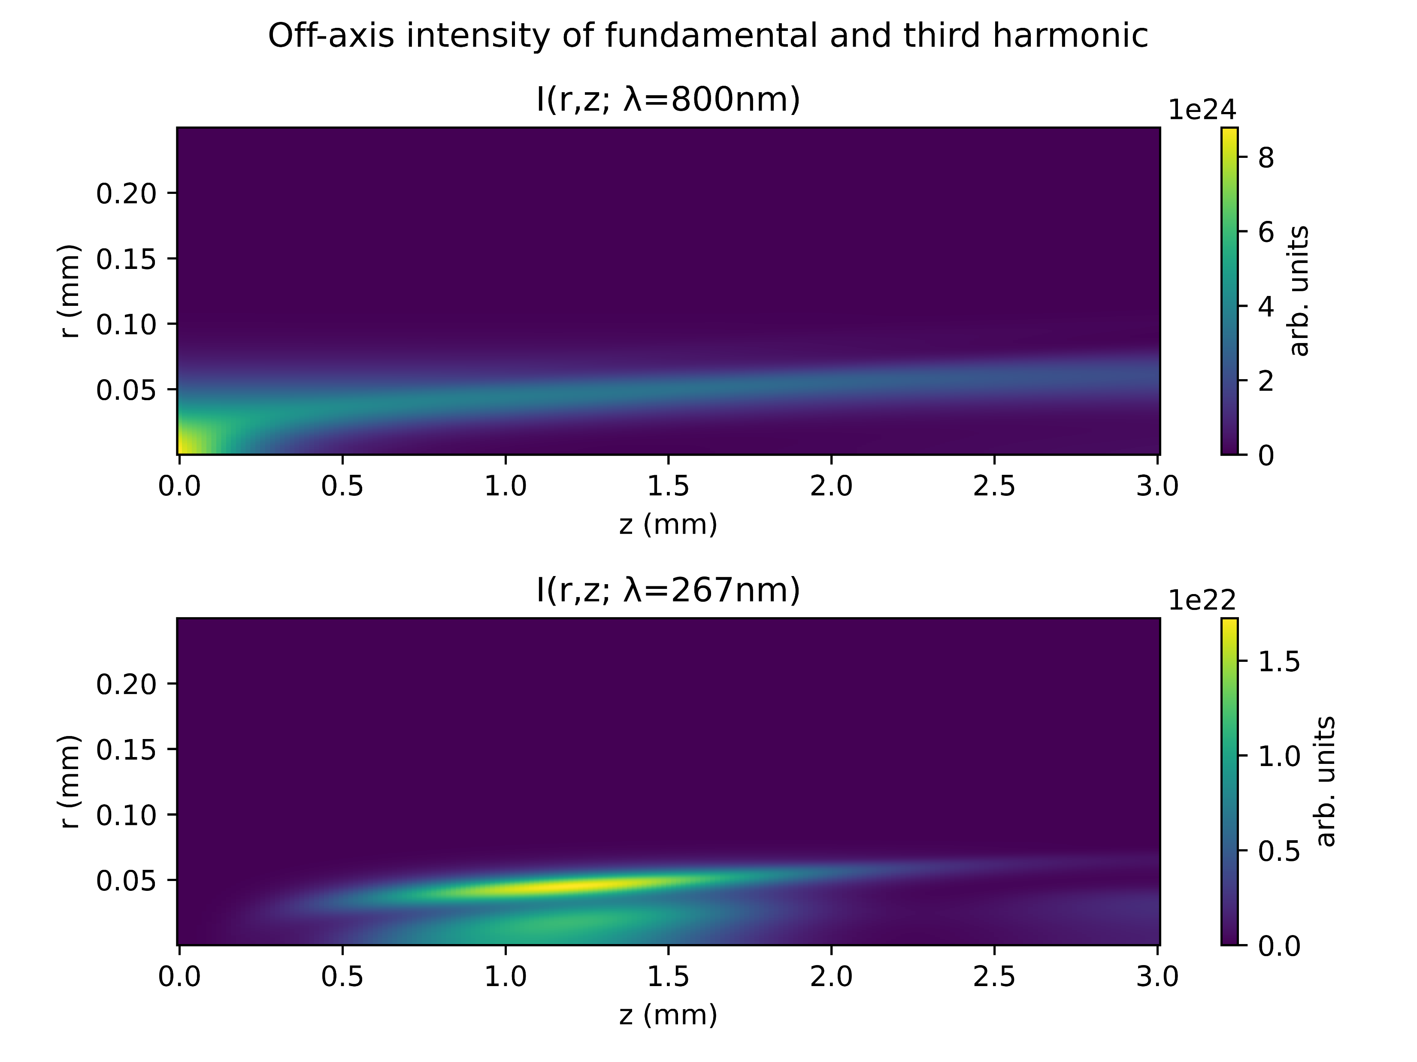
Beam profile at medium power (150 mW Argon)
At saturation pressure (1.7 bar)
Beyond saturation pressure (5.0 bar)

Slide 29
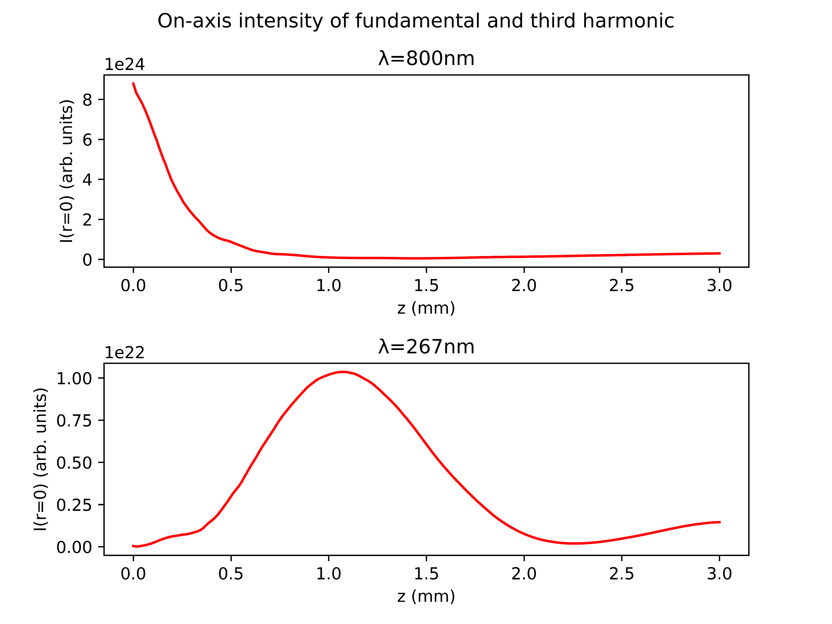
Summary: beam profile
At the saturation pressure, the UV intensity peaks at the cell output
Beyond saturation, the UV intensity reaches a maximum within the cell and then decreases at the output
Related to coherence length/phase matching considerations?
Other nonlinear effects appear to take over, resulting in a “broken down” output spectrum?
150mW Argon
Beyond saturation pressure (5.0 bar)

Slide 30
IV. SELF-STEEPENING

Slide 31
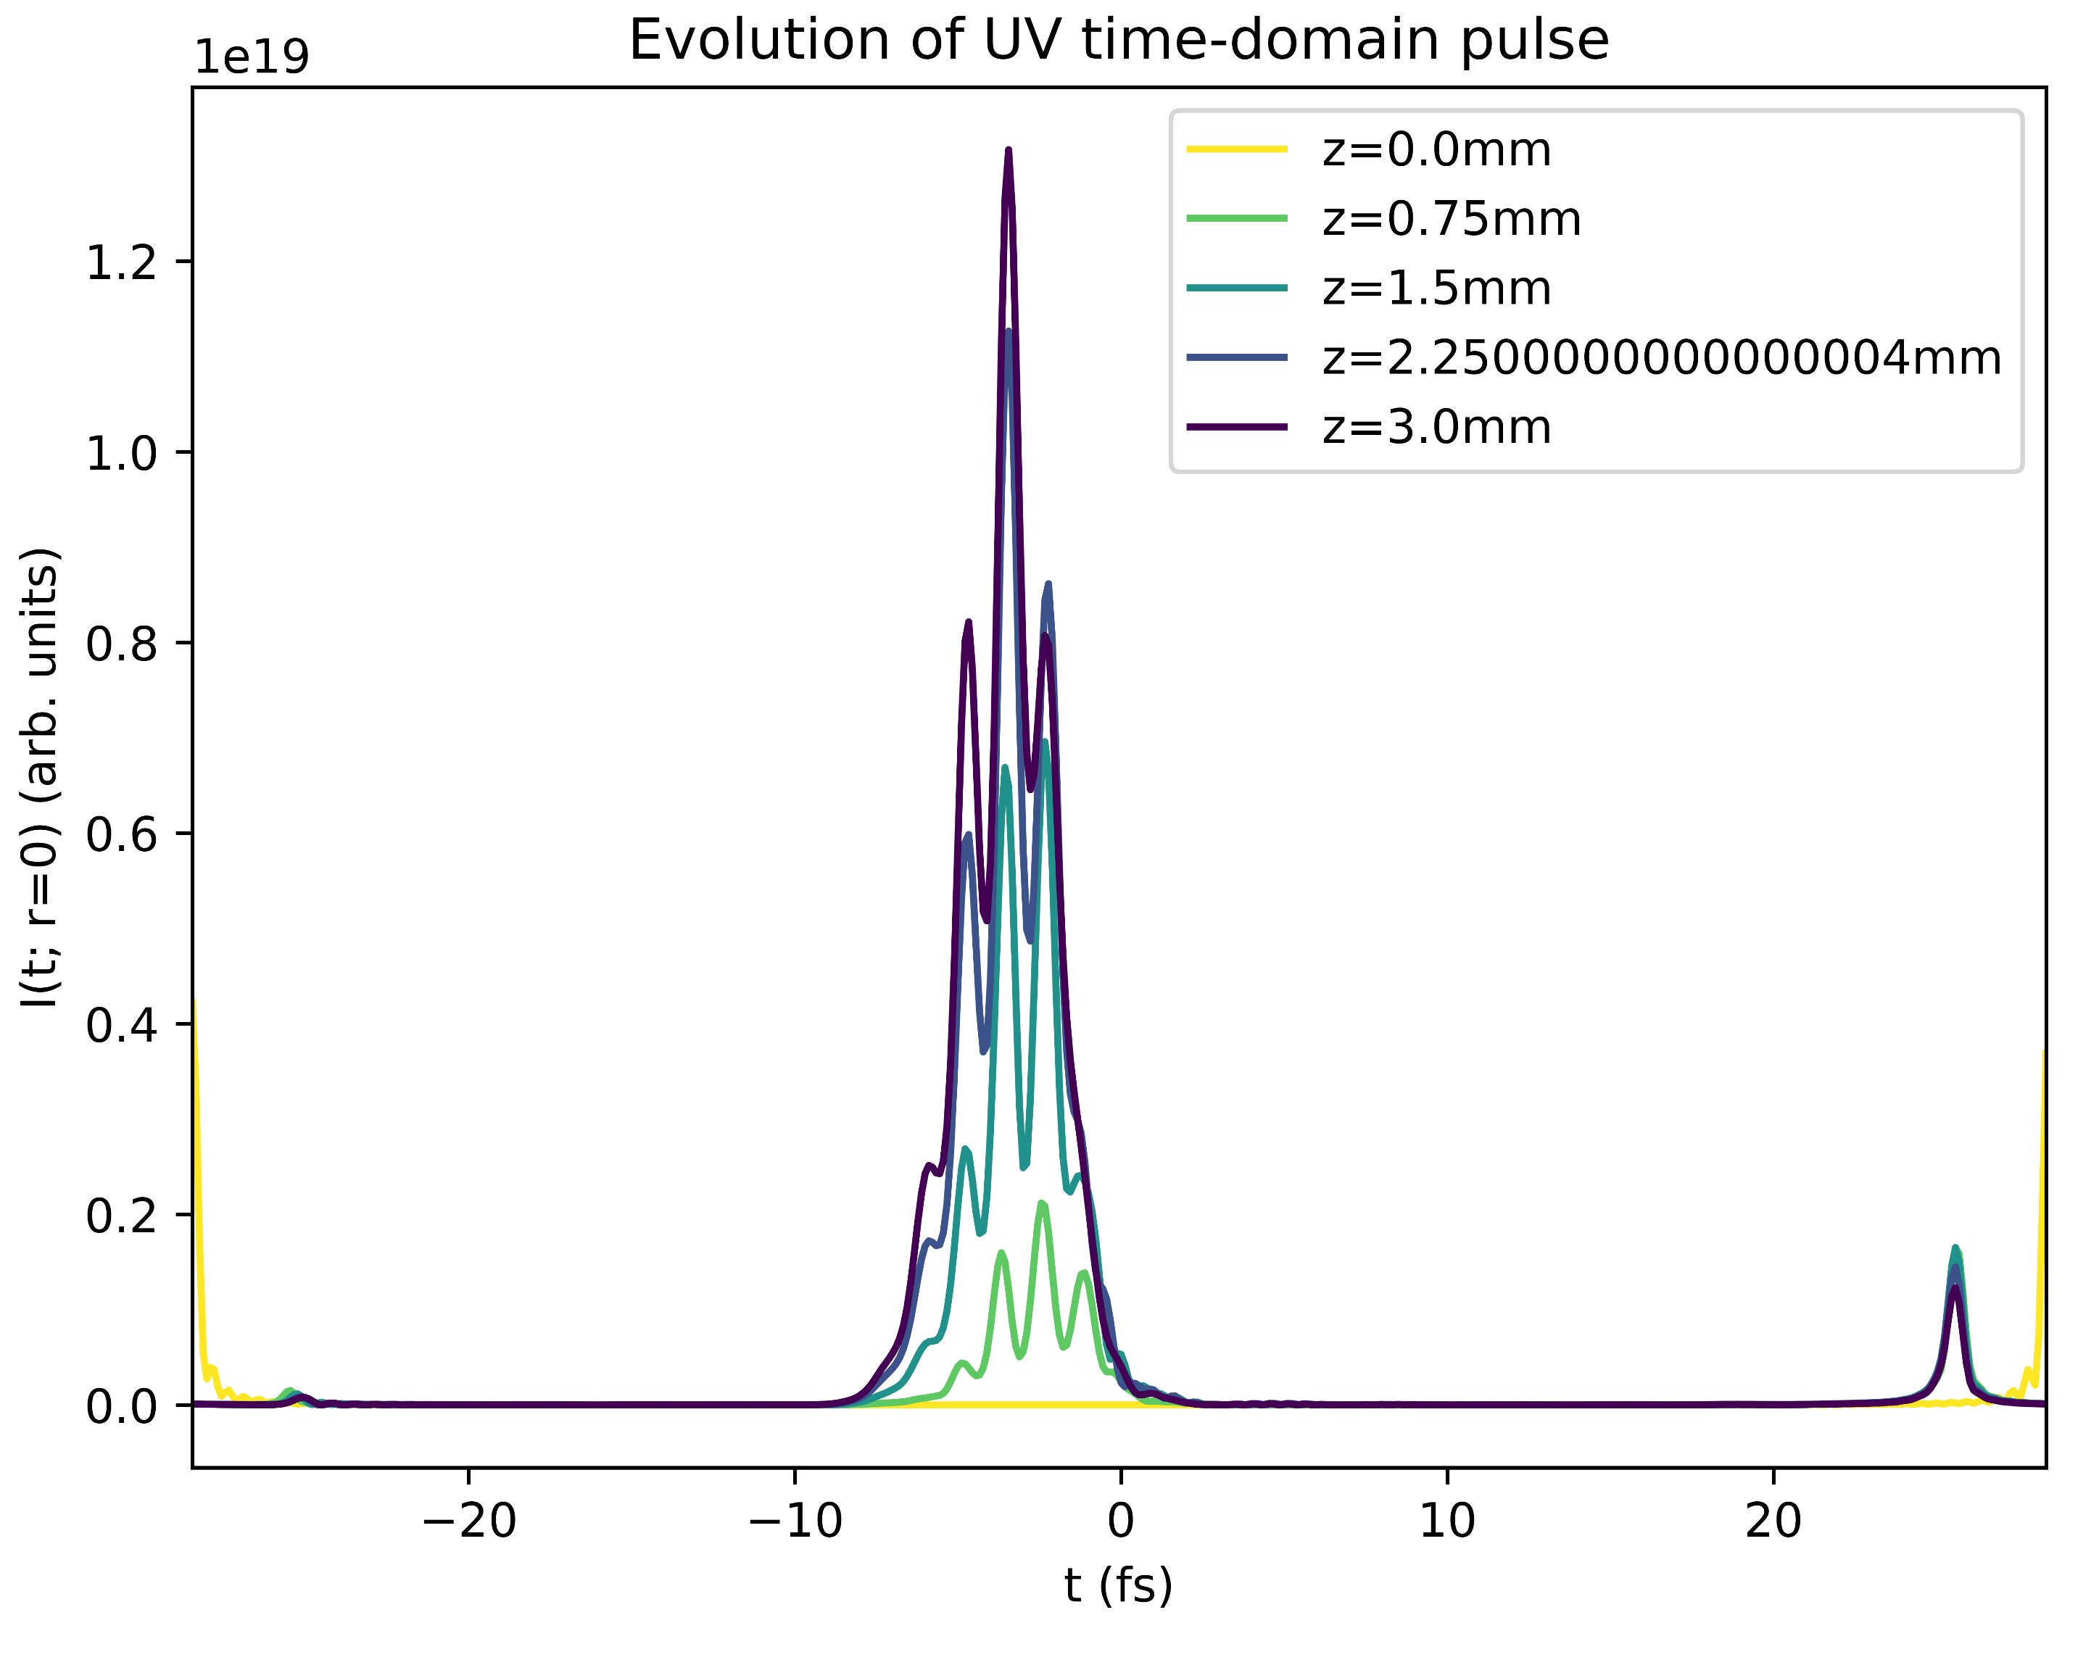
Self-steepening
The simulation shows leading-edge self-steepening in the UV pulse
Also: trailing-edge self-steepening in the IR pulse
The following slides investigate self-steepening at saturation and after “breakdown”

Slide 32
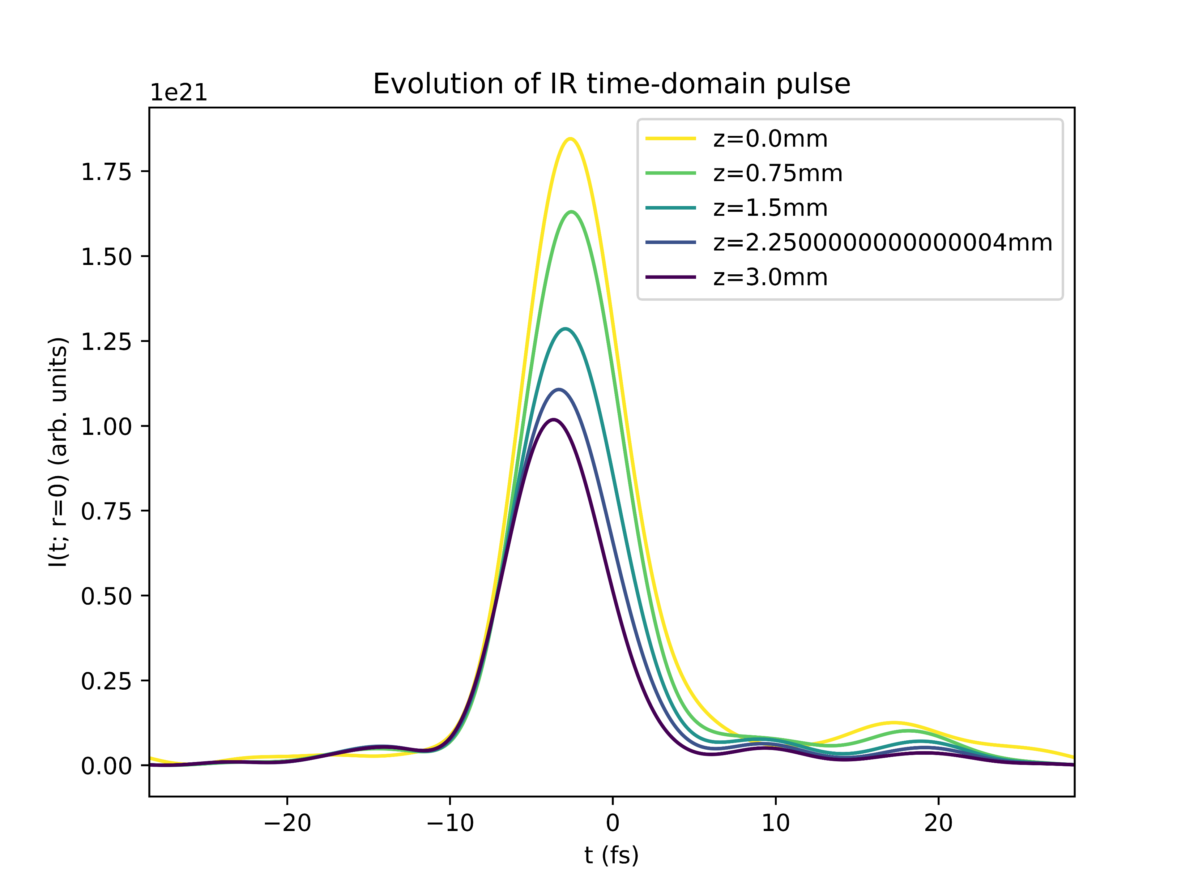
Self-steepening
The simulation shows leading-edge self-steepening in the UV pulse
Also: trailing-edge self-steepening in the IR pulse
The following slides investigate self-steepening at saturation and after “breakdown”

Slide 33
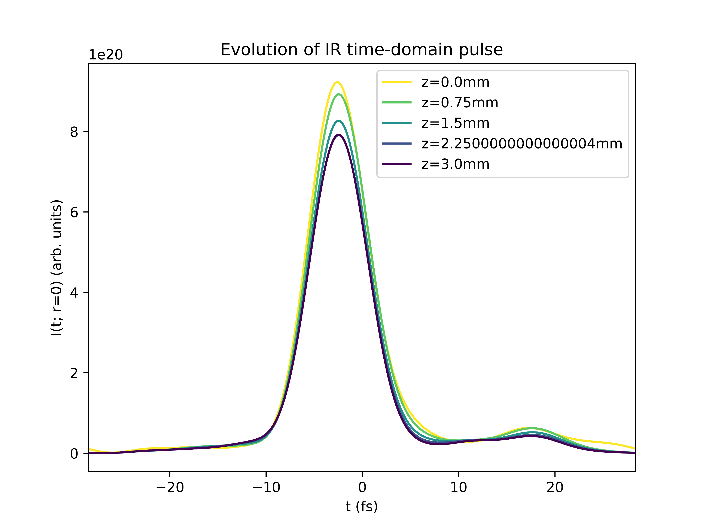
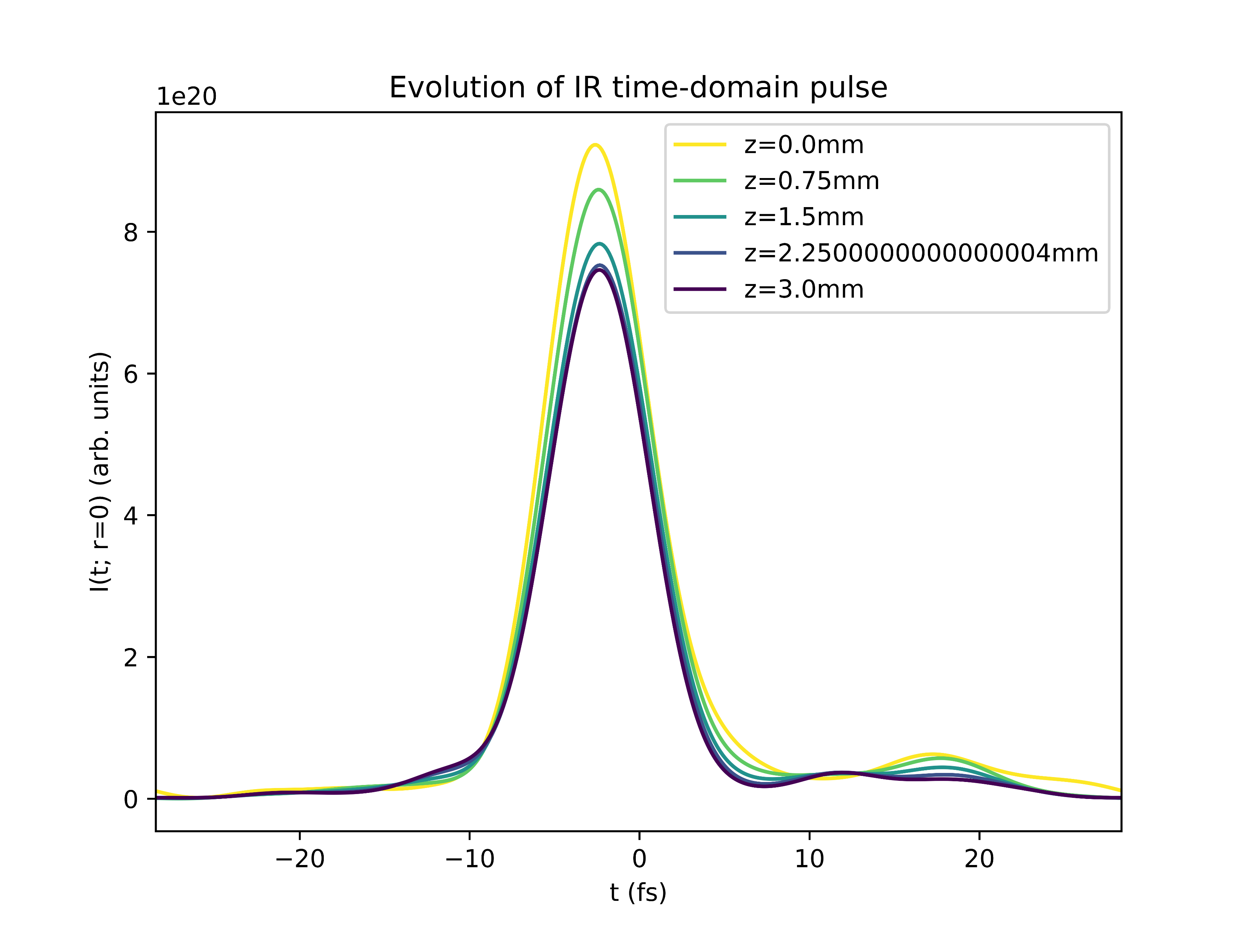
Self-steepening at low power (75mW Argon)
At saturation pressure (2.2 bar)
Beyond saturation pressure (4.8 bar)

Slide 34
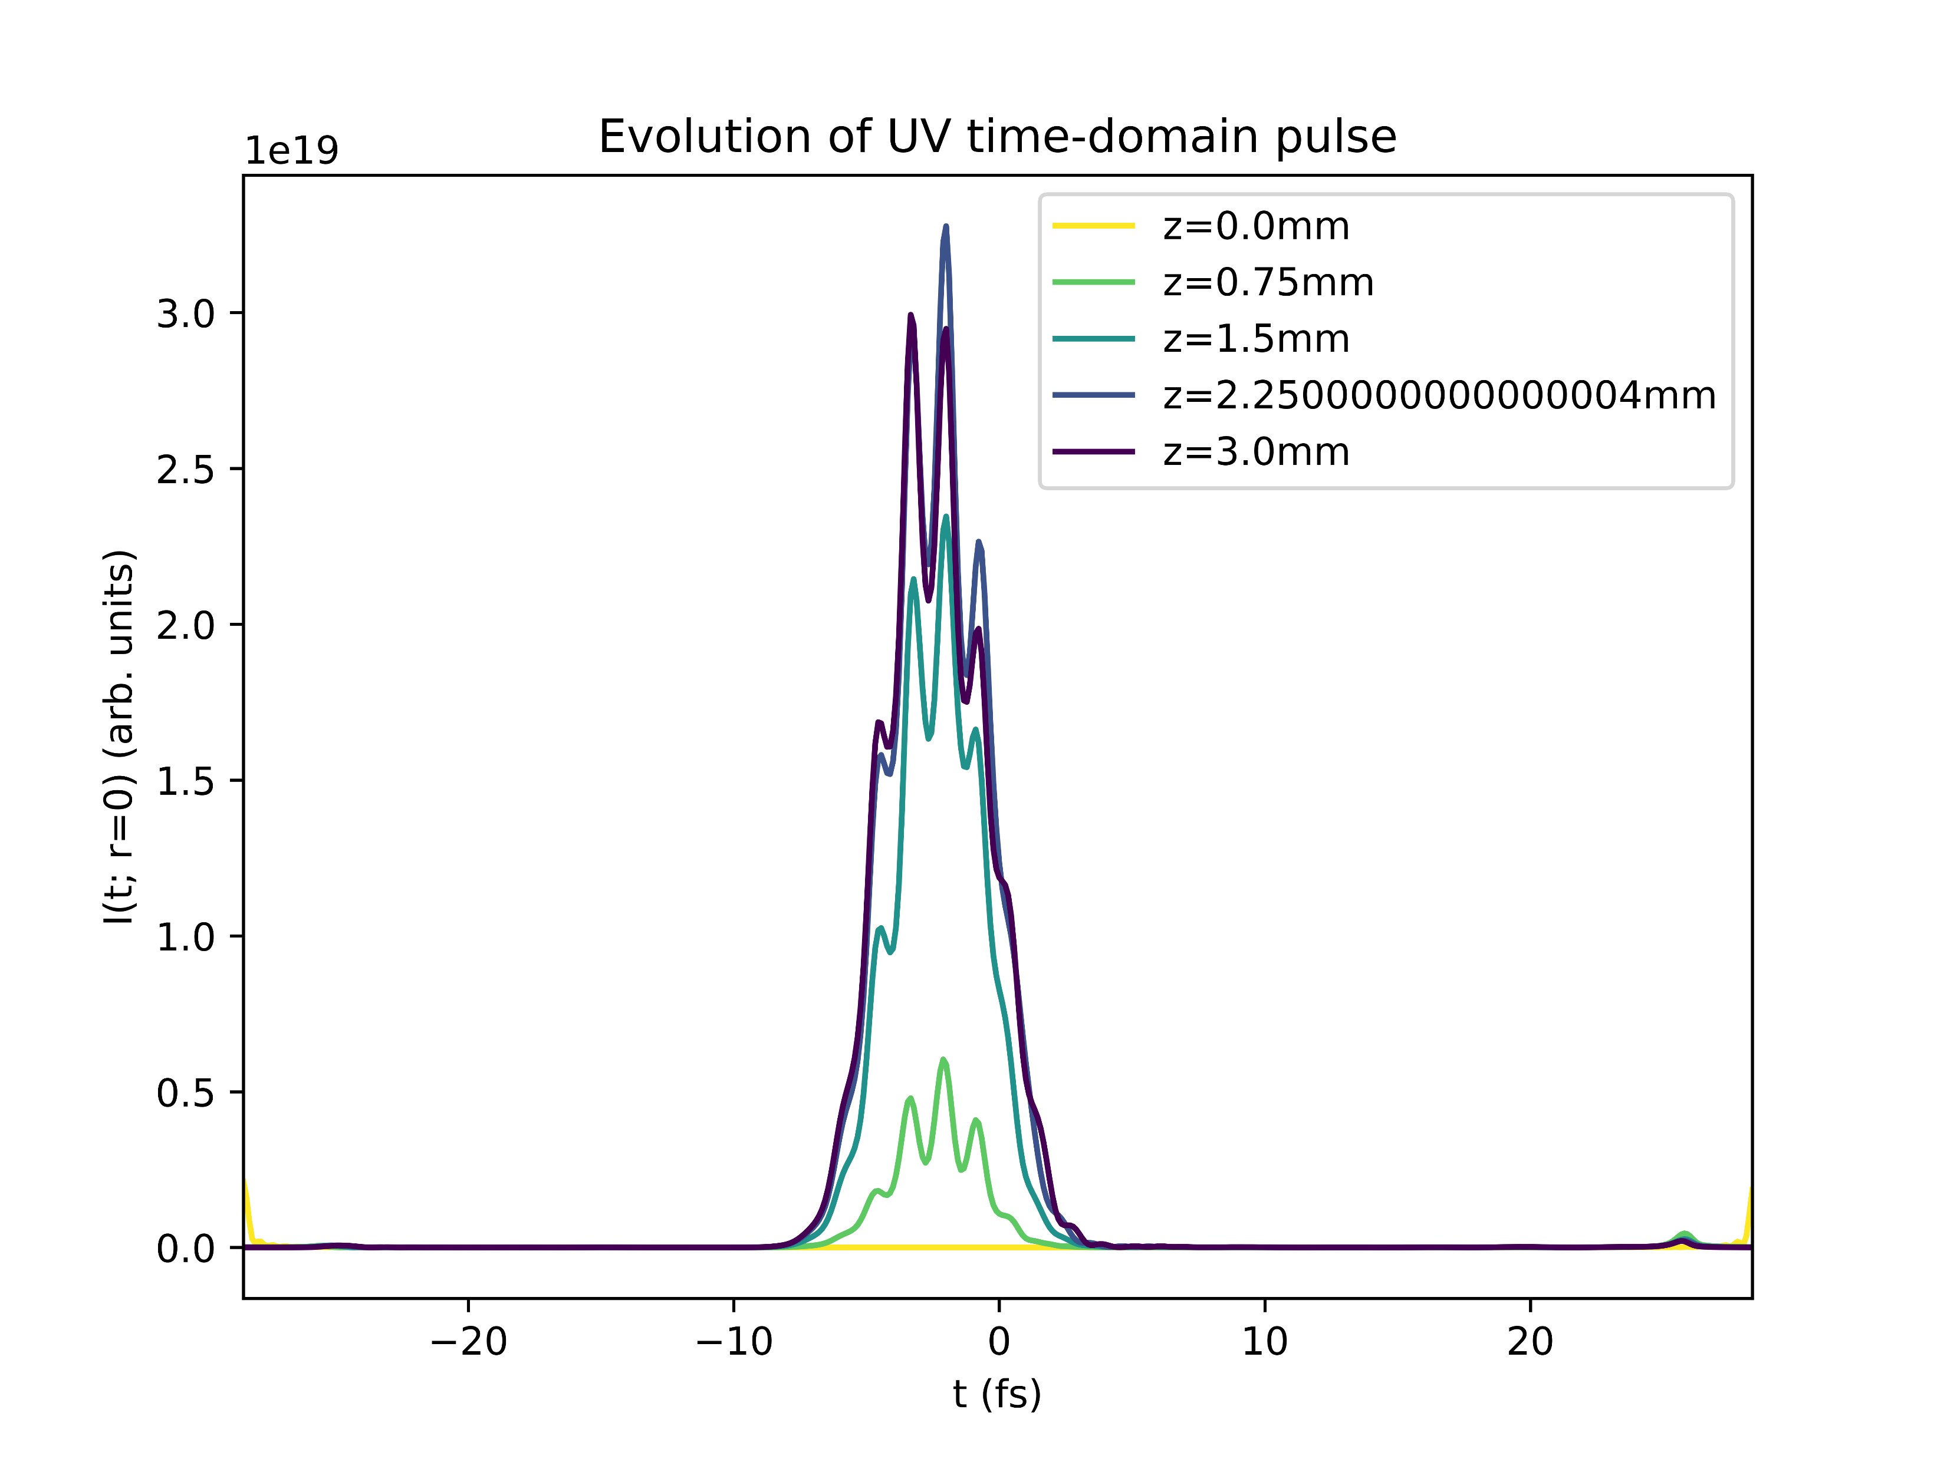
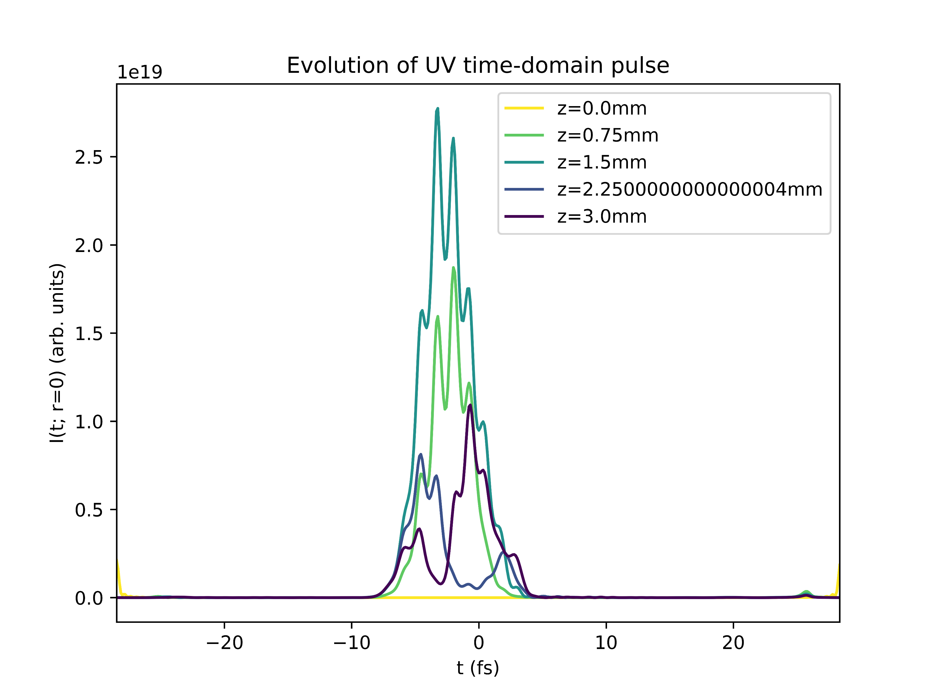
Self-steepening at low power (75mW Argon)
At saturation pressure (2.2 bar)
Beyond saturation pressure (4.8 bar)

Slide 35
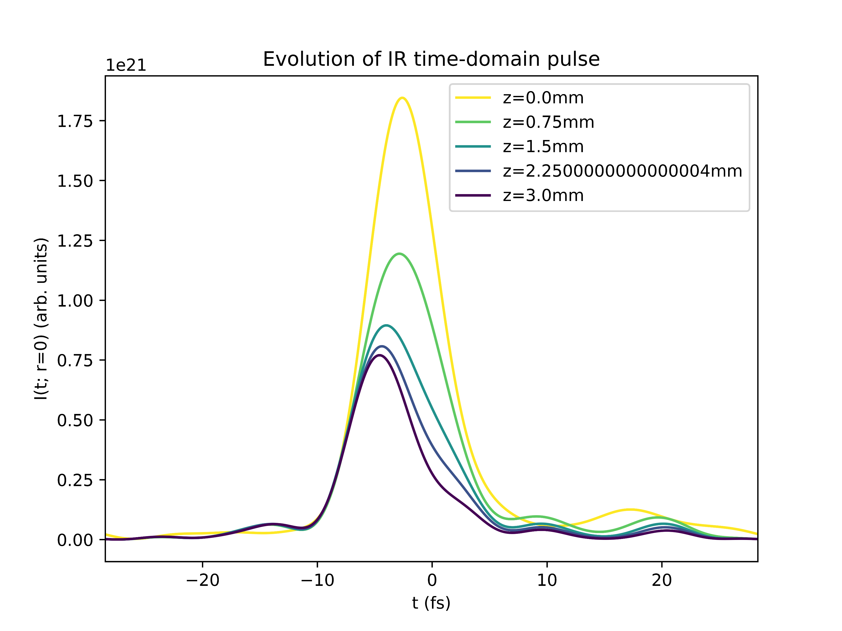
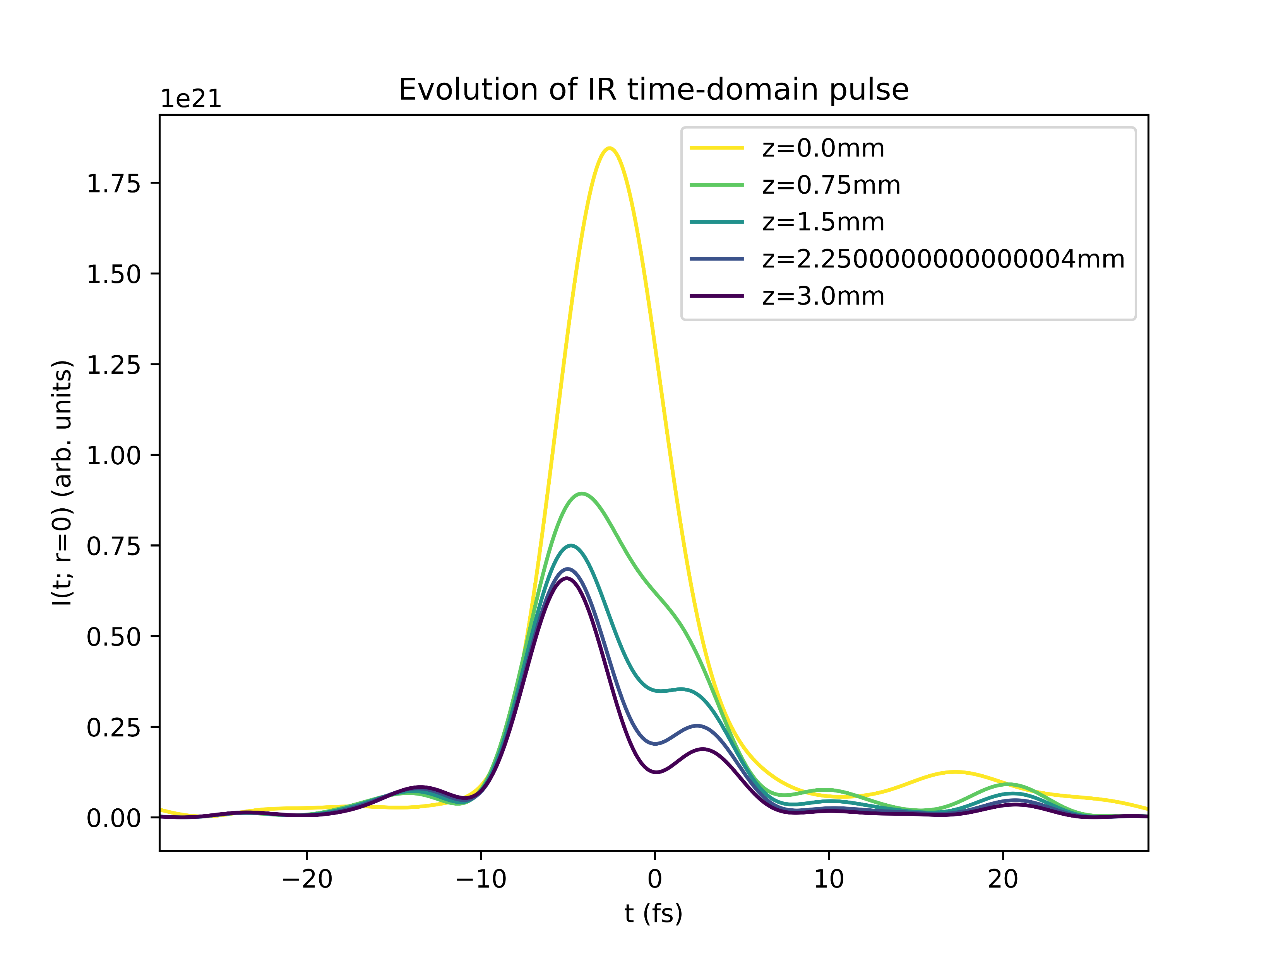
Self-steepening at medium power (150mW Argon)
At saturation pressure (1.7 bar)
Beyond saturation pressure (5.0 bar)

Slide 36
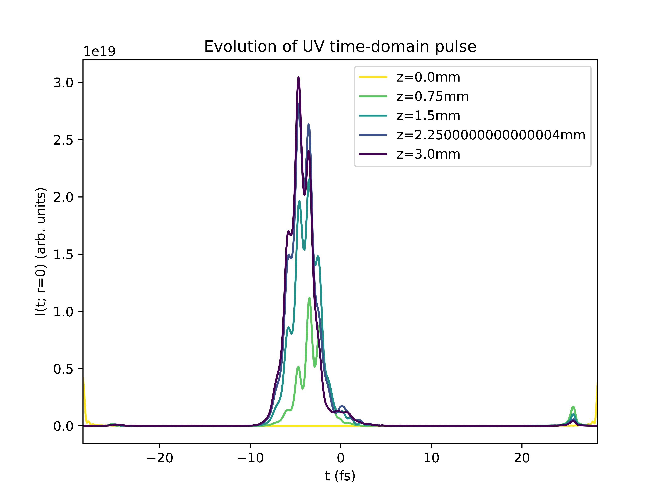
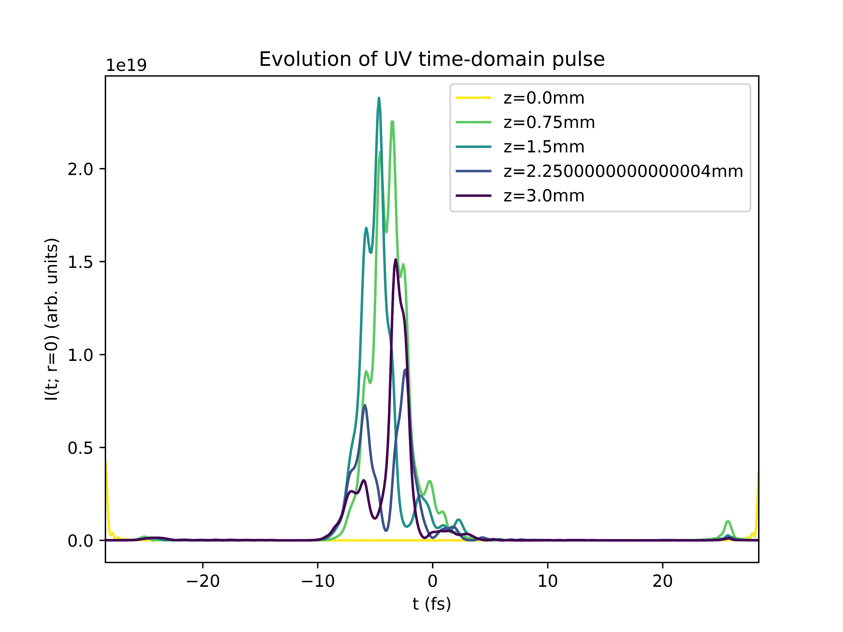
Self-steepening at medium power (150mW Argon)
At saturation pressure (1.7 bar)
Beyond saturation pressure (5.0 bar)

Slide 37
Summary: self-steepening
The trailing-edge self-steepening of the IR pulse persists at pressures beyond the saturation pressure
The UV pulse leading-edge self-steepening seems to subside at “breakdown”
Compare with role of self-steepening in the THG process reported in the literature (e.g., Reiter 2010)

Slide 38
Conclusion & Next Steps

Slide 39
Conclusion & next steps
Start working with COMSOL
export & test existing density simulations
try to improve existing simulations/expand to the high-pressure regime?
Analyse the open questions posed throughout these slides
Compare simulations with literature and experiments
Find explanations for the observed effects
Focus on a few key questions to investigate in more detail

